Slide 1
Family Medicine Research Unit
Monthly Meeting
September 2024

Slide 2
Recently Submitted Proposals (since June)
PI |  | Title | Sponsor | Prime Sponsor | Program Type | Overall Proposal Type | Project Begin Date | Project End Date
Sur, Denise Kc |  | CA-Department of Health Care Access and Information | - | Contract | Training | New | 6/30/2025 | 6/29/2028
Hervey, Shane |  | British Journal of Sports Medicine (United Kingdom) | - | Grant | Applied Org Research | New | 11/1/2024 | 10/31/2025
Gelberg, Lillian |  | General Hospital Corporation, The (DBA Massachusetts General Hospital) (MGH) | PATIENT-CENTERED OUTCOMES RESEARCH INSTITUTE | Subcontract | Basic Org Research | New | 8/1/2025 | 7/31/2030
Li, Michael Jonathan |  | NIH - National Institutes of Health | - | Grant | Clinical Research | Resubmission - New | 4/1/2025 | 3/31/2029
Tarn, Derjung Mimi |  | UNIVERSITY OF CALIFORNIA, IRVINE | UC/OFFICE OF THE PRESIDENT, SYSTEMWIDE | Subgrant | Basic Org Research | New | 1/1/2025 | 12/31/2028
Li, Michael Jonathan |  | UNIVERSITY OF ILLINOIS | DHHS-HRSA Health Resources and Services Administration | Subgrant | Training | Modification/Amendment | 9/1/2024 | 8/31/2025
Shoptaw, Steven J |  | University of Texas-Southwestern Medical Center at Dallas | NIH-NIDA National Institute on Drug Abuse | Subgrant | Clinical Research | Modification/Amendment | 8/1/2024 | 2/28/2025
Shoptaw, Steven J |  | FHI 360 (Family Health International) | NIH-NIAID National Institute of Allergy and Infectious Diseases | Subgrant | Dev Org Research | Modification/Amendment | 12/1/2024 | 11/30/2025

Slide 3
Recently Processed Awards (since June)
PI | Award Title | Sponsor | Prime Sponsor | Program Type | Action Type | Project Period Start Date | Project Period End Date
Gelberg, Lillian | Subthreshold Opioid Use Disorder Prevention (STOP) Trial | NEW YORK UNIVERSITY | NIH-NIDA National Institute on Drug Abuse | Clinical Research | Continuation | 02/15/2019 | 02/28/2025
Tarn, Derjung Mimi | Medicare Annual Wellness Visit Practice Redesign Toolkit: A Tailored Intervention to Improve Preventive Health Service Use | NIH-NIA National Institute on Aging | - | CT Government/Non-Profit | Continuation | 08/15/2020 | 07/31/2025
Sur, Denise Kc | SBPCR-1000756: UCLA Family Medicine Residency Program (Song-Brown 2021) | CA-Department of Health Care Access and Information | - | Training | Continuation | 06/30/2022 | 06/29/2025
Shoptaw, Steven J | Center for HIV Identification, Prevention and Treatment Services | NIH-NIMH | - | Basic Org Research | Supplement | 03/01/2022 | 12/31/2026
Tarn, Derjung Mimi | Nasal Steroids, Nasal Irrigation, Oral antibiotics and Subgroup Targeting for Effective Management of Sinusitis (NOSES) | GEORGETOWN UNIVERSITY | PATIENT-CENTERED OUTCOMES RESEARCH INSTITUTE | Clinical Research | No Cost Extension | 04/01/2023 | 12/15/2024
Shoptaw, Steven J | Clinical Trials Network Big South/West Node – Yr18 Remove Restrictions Request: CTN-0109 CURB-2 | Univ of Texas-Southwestern Med Center at Dallas | NIH-NIDA National Institute on Drug Abuse | Clinical Research | Continuation | 04/01/2022 | 02/28/2025
Sur, Denise Kc | HCAI Song-Brown Grant Primary Care Residency (2023-2026) | CA-Department of Health Care Access and Information | - | Training | Continuation | 06/30/2023 | 08/31/2026
Shoptaw, Steven J | Contingency Management Pilot Program | Shine BC-LA | CONRAD HILTON FOUNDATION | Basic Org Research | Continuation | 03/23/2023 | 12/31/2025

Slide 4
Upcoming Holidays
Veterans Day holiday | Monday, November 11
Thanksgiving holiday | Thursday-Friday, November 28-29
Christmas holiday | Tuesday-Wednesday, December 24-25
New Year’s Eve/Day holiday | Tuesday-Wednesday, December 31-January 1, 2025
Winter Campus Closure | TBD

Slide 5
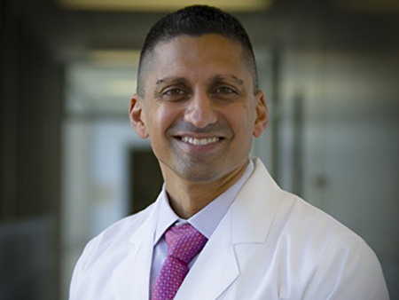
Grand Rounds
September Grand Rounds
Friday, September 27, 2024
12:00pm-1:00pm
Irfan M. Asif, MD
Exercise as Medicine: A Prescription for Health in Primary Care

Slide 6
Research Admin Team Updates
Laura Sheehan
Manager of Research Admin
TBD
Post-Award Fund Manager
TBD
Post Award
Fund Manager
Valencia Moody
Purchaser
TBD
Pre-Award
Res Admin 2

Slide 7
Valencia and the Pediatric Purchasing Team
Valencia will be transitioning to work with the purchasers in the Department of Pediatrics
They will help provide back-up when Valencia is out of the office
Will both serve as a resource for Valencia, and will be able to utilize Valencia’s expertise to assist them
All procurement/purchasing requests should continue to be submitted to your fund manager (or Laura for the time being) first

Slide 8
Laura’s Schedule
Laura will be on vacation Fri, Oct 4 – Wed, Oct 9, 2024 and at an out-of-state conference Mon, Oct 28 – Tue, Oct 29, 2024.
All proposals due to OCGA prior to Oct 15 should be coordinated with Laura for submission before Oct 4.
Who to coordinate with in her absence will depend on staffing status; will provide further guidance in upcoming weeks

Slide 9
Outgoing Proposals
The Proposal Intake Form is required; submit to the Pre-Award Research Administrator as soon as possible
The Pre-Award Admin will submit to the appropriate central office by COB on the 6th business day prior to deadline

Slide 10
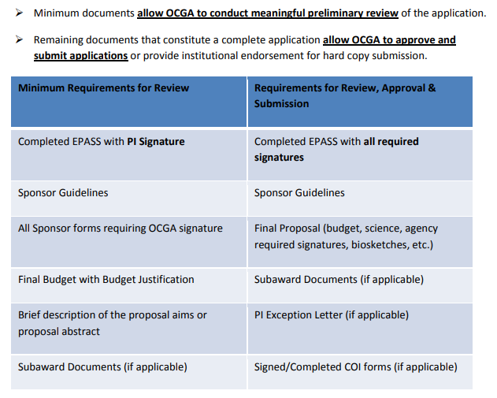
Aim to submit a complete proposal, not just minimum documents required

Slide 11
Available starting September 4, 2024
Centrally managed, secure, scalable data storage solution that is mountable as a local network share and accessible with your Mednet username and password on-site or remotely via VPN.
All senate series research faculty members are eligible to request and access RDSS storage. Eligible DGSOM faculty will receive at least 5TB of storage at no cost with the option to purchase additional storage as needed.
RDSS is best for research data containing large files that is actively used and needs to be readily available to all lab members. This complements our Box offering which is best for smaller files that need to be shared externally and/or requires real-time collaborative editing. While RDSS is compliant with UC data security policies for restricted and protected data, identified UCLA Health patient data will remain in ULEAD, the UCLA Health IT secure enclave environment.
For additional storage options, please review the available storage solutions

Slide 12
BruinIRB
1. BruinIRB will be Live for NEW Study Submissions on September 9, 2024
Starting Monday, September 9, 2024, all new study submissions must be submitted in BruinIRB.
If a new study application is created in webIRB on or before September 6, it can be finalized and submitted in webIRB. This application must be submitted to our office before the end of December 2024.
BruinIRB Migration for Existing Studies starting September 7, 2024
All active study submissions in webIRB, without an open Amendment, PAR, Continuing Review or Closure submission, will be migrated to BruinIRB starting September 7, 2024. See the Migration Quick Guide for additional information.
You will receive an email notification when your study is transferred to BruinIRB. The migration will also be documented in the webIRB study history.
BruinIRB Accounts and Contact Information
Users with active webIRB accounts will have an active BruinIRB
Please try to log-in to BruinIRB using your UCLA Logon ID and password. If you need a BruinIRB account, please follow these instructions.
Please check your profile and preferred email address to ensure notifications are sent to the correct email address. Please see quick guide for Updating Your Contact Information and Profile in BruinIRB for details.

Slide 13
Ethical Use of AI in Research
AI is rapidly evolving and extremely seductive
Policies to assist researchers in utilizing AI in an ethical and regulated manner have not been fully established
Researchers need to regulate themselves
PI’s must take responsibility for training and overseeing personnel in the use of AI
Any AI-generated material should be thoroughly vetted for accuracy
Teams should check for updated AI policies to ensure they are up to date and in compliance

Slide 14
Ethical Use of AI in Research
CONSIDERATIONS:
Data privacy and security
Bias and fairness
Transparency and explainability
Responsibility and Accountability
Human Oversight
Continuous monitoring
For more info:
https://osp.od.nih.gov/policies/artificial-intelligence/

Slide 16
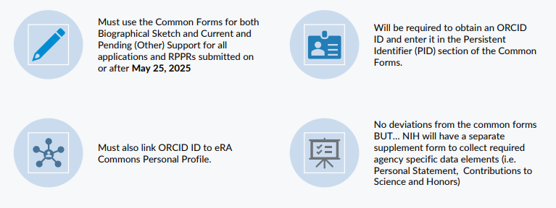
NIH will adopt Common Forms in May 2025

Slide 17
NIH will adopt Common Forms in May 2025

Slide 18
Science Experts Network Curriculum Vitae (SciENcv) is a new electronic system that helps researchers assemble the professional information needed for participation in federally funded research.
Gathers and compiles information on expertise, employment, education and professional accomplishments.
Researchers can use it to create and maintain biosketches that are submitted with grant applications and annual reports.
Allows researchers to describe and highlight their scientific contributions in their own words.

Slide 19
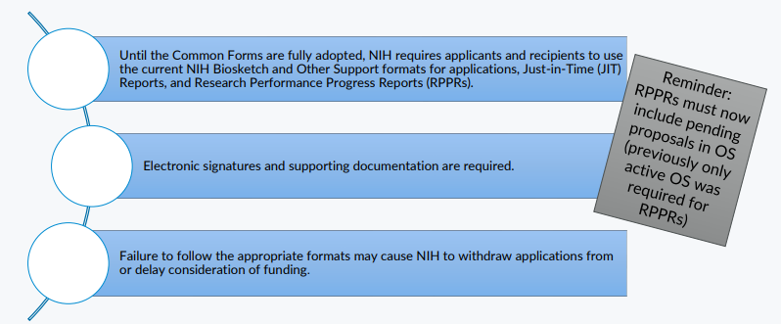
In the meantime…

Slide 20
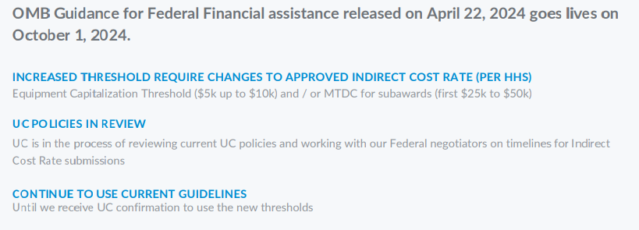
New Uniform Guidance

Slide 21
NIH – Oversight of Foreign Subawards
Effective January 2, 2024, foreign subawards must provide access to copies of all lab notebooks, all data, and all documentation that supports the research outcomes as described in the progress report, to the primary recipient with a frequency of no less than once per year, in alignment with the timing requirements for Research Performance Progress Report submission. Such access may be entirely electronic.

Slide 22
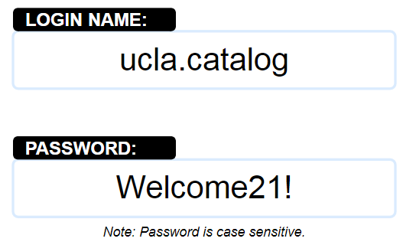
Office Depot – View Only Catalog
Dedicated Corporate Solutions (DCS) has partnered with ODP Business Solutions (formerly Office Depot).
You can browse the view-only version of the DCS catalog at:
https://www.dedicatedcorporatesolutions.com/dcs

Slide 23
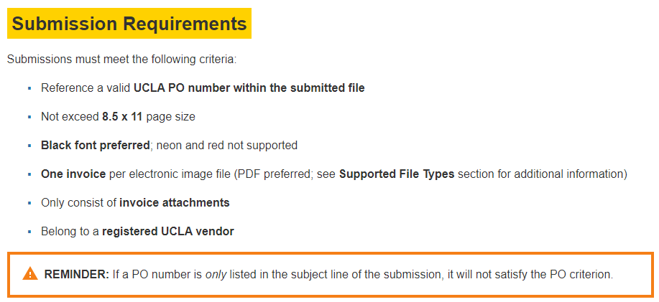
Vendor Invoices

Slide 24
Vendor Invoice Rejections
Now
Then
Now invoices that do not have a PO # or list an invalid/closed PO will be rejected upon submission. Vendors will receive an automated rejection message with resolution instructions and the rejected invoice will be deleted from the system.
Prior to Aug 2024, invoices that listed closed or invalid PO #’s (or no PO #’s) would be put on hold.

Slide 25
Vendor Invoice Rejections
Why might an invoice be rejected upon initial submission?
Missing PO number
Invalid PO number (closed or not in system)
Multiple invoices in a single file attachment
Incomplete vendor registration

Slide 26
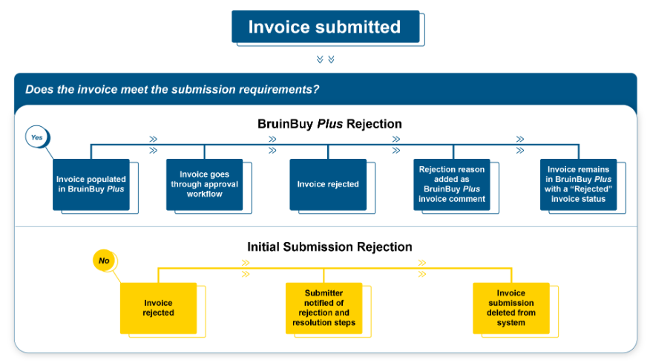
Vendor Invoice Rejections

Slide 27
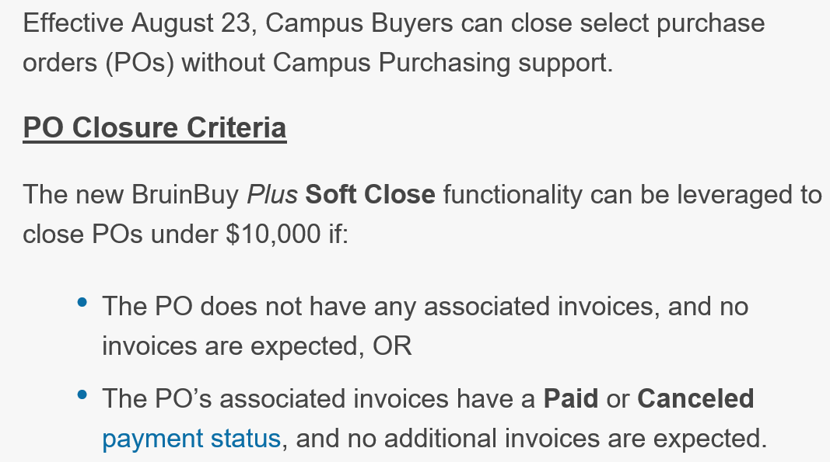
Closing PO’s
PO’s over $10k and subaward Po’s are excluded. We still need to create a ticket to close those.

Slide 28
Travel Reminders
Airfare should be purchased through UCLA via PTA. Travelers who do not purchase in this manner are responsible for ensuring that the purchased flight is compliant with all university and sponsor guidelines/policies.
Car rentals are not encouraged unless it is more cost-effective than utilizing local transportation (e.g. taxi’s, Lyft/Uber, public transit, etc.). Traveler is responsible for obtaining best available rate; therefore it is encouraged that car rentals be reserved via UCLA Travel.
Reimbursement for meals for domestic travel should be based on actual costs and cannot exceed the daily maximums. There is no per diem for domestic meals. Save and submit receipts.
Guests should be trained on all travel reimbursement policies and requirements PRIOR to incurring any travel related costs.

Slide 29
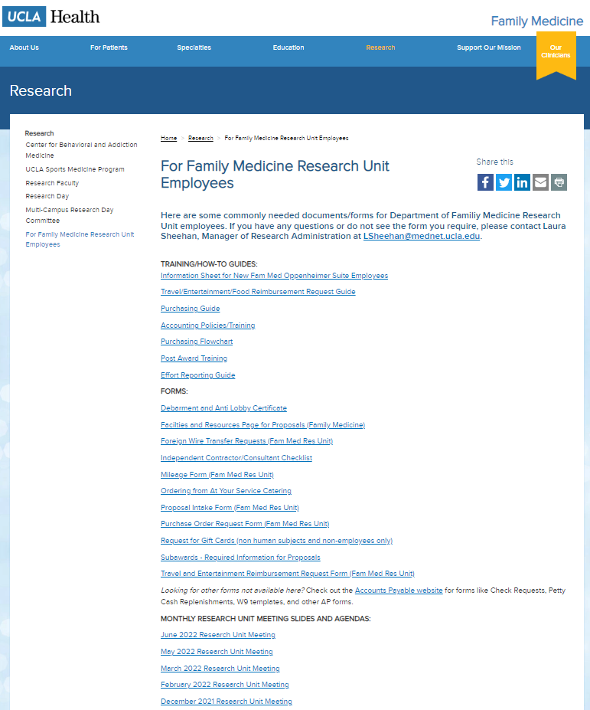
Upcoming Meetings/Events
Next Research Unit Meeting: Oct 3
Next Grand Rounds: Sep 27
Prior monthly meeting agendas/slides are available on the website

