Slide 1
Family Medicine Research Unit
Monthly Meeting
December 2023

Slide 2
Recently Submitted Proposals (since October)
PI | Title | Sponsor | Prime Sponsor | Type
Li, Michael Jonathan | Mobile, AI-integrated contingency management for methamphetamine-using sexual minority men with HIV | NIH-NIDA National Institute on Drug Abuse | - | New
Shoptaw, Steven J | ED-Based Substance Navigation | Public Health Institute | National Association of County and City Health Officials (NACCHO) | New
Shoptaw, Steven J | Racial Equity in Systems to Treat Opioid Use Disorder for Everyone (RESTORE) | SAN DIEGO STATE UNIVERSITY RESEARCH FOUNDATION | NIH-NIDA National Institute on Drug Abuse | New
Gusoff, Geoffrey Michael | The Role of Home Care Cooperatives in Home Health Aide Turnover, Job Quality, and Care Quality | NIH - National Institutes of Health | - | New
Gelberg, Lillian | Extended intervention for tobacco use (EXIT) for people experiencing homelessness | UNIVERSITY OF SAN FRANCISCO | UC TOBACCO-RELATED DISEASE RESEARCH PROGRAM | Resubmission - New
Gelberg, Lillian | Subthreshold Opioid Use Disorder Prevention (STOP) Trial (Year 4) | NEW YORK UNIVERSITY | NIH-NIDA National Institute on Drug Abuse | Modification/ Amendment

Slide 3
Recently Processed Awards (since October)
PI | Award Title | Sponsor | Prime Sponsor | Action Type | Project Period Begin Date | Project Period End Date
Gelberg, Lillian | Comparative Effectiveness of Single-Site and Scattered-Site Permanent Supportive Housing on Patient-Centered and COVID-19 Related Outcomes for People Experiencing Homelessness Receiving Contingency Management | UNIVERSITY OF SOUTHERN CALIFORNIA | PCORI | Modification/ Amendment | 10/01/2020 | 08/31/2024
Shoptaw, Steven J | HPTN 094 Integra | FHI 360 | NIH-NIAID | No Cost Extension | 10/01/2020 | 03/31/2025
Shoptaw, Steven J | Center for HIV Identification, Prevention and Treatment Services | NIH-NIMH | - | Continuation | 03/01/2022 | 12/31/2026
Shoptaw, Steven J | Center for HIV Identification, Prevention and Treatment Services | NIH-NIMH | - | Continuation | 03/01/2022 | 12/31/2026
Tarn, Derjung | LatinX/HIspanic Attitudes and Perspectives on Investigations and Studies- of New Therapeutics: The LAPIS Study | UNIVERSITY OF CALIFORNIA, SAN FRANCISCO | DHHS-FDA | No Cost Extension | 09/01/2022 | 08/31/2024
Shoptaw, Steven J | Clinical Trials Network Big South/West Node – Yr18 Remove Restrictions Request: CTN-0109 CURB-2 | University of Texas-Southwestern Medical Center at Dallas | NIH-NIDA | Supplement | 04/01/2022 | 02/28/2025
Li, Michael Jonathan | Midwest Integration of the National HIV Curriculum (MINHC) Grant | UNIVERSITY OF ILLINOIS | DHHS-HRSA | Continuation | 03/01/2023 | 08/31/2026

Slide 4
WebClock
Clock in and out within 7 minutes of your scheduled start/end time. Set a timer or calendar reminder if you need to. Your supervisor will need to manually make corrections each time you forget, so please do what you can to avoid this.
Overtime is not allowed unless approved in advance
Members of RX union: you cannot exceed 8 hours per day without triggering overshift pay.
Members of other unions and non-union members: cannot exceed 40 hours per work week without triggering overtime pay.

Slide 5
WebClock
Unplanned sick time must be entered as a note.
Missed clock-in/-out must be entered as a note.
Vacation not requested at least 2 weeks in advance (prior to biweekly period start) must be entered as a note.
Notes are entered via TimeSuite, not Webclock:
Employee Tasks > Timesheet
Select PPE
Click on the note icon:
Add note(s) and save

Slide 6
Winter Closure
Includes 4 paid holidays (Dec 25-26, and Jan1-2). Wed-Fri, Dec 27-29 should be reported as vacation (or leave without pay)
Supervisors: If you or your staff are planning to work during closure, you need to get permission from the CAO this week.

Slide 8
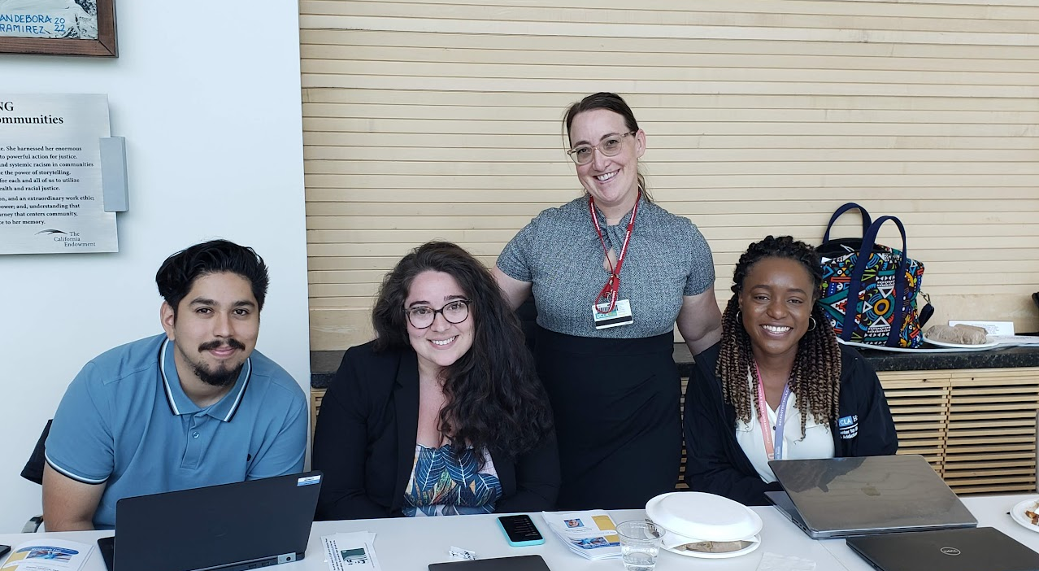
Research Day 2024
Wednesday, May 22, 2024
Abstract submission details will be announced after winter break
Keynote Speaker: Tony Kuo, MD

Slide 9
Grand Rounds
No Grand Rounds
In December or January
Coming Soon: Slides will be made available on our website for all speakers who agree to share their presentations.

Slide 10
Outgoing Proposals
Chris Ashikyan is now your point of contact for all outgoing proposals
You must include a Proposal Intake Form when you contact Chris
Plan to submit to OCGA by COB on the 6th business day prior to deadline
Aim to submit a complete proposal, not just minimum documents required
If you are the lead investigator, proposal must be submitted through Fam Med
SIX is the new FIVE
(business days)

Slide 11
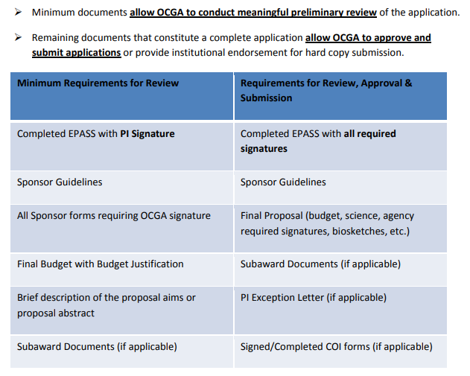

Slide 12
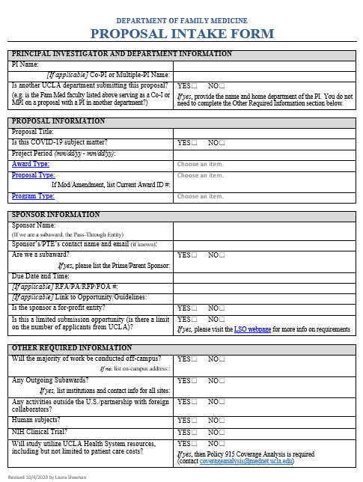
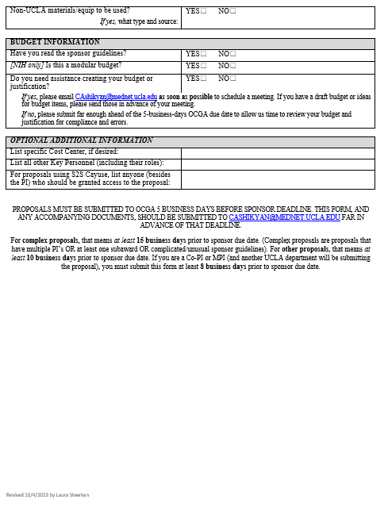
Updated Proposal Intake Form

Slide 13
OCGA Winter Closure
Proposals with submission deadlines between Friday, December 22nd, 2023 and Wednesday, January 3rd, 2024 must be submitted to OCGA by Friday, December 15, 2023 to ensure submission.
Any other transaction that needs to be resolved prior to closure should be submitted by Monday, December 18, 2023
Proposals due between Jan 3-9, 2024, must be submitted
to OCGA prior to winter closure (how many days prior
depends on the due date)
------------------------------
Thursday, December 14

Slide 14
https://brimr.org/
Authoritative annual rankings of NIH funding to individual researchers and academic institutions
The 2023 federal fiscal year ended on 30 September 2023 and fiscal 2024 is now underway.
We anticipate that NIH will release its final summary of 2023 awards in late December. BRIMR will then post a modified version of the NIH data for a 4-week period of public review, likely during January-February 2024, and shortly thereafter BRIMR will release their 2023 rankings.

Slide 15
Preparing for BruinBuy Plus
On December 14, the ability to create BruinBuy purchase requests, purchase orders (POs), and change orders will be disabled.
You will not be able to place orders during this time unless they are emergent, and those will require special approval and processing
We encourage you to place supply orders and pay invoices RIGHT NOW
Delay non-urgent requests in December until after roll-out
Beginning January 3, purchase requests, POs, and change orders will be processed in BruinBuy Plus.

Slide 16
Preparing for BruinBuy Plus
The New Invoice Submission Process Begins on December 14th
Starting December 14, 2023, vendors must submit invoices through a new centralized email address. That centralized email address will be shared soon. Transcepta and the Invoice Submission Portal will be decommissioned on December 13th. Review the BruinBuy Plus New Invoice Submission Process email that was sent to campus earlier this fall to get familiar with the new process.
Vendors have received a similar email outlining the new process. UCLA will continue communicating this change to vendors leading up to process launch on December 14th.

Slide 17
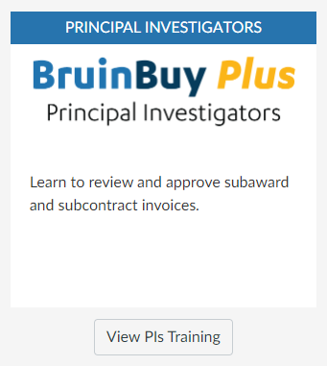
Preparing for BruinBuy Plus
PIs and Fund Managers with awards that have outgoing subawards or subcontracts are required to complete BruinBuy Plus training.
Visit Bruin Learn to complete your required BruinBuy Plus training by January 2, 2024.

Slide 18
Pcard Purchases
All Pcard purchases must be submitted to Valencia by Monday, December 11, 2023

Slide 19
Small Business First (SBF) Program
Helps UC invest in and enrich our local communities with jobs and economic stability
UC procurements between $10,000 and $250,000 must be awarded to a certified small business (SB) whenever practicable

Slide 20
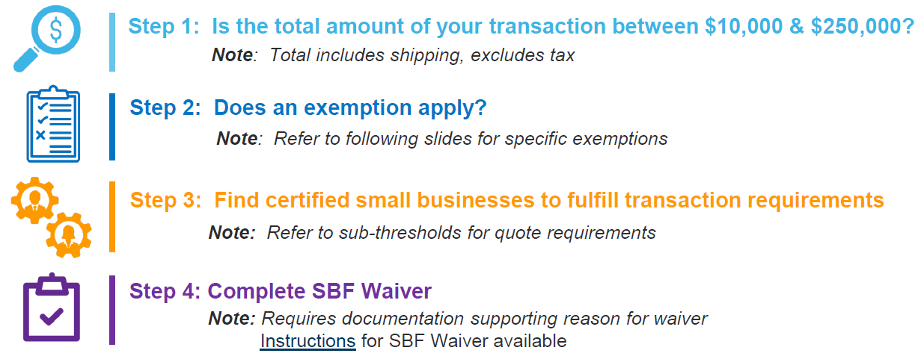
Small Business First (SBF) Program

Slide 21
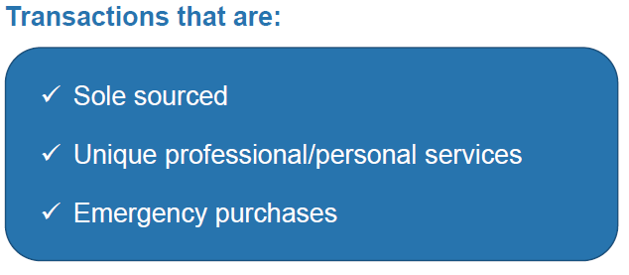
SBF Exemptions

Slide 22
Before you seek a waiver…
Effective immediately, if you cannot find a Small Business Enterprise (SBE) or Disabled Veteran Business Enterprise (DVBE), before you send a waiver look for other accepted certified businesses in these categories:
Minority Business Enterprise (MBE)
Women Business Enterprise (WBE)
Veteran Business Enterprise
LGBT
American Indian Tribes
These certifications, together with SBE and DVBE, will be accepted into the Small Business First program. Buyers who still send waivers will be asked to go through rigorous training.

Slide 23
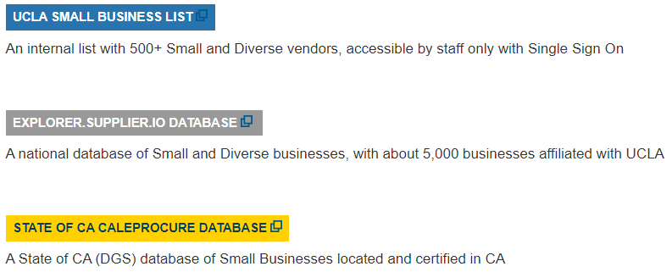
Finding a Certified Small Business
Go to: https://purchasing.ucla.edu/small-business-databases
If you are not able to find a Certified Small Business you must complete a SBF Waiver and attach the Waiver to your requisition.

Slide 24
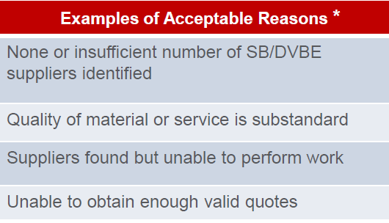
Paying a Certified Small Business
Complete the Purchase Request Form as usual
Attach the following:
Quote
Screenshot from database showing certification for chosen SB
If you were unable to utilize a Small Business, you must attach:
Waiver
Supporting documents

Slide 25
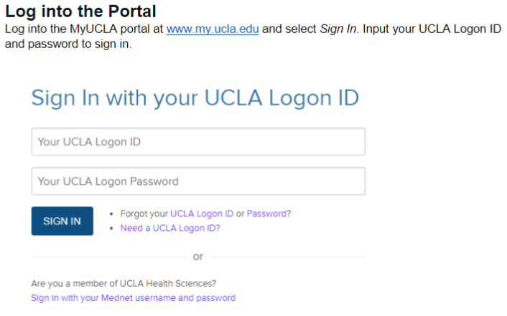
Research Participant Payment (Incentive) Requests
https://www.finance.ucla.edu/business-finance-services/payment-solutions-and-compliance/how-to-submit-research-payment-request
IRB Approved Research Payment Requests are completed through a combination of the Research Payment Portal on MyUCLA and the MyUCLA Message Center. You can track the status of your request on the Research Payment Portal.

Slide 26
Research Participant Payment (Incentive) Requests

Slide 27
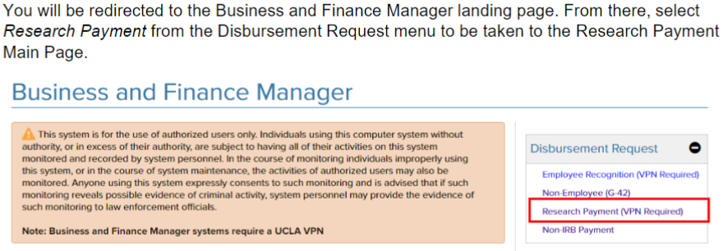
Research Participant Payment (Incentive) Requests

Slide 28
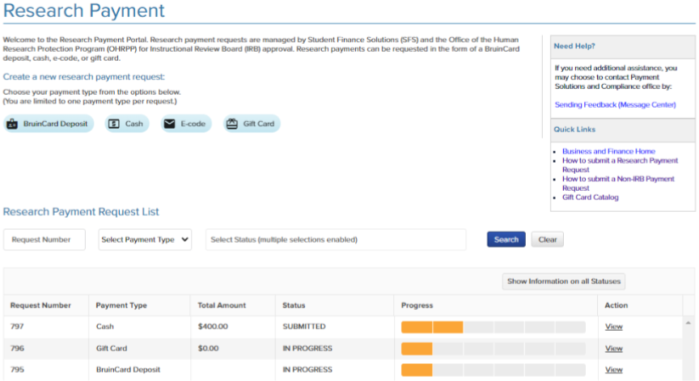
Research Participant Payment (Incentive) Requests

Slide 29
Research Participant Payment (Incentive) Requests
Provide contact info for authorized personnel, fund manager, PI’s etc.
Select delivery method (for physical cards) or authorized recipient (for e-codes)
3) Provide Order Information (Select “Add New” and enter vendor, amount, quantity, etc.)
4) Provide FAU, IRB Approval Number, IRB Expiration Date
5) Finalize Request by acknowledging policies and procedures and clicking “submit”
6) Both Fund Manager and PI will then receive automatic email to review and approve the request

Slide 30
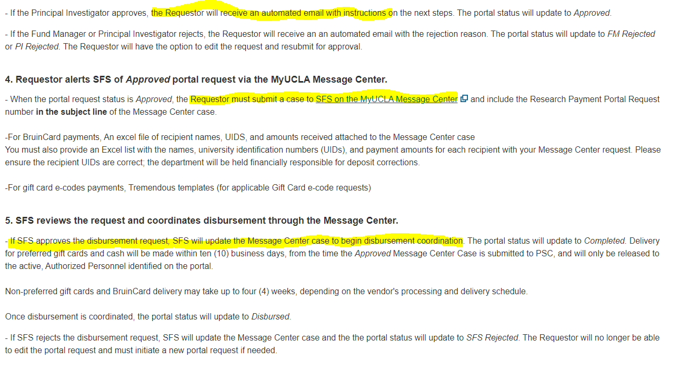

Slide 31
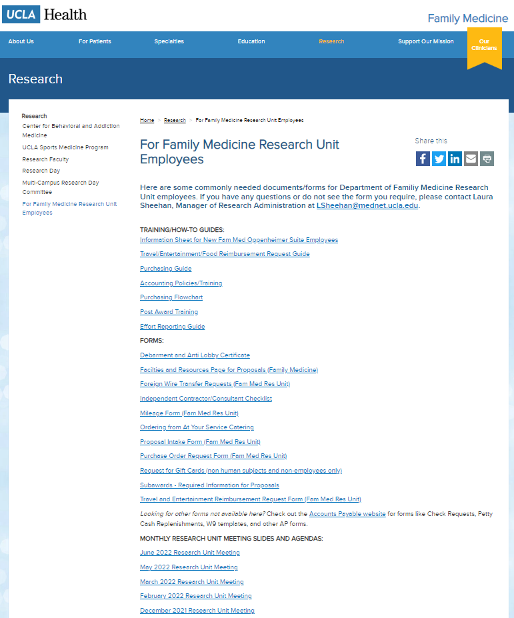
Upcoming Meetings/Events
Next Research Unit Meeting: Feb 1st
No Research Unit Meeting in January
Next Grand Rounds: FEBRUARY 2024
Prior monthly meeting agendas/slides are available on the website

