Slide 1
Preventive Healthcare for Older Adults in the Primary Care Setting: Opportunities and Pitfalls of the Medicare Annual Wellness Visit (AWV)
Derjung Mimi Tarn, MD, PhD
Professor
Department of Family Medicine
David Geffen School of Medicine at UCLA
August 23,2024

Slide 2
Outline
Preventive healthcare for the older adult
How do AWVs fit in?
Barriers to adoption of AWVs
NIH R61: Pilot study of intervention to increase AWV use
Current and future work

Slide 3
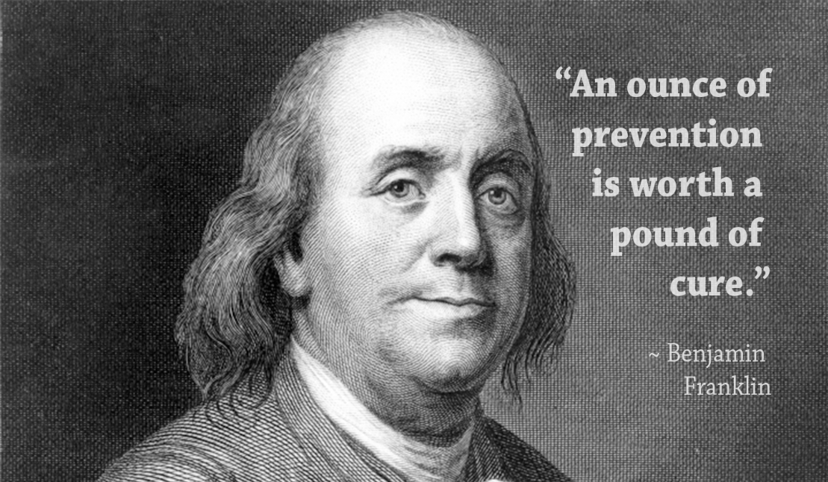

Slide 4
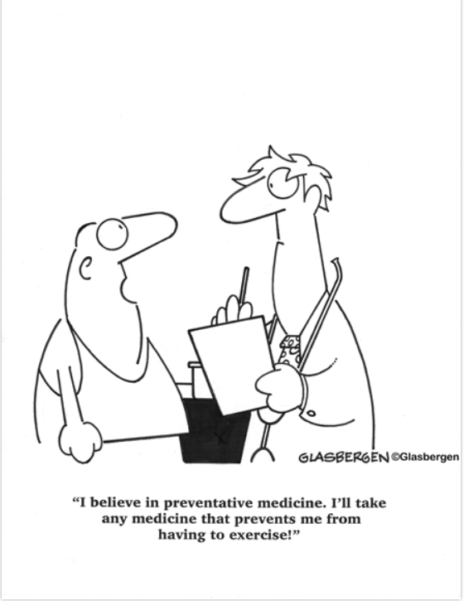
What IS Preventive Healthcare?
Healthcare.gov
Care that helps prevent health problems or finds them before they become serious
Routine health care that includes screening, check-ups, and patient counseling to prevent illnesses, disease, or other health problems
CA Department of Managed Care

Slide 5
United States Preventive Services Task Force (USPSTF) Recommendation Grading
A: The USPSTF recommends the service. There is high certainty that the net benefit is substantial.
B: The USPSTF recommends the service. There is high certainty that the net benefit is moderate or there is moderate certainty that the net benefit is moderate to substantial.
C: The USPSTF recommends selectively offering or providing this service to individual patients based on professional judgment and patient preferences. There is at least moderate certainty that the net benefit is small.
D: The USPSTF recommends against the service. There is moderate or high certainty that the service has no net benefit or that the harms outweigh the benefits.
I: The USPSTF concludes that the current evidence is insufficient to assess the balance of benefits and harms of the service. Evidence is lacking, of poor quality, or conflicting, and the balance of benefits and harms cannot be determined.
Notes:
A and B grade recommendations are services that the Task Force most highly recommends implementing for preventive care and that are also relevant for implementing the Affordable Care Act. These preventive services have a high or moderate net benefit for patients.

Slide 6
Summary USPSTF Recommendations by Grade and Type for Adults ≥ 65+ (n=81)
Grade | n | Screening |  |  | Behavioral Counseling (n) | Interventions (n) | Medications (n)
 |  | Men and women (n) | Women only (n) | Men only (n)
A | 6 | 3 | 1 | 0 | 0 | 1 | 2
B | 21 | 9 | 4 | 1 | 4 | 1 | 2
C | 7 | 1 | 0 | 2 | 2 | 0 | 2
D | 17 | 5 | 4 | 3 | 1 | 0 | 5
I | 30 | 20 | 3 | 2 | 3 | 0 | 5

Slide 7
Grade A USPSTF Recommendations for Adults ≥ 65
Topic | Type of Recommendation | Population | Approx # Existing Interventions
Colorectal Cancer | Screening | Adults aged 50-75 | 37
Hypertension in Adults | Screening | Adults 18 or older without known hypertension | 9
Syphilis Infection in Nonpregnant Adolescents and Adults | Screening | Asymptomatic, nonpregnant adolescents and adults who are at increased risk for syphilis infection | 24
Tobacco Smoking Cessation | Intervention | Adults | 9
Prevention of Acquisition of HIV: Preexposure Prophylaxis | Medication (Preexposure prophylaxis) | Adolescents and adults at increased risk of HIV | 9

Slide 8
Grade A USPSTF Recommendations for Women ≥ 65
Topic | Type of Recommendation | Population | Approx # Existing Interventions
Cervical Cancer | Screening | Women aged 21-65 years | 50

Slide 9
Grade B USPSTF Recommendations for Adults ≥ 65
Topic | Type of Recommendation | Population | Approx # Existing Interventions
Abdominal Aortic Aneurysm | Screening | Men aged 65 to 75 years who have ever smoked | 10
Depression and Suicide Risk in Adults | Screening | Adults and older adults (65 years or older) | 20
Hepatitis B Virus Infection | Screening | Adolescents and adults at increased risk for infection | 22
Hepatitis C Virus Infection in Adolescents and Adults | Screening | Adults aged 18 to 79 years | 27
Latent Tuberculosis Infection in Adults | Screening | Asymptomatic adults at increased risk of latent tuberculosis infection | 5
Intimate Partner Violence, Elder Abuse, and Abuse of Vulnerable Adults: Screening | Screening | Older or vulnerable adults | 50

Slide 10
Grade B USPSTF Recommendations for Adults ≥ 65 (cont.)
Topic | Type of Recommendation | Population | Approx # Existing Interventions
Lung Cancer | Screening | Adults aged 50 to 80 years with 20 pack-year smoking history and currently smoke or have quit within the past 15 years | 5
Prediabetes and Type 2 Diabetes: Screening | Screening | Asymptomatic adults aged 35 to 70 years who have overweight or obesity | 11
Unhealthy Drug Use | Screening | Adults aged 18 years or older | 16
Unhealthy Alcohol Use in Adolescents and Adults | Screening | Adults 18 years or older | 7

Slide 11
Grade B USPSTF Recommendations for Adults ≥ 65 (cont.)
Topic | Type of Recommendation | Population | Approx # Existing Interventions
Unhealthy Alcohol Use in Adolescents and Adults | Behavioral Counseling | Adults 18 years or older | 7
Healthy Diet and Physical Activity for Cardiovascular Disease Prevention | Behavioral Counseling | Adults with cardiovascular disease risk factors | 7
Sexually Transmitted Infections | Behavioral Counseling | Sexually active adolescents and adults at increased risk | 9
Weight Loss to Prevent Obesity-Related Morbidity and Mortality in Adults | Behavioral Counseling | Adults | 14

Slide 12
Grade B USPSTF Recommendations for Adults ≥ 65 (cont.)
Topic | Recommendation | Population | Approx # Existing Interventions
Falls Prevention in Community-Dwelling Older Adults | Interventions | Adults 65 years or older | 7
Statin Use for the Primary Prevention of Cardiovascular Disease (CVD) in Adults | Preventive Medication | Adults aged 40-75 who have 1 or more CV risk factors and an estimated 10-year CVD risk of 10% or greater | 25

Slide 13
Grade B USPSTF Recommendations for Women ≥ 65
Topic | Recommendation | Population | Approx # Existing Interventions
Breast Cancer | Screening | Women aged 50 to 74 years | 35
Chlamydia and Gonorrhea | Screening | Sexually active women, including pregnant persons | 15
Osteoporosis to Prevent Fractures | Screening | Postmenopausal women younger than 65 years at increased risk of osteoporosis, women 65 and older | 8
BRCA-Related Cancer: Risk Assessment, Genetic Counseling, and Genetic Testing: | Risk Assessment, Genetic Counseling, and Genetic Testing | Women with a personal or family history of breast, ovarian, tubal, or peritoneal cancer or an ancestry associated with brca1/2 gene mutation | 4
Breast Cancer | Medication Use to Reduce Risk | Women at increased risk for breast cancer aged 35 years or older | 6

Slide 14
Advisory Committee on Immunization Practices (ACIP) Guidance for Adults Aged 65+
Pneumococcal
Zoster recombinant
Tetanus booster
RSV (shared decision-making)
Influenza
COVID-19

Slide 15
Small Solutions (Interventions) are Not the Answer

Slide 17
Physician Perspective on AWVs as an Intervention to Promote Preventive Healthcare
“We do a lot of specific QI projects with regard to health maintenance and preventive care. We have a lot of separate studies for mammography, for colonoscopy, for vaccines. If we were to include all of those QIs for all those individual things, and so, "Hey, we can try to start to address, not just one of these issues, but all of them during the annual Medicare Wellness visit," then that I think would benefit the practice as a whole. Essentially, that's what that visit is utilized for. All of those individual studies are basically gearing toward, "Let's get someone in to specifically talk about this." I think that's the biggest motivating thing that I can come up with instead of looking at all these individual parts.”
- Physician in Ohio

Slide 18
Differentiating the Preventive Visits: Terminology
Comprehensive physical exam / Physical
Preventive visit
Annual preventive wellness visit
Annual physical (exam)
Annual / yearly check up
Well woman exam
Annual Wellness Visit (AWV)
Medicare Wellness Visit (MWV)

Slide 19
Before 2011, Medicare did not cover any yearly primary care office visits for fee-for-service Medicare patients
X

Slide 20
History of Annual Wellness Visits
January 1, 2005
“Welcome to Medicare” visit
New Medicare beneficiaries within 6 months of beginning Part B coverage
January 1, 2008
Welcome to Medicare visit expanded
January 1, 2011
Patient Protection and Affordable Care Act of 2010
1 visit within first 12 months of Part B coverage
Part B deductible waived; copay applies
New yearly wellness visit
Copays eliminated for almost all preventive services
Notes:
2005: one-time coverage; Medicare's regular cost-sharing provisions applied to the visit; it was subject to the Medicare annual Part B deductible (of $100 at the time) and a standard 20% Medicare copay above that amount.
2010 Eliminated cost-sharing for almost all preventive services
https://medicareadvocacy.org/affordable-care-act-expands-medicare-coverage-for-prevention-and-wellness/

Slide 21
Why are AWVs Important?

Slide 22
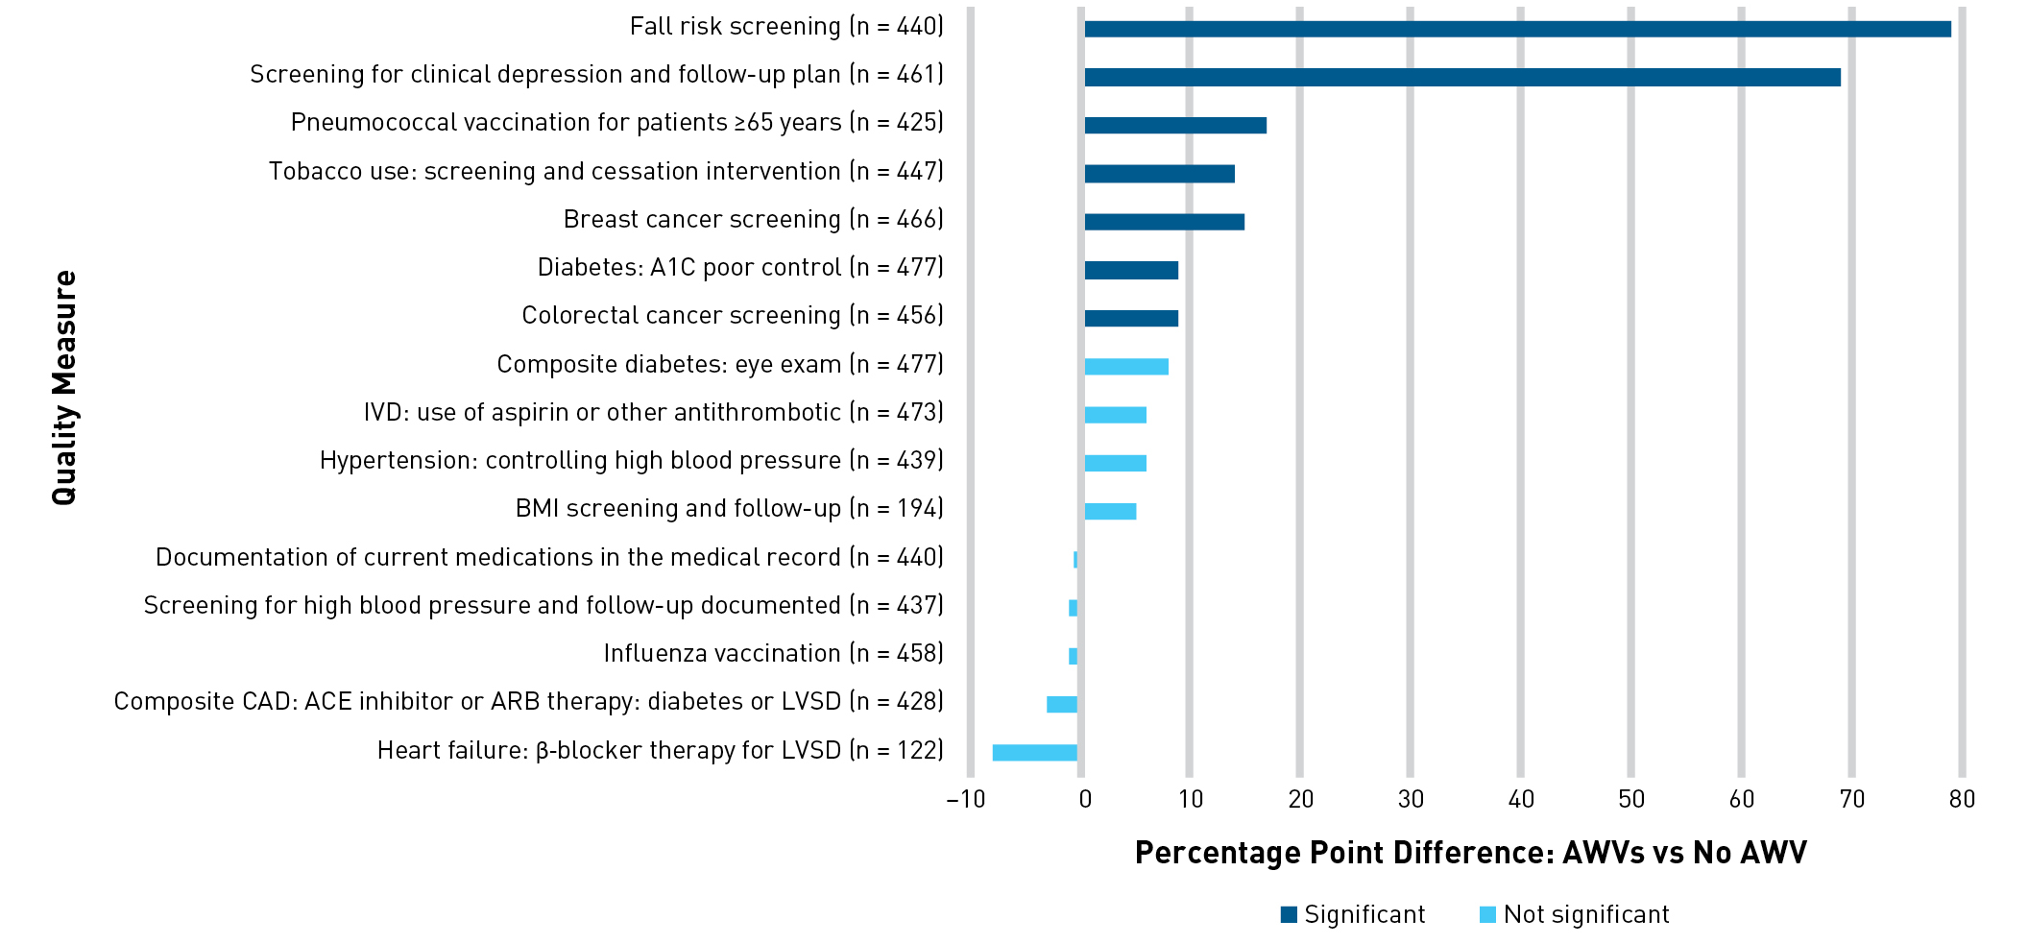
AWVs Increase Use of Preventive Health Services
Beckman AL et al. Am J Manag Care. 2019. e76-e82.
Notes:
Medicare beneficiaries attributed to providers across 44 primary care clinics participating in 2 ACOs; 2014-2016
Beneficiaries who had an AWV were also more likely to receive recommended preventive clinical services.
Better detection of falls, cognitive impairment, more discussions about ACP

Slide 23
Carter, (2019) AARP Report.
Patients with AWVs had Greater Use of Preventive Services, n=1,762,413
Notes:
Patients represented in OptumLabs data warehouse in 2015
codes G0438 (first AWV) and G0439 (subsequent AWVs) on insurance claim form

Slide 24
Importance of AWVs for Preventive Care (Providers)
“…you get so busy taking care of someone's train wreck, just whack-a-mole problems where…it's like, "Have we just stopped for a minute and talked about preventive healthcare because I've seen you 20 times this year." None of it was preventive stuff because you've just had so much going on. It's that nice cue to be like, “…Let's zoom out for a minute and look at the big picture and have a visit dedicated to that.”” (physician in Oregon)
“I feel like many of my appointments with my patients are so focused on their trying to manage their A1C and their cholesterol and their hypertension, because we have so much lifestyle education that needs to take place that I don't always, until we do an AWV, I don't always have time to go over their all of their other stuff.” (NP in Ohio)
“[AWVs have] also been helpful in terms of - I like some of Medicare's little quirks…I send a lot more people to audiology because I ask about hearing a lot more than I did before I reviewed the recommendations for Medicare.” (physician in Massachusetts)
Notes:
Patient experience is a big thing – tied to reimbursement; insurers are measuring

Slide 25
Importance of AWVs for Preventive Care (Patients)
“It’s important because it's going to help you to have better health, because you're trying to catch things before they actually happen to you or get worse.” (patient of solo practice in CA)
“I'm looking forward to [my next AWV] because I want to make sure I'm doing what I need to do to be healthy.” (patient of community-based practice in MA)
“Early detection of certain illnesses can keep you [be] here longer on this earth.” (patient of Federally Qualified Health Center in NY)

Slide 26
AWVs Build Stronger Provider-Patient Relationships
Physicians (Hamer et al, Med Care Res Rev, 2023)
“The magic of the wellness visit is development of the relationship with the patient, and having the patient understand that you as a practice care about them, and care about their overall health and wellness.”
“…it’s cherished time to connect with the patients on a different level, where they’re not in pain, or sick, or in fear.”
Patients (from practices in CO)
“getting to a personal level with the doctor”
“…wellness - it's such a brilliant idea…most older people like to sit and chat about themselves. If you give them an opportunity, most of them, I think - will be honest and reveal things that they wouldn't if it was just a rushed little thing...”
Notes:
Patient experience is a big thing – tied to reimbursement; insurers are measuring

Slide 29
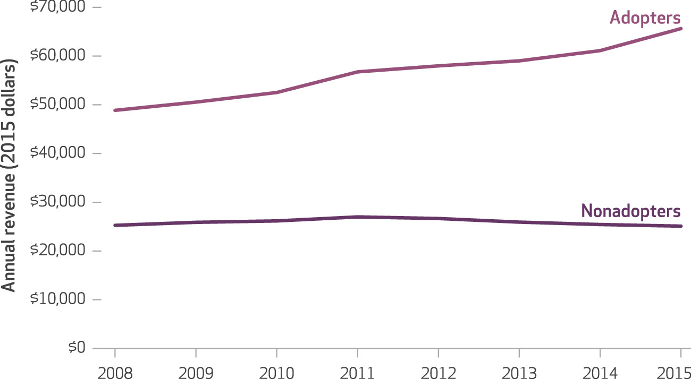
AWVs Increase Revenue
Ganguli et al. Health Affairs 2018, 283-291
Notes:
On average, practices that adopted the annual wellness visit generated greater primary care revenue and had an increase in revenue over the study period, while nonadopters had a slight decline
Used standardized Medicare payments based on 2015 physician fee schedule to calculate average practice-level Medicare revenue for primary care visits

Slide 30
Other Benefits
Only dedicated visit to discuss preventive care with Fee-for-Service Medicare patients
Allow providers to capture Hierarchical Condition Coding (HCC) codes
Chance to establish relationships with those without acute complaints
Notes:
FFS Medicare patients will incur out-of-pocket costs if a physician bills for a physical
Hierarchical condition category coding helps communicate patient complexity and paint a picture of the whole patient. In addition to helping predict health care resource utilization, RAF scores are used to risk adjust quality and cost metrics. Risk adjustment can play an important role in payment and can have a direct impact on a practice’s revenue. When risk scores do not accurately reflect patient complexity, it may appear patients had higher costs and/or lower quality outcomes than would be expected. In certain payment models, this may cause a practice to fall below quality and cost performance targets and potentially miss out on the opportunity for shared savings.

Slide 31
Problem: AWVs are Underutilized
2011–2013
23% of patients had an AWV
2015
Fewer than ¼ of practices did AWVs on at least 25% of patients
2017
24% of patients had an AWV
2020
45% of patients had an AWV
Jiang (2018) Prev Med; Ganguli et al., (2018) Health Aff; Misra & Lloyd (2019) Prev Med; CMS.gov (2023)

Slide 32
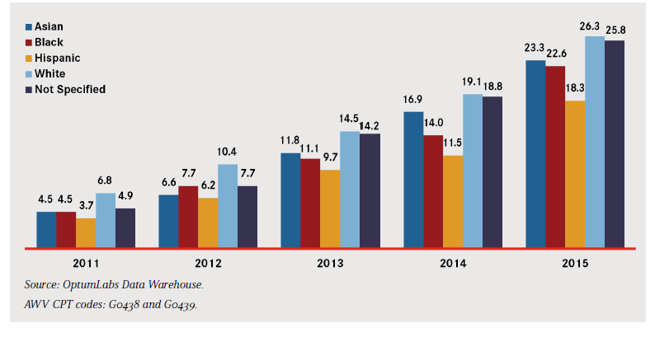
Asian, Black, and Hispanic Patients Receive Fewer AWVs than White Patients (2011-2015)
Carter. (2019). AARP Report.
Notes:
Older
Black or Hispanic
Female, Not Married
Lower incomes, less education
More chronic conditions
Living in rural areas

Slide 33
What is an AWV?

Slide 34
Definitions
Initial Preventive Physical Exam (IPPE) | Initial AWV | Subsequent AWV
G0402 | G0438 | G0439
Within first 12 months of Medicare Plan B enrollment Only time Medicare pays for a “physical” | No longer within initial 12 months of Plan B enrollment AND Have not had IPPE in past 12 months | Patient has not received an AWV in the past 12 months
One per lifetime | One per lifetime | Annually

Slide 35
Time since previous AWV
IPPE | Initial AWV | Subsequent AWV
Not applicable (first visit) | At least 11 full months after IPPE (Can be billed in same calendar month as previous year’s visit) | At least 11 full months after last initial or subsequent AWV (Can be billed in same calendar month as previous year’s visit)

Slide 36
Who can perform an AWV?
Physician (MD or DO)
Nurse practitioner
Physician assistant
Clinical nurse specialist
Medical professional
Health educator
Registered dietitian
Nutrition professional
Other licensed practitioner (e.g., pharmacist)
Notes:
Team of medical professionals working under direct supervision of a physician
In some places non-PCPs are doing these outside of the auspices of the physician’s office

Slide 37
The AWV Does Not Require a Physical Examination
Notes:
This can be misunderstood by providers

Slide 38
AWV Components (Summary)
Provider documentation template
Personalized prevention plan (PPP)
Health Risk Assessment
Team Tasks

Slide 39
AWV Components
Health risk assessment (HRA) (AWVs)
Activities of daily living (ADLs) / Independent ADLs (IADLs)
Self-assessment of health status, frailty, physical functioning
Behavioral risks (e.g., physical activity, nutrition and oral health, sexual health, seatbelt use)
Psychosocial risks (loneliness / social isolation, pain, fatigue)
Fall risk
Home safety
Notes:
34 items mandated by CMS on HRA

Slide 40
AWV Components
Team tasks
Vision test (IPPE), EKG (optional during IPPE)
Cognitive impairment screening (not required for IPPE)
Care teams / Durable Medical Equipment (DME) suppliers
Depression, alcohol misuse, tobacco use screening
Notes:
34 items mandated by CMS on HRA

Slide 41
AWV Components
Provider documentation template
Past medical / surgical / family history
Advance care planning (optional)
Personalized prevention plan (PPP)
Screening schedule
Review of current opioid prescriptions
Medications / supplements
h/o alcohol, tobacco, illicit drug use (IPPE only)
Risk factors for depression
Personalized health advice

Slide 42
What are barriers to AWV adoption?

Slide 43
Organizational / Practice Barriers
No workflows for administering HRA
No way to send forms via patient portal: “We're working on trying to have in the future, forms digitally… instead of having to…put [the HRA] in manually, which is what happens now.” (clinician, AZ)
Limited ability of patients to complete forms online
Patient language limitations
Staffing shortages
“Honestly, at this point in time, we're short-staffed.” (MA, OH)
Poor staff / medical assistant (MA) training on AWVs
Notes:
Goal is to send via patient portal – many not on portal (especially older, minority patients)

Slide 44
Provider Barriers
Poor knowledge about AWV components
Fear of being noncompliant with documentation requirements
Difficulty identifying which type of AWV patient needs
AWV is “overwhelming”
Belief that AWVs are not important
Do not believe in “well” visits
Fulfilling metrics during other visits
Access issues

Slide 45
Patient Barriers
Lack knowledge
Priorities differ from what Medicare covers; may be unhappy if incur copayment
“[Patients are] taken aback when they find out that they go in there for a wellness visit, and it's not really a physical exam.”
“I've always been used to at my annual physical, I bring up every little thing. I'm going, "Okay, look at this little spot here. I've had this problem with this, you know, wrist." And I've un-- I've come to understand in the past that those kinds of questions aren't necessarily covered under insurance coding for your physical. So I've had to learn to make a separate appointment if I need for those kinds of things, that I know those questions, um, really aren't covered anymore under a standard physical.”
Believe forms are cumbersome
“This is ridiculous, but just the paperwork, I'm just doing the paperwork and filling everything out. Again, I'm healthy so I don't have the issues. Just run through every checklist…and it's always just no, no, no, no, no, no.”

Slide 46
NIH R61 Overall Goal
To help practices increase rates of AWVs, as a means to improve patient use of preventive health services
vaccinations
cancer screenings
advance care planning
depression and alcohol misuse screening

Slide 47
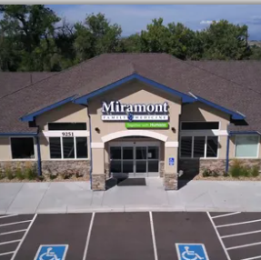
Participating Sites
3 community-based practices
Located in Colorado
Belong to the same organization
2-5 clinicians each
At least 1 NP at each site

Slide 48
Intervention (Tailored based on practice preferences)
AWV workflows
Clinician/staff training
Templates
Health risk assessment
Documentation
Personalized prevention plan
EHR-based tools
Dashboard (AWV registry)
Reports on AWV / metric fulfillment
Feedback reports

Slide 49
Sample Study Flow
Meet with Practice Champion, Providers, Staff
Provider / Staff Training Sessions and Meetings
Provider, Staff, Patient Interviews
Dashboard access
Feedback Report
Feedback Report
Check-ins with Practice Champion
Control
Toolkit Implementation
Post Implementation
Dec 20 |  | Apr-21
Jun-21 |  | Oct-21 | Dec-21

Slide 50
Qualitative Findings – Patient Interviews
Patients grateful that the practices implemented initiatives to improve patient wellness
“Adds to the humanity of the visit”
Several patients were unaware that they received an AWV until Medicare sent them information about their completed visit *
Some patients who had an ‘impromptu’ AWV appreciated the practice’s efforts to save them a trip back to the office
Patients appreciated talking about advance care planning
* Tarn et al, Ann Intern Med, 2022

Slide 51
Results
Intervention associated with:
Increased rates of AWVs
Increased rates of vaccinations and preventive health screenings (particularly screenings that are clinician-driven)
AWVs associated with:
Increased rates of vaccinations and preventive health screenings

Slide 52
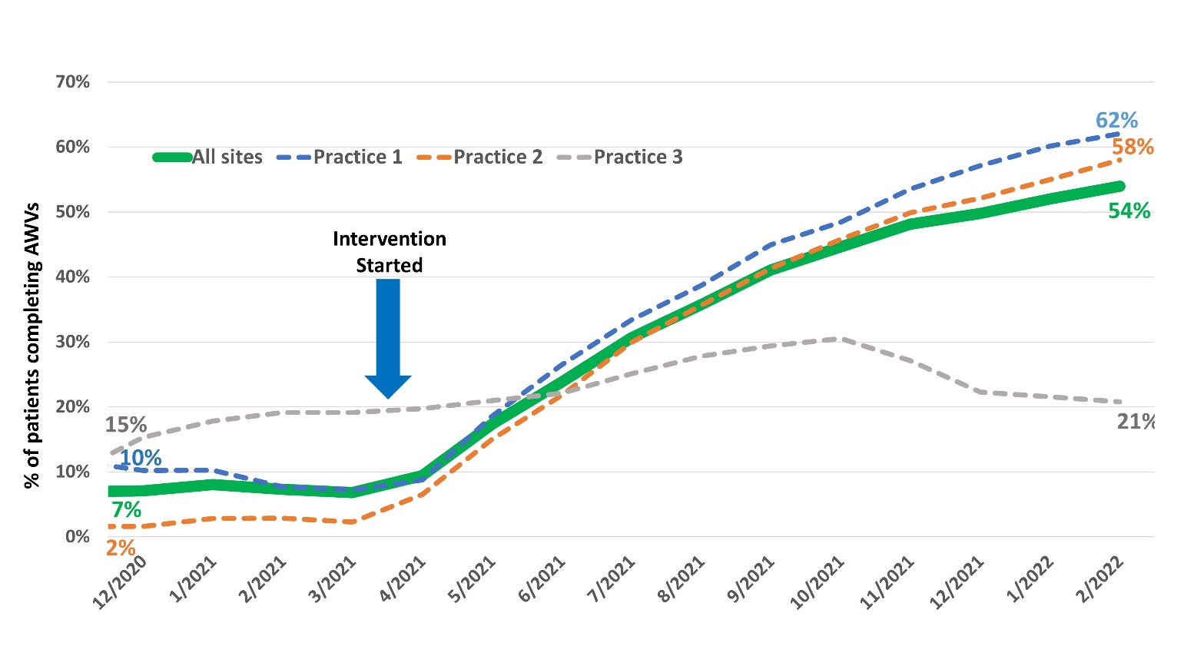
Effect of Intervention on Rates of AWVs, Overall and by Practice Site *
* Tarn et al, J Am Board Fam Med, 2023

Slide 53
Effect of Intervention on Vaccinations
Vaccination | Baseline |  | 8 months post-implementation |  | p-value for difference in % fulfillment
 | Eligible cohort, n | Fulfilled, n (%) | Eligible cohort, n | Fulfilled, n (%)
Influenza | 1512 | 840 (56.3) | 1166 | 693 (59.6) | 0.032
Herpes zoster | 1431 | 622 (43.5) | 1119 | 530 (47.4) | < 0.001
Pneumococcal | 1149 | 831 (72.3) | 1000 | 744 (74.4) | < 0.001
Tetanus | 1512 | 862 (57.0) | 1166 | 662 (56.8) | < 0.001

Slide 54
Effect of Intervention on Cancer Screenings
Cancer Screening | Baseline |  | 8 months post-implementation |  | p-value for difference in % fulfillment
 | Eligible cohort, n | Fulfilled, n (%) | Eligible cohort, n | Fulfilled, n (%)
Colorectal cancer | 945 | 324 (34.3) | 675 | 222 (32.9) | 0.026
Breast cancer | 517 | 215 (41.6) | 340 | 153 (45.0) | 0.777
Cervical cancer | 116 | 64 (55.2) | 75 | 46 (61.3) | 0.357

Slide 55
Effect of Intervention on Other Screenings & Advance Care Planning
Screening / Discussion | Baseline |  | 8 months post-implementation |  | p-value for difference in % fulfillment
 | Eligible cohort, n | Fulfilled, n (%) | Eligible cohort, n | Fulfilled, n (%)
Osteoporosis | 317 | 120 (37.9) | 231 | 103 (44.6) | < 0.001
Hepatitis C | 1179 | 275 (23.3) | 861 | 249 (28.9) | < 0.001
Alcohol misuse | 1492 | 635 (42.6) | 1161 | 696 (59.9) | < 0.001
Depression | 1279 | 661 (51.7) | 954 | 649 (68.0) | < 0.001
Tobacco use | 1498 | 1266 (84.5) | 1161 | 926 (79.8) | < 0.001
Advance care planning | 1234 | 97 (7.9) | 1026 | 191 (18.6) | < 0.001

Slide 56
Vaccinations are Higher with AWV Completion

Slide 57
Cancer Screenings are Higher with AWV Completion

Slide 58
Other Screenings & Advance Care Planning are Higher with AWV Completion*
* All p ≤ 0.001

Slide 59
% Fulfillment of All Assessed Preventive Health Services With and Without AWV Completion (8-Months Post-Implementation)

Slide 60
Results
Intervention associated with:
Increased rates of AWVs
Increased rates of vaccinations and preventive health screenings (particularly screenings that are clinician-driven)
AWVs associated with:
Increased rates of vaccinations and preventive health screenings

Slide 61
Current Research
NIH R33 (May 2023 – Sept 2025)
Stepped Wedge Randomized Trial
8 community-based practices across the country
4 months per wedge
Replication Trial
Conducted simultaneously
8 Federally Qualified Health Center (FQHC) practices

Slide 62
Current Research (cont.)
NIH R01 (2023 – 2028)
Stepped Wedge Randomized Trial
24 practices
Banner Health System (AZ, CO)
MetroHealth System (OH)
UCLA
6 months per wedge
Assess sustainability over 24 months; determine impact on reducing racial/ethnic disparities in AWVs

Slide 63
% AWVs Completed for Eligible Patients, 2023
Goal
Mean 39%

Slide 64
Lessons learned
Each practice (even within a single organization) has different obstacles to performing AWVs
Patient priorities for AWVs are often at odds with Medicare stipulations for the visit
Prevention is often a hard sell

Slide 66
Summary
AWVs provide a unique opportunity to address multiple preventive health metrics and screenings in a single visit
Efforts to increase AWVs require multi-level interventions that are tailored for practices

Slide 67
Collaborators
Wilson Pace, MD (DARTNet Institute)
Kurt Stange, MD, PhD (Case Western)
Neil Wenger, MD, MPH (UCLA)
Chi-hong Tseng, PhD (UCLA)
Jack Westfall, MD, MPH (DARTNet Institute)

Slide 68
dtarn@mednet.ucla.edu

