Slide 1
Family Medicine Research Unit
Monthly Meeting - August 2022
Laura Sheehan
Manager of Research Administration, Dept. of Family Medicine

Slide 2
Recently Processed Awards
PI | Award Title | Sponsor | Prime Sponsor | Action Type
Sur, Denise Kc | SBPCR-1000218: UCLA Family Medicine Residency Program (Song-Brown 2019) | CA-Department of Health Care Access and Information | - | Continuation
Sur, Denise Kc | SBPCR-1000497: UCLA Family Medicine Residency Program (Song-Brown 2020) | CA-Department of Health Care Access and Information | - | Continuation
Sur, Denise Kc | CalMedForce - UCLA Family Medicine Residency Program | Physicians for a Healthy California | UC/OFFICE OF THE PRESIDENT, SYSTEMWIDE | New

Slide 3
Recently Submitted Proposals
PI | Title | Sponsor | Prime Sponsor | Proposal Type
Sur, Denise Kc | HCAI Song-Brown Grant Primary Care Residency (2023-2026) | CA-Department of Health Care Access and Information | - | New
Shoptaw, Steven J | CTN-0109 CURB-2 | University of Texas-Southwestern Medical Center at Dallas | NIH | New
Shoptaw, Steven J | Center for HIV Identification, Prevention and Treatment Services (CHIPTS) - UCLA Rapid, Relevant, Rigorous Implementation Science Hub | NIH-NIMH National Institute of Mental Health | - | Modification/ Amendment
Shoptaw, Steven J | HIV Prevention Trials Leadership Group: 094 Protocol Chair (Year 17) | FHI 360 (Family Health International) | NIH-NIAID | Modification/ Amendment

Slide 4
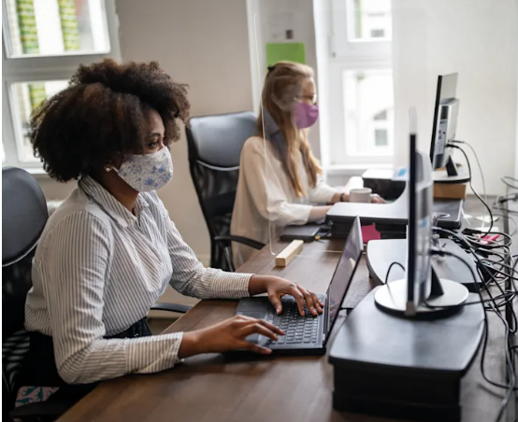
Human Resources/Personnel/COVID Updates
Masks are required in Oppenheimer
You may only remove your mask if you are alone in a closed office.
Conference Room is not available 12-1pm for meetings, as it is reserved for those in cubicles who need a space to
remove their masks for lunch.
If you are in a cubicle, please utilize the
conference room when needed for mask breaks.
If you are in a cubicle or a shared office, please
reach out to Laura if you have concerns/
questions and would like to explore the option
of temporarily utilizing an unoccupied office
for your work.

Slide 5
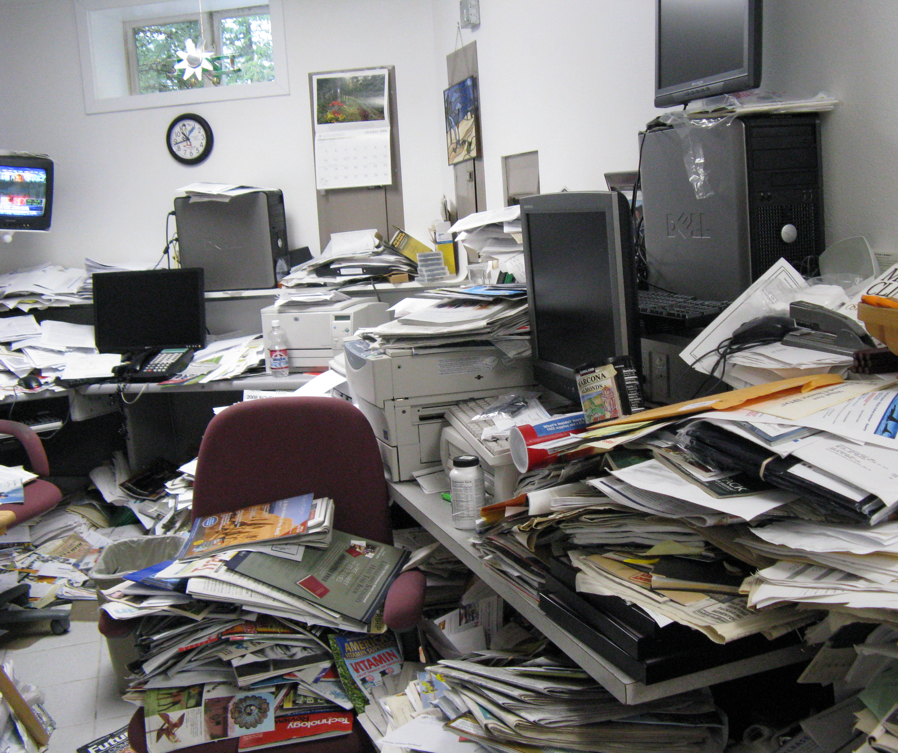
Human Resources/Personnel/COVID Updates
If you are in a private or shared office, please consider removing unused items and files from your space.
If you are utilizing a cubicle area for storage, please store items away from walking areas. Keep things organized and safely tucked away.
Please do not remove items from cubicle areas that do not belong to you. If you are unsure if a cubicle space is being occupied, please reach out to Laura to clarify.

Slide 6
17th Annual UCLA All-Staff Picnic
When: Thursday, August 18
11:30AM– 1:30PM
You must register to get a free lunch, but you can bring your own lunch and attend without registering as well. Bring a reusable bottle as there will be drinks, but no cups, for sustainability purposes. Supervisors should grant employees sufficient time in addition to normal lunch period to attend.

Slide 7
Monday, September 5th is Labor Day

Slide 8
Financial Process
Vendors should not be providing any goods or services without a PO (purchase order), number in place. Submitting a PO Request Form is NOT the same thing as having a PO number. PO number’s are 10-digits that always start with 1550 (in our department). If it is a 1550R-, this is also not a valid PO. (R = requisition, meaning we are requesting an actual PO number be established).

Slide 9
Financial Process
If you submit an invoice for payment and AP notices that the PO creation date is AFTER the invoice date, it may be rejected.
An After-the-Fact form may be required to move forward.
The finance team will no longer be obtaining these forms on your behalf.

Slide 10
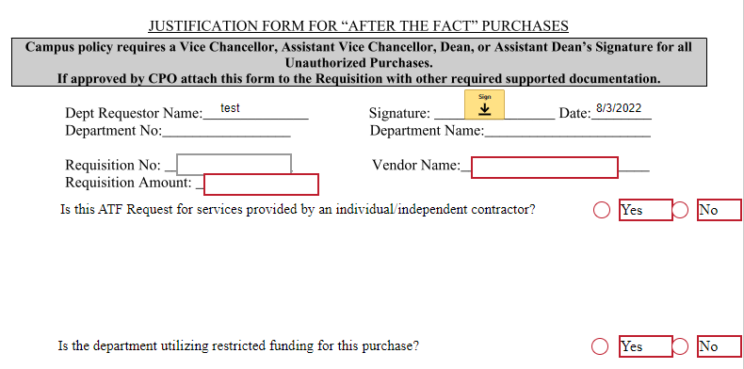
Financial Process

Slide 11
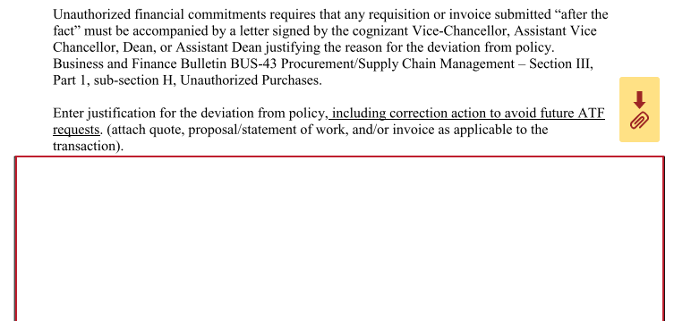
Financial Process

Slide 13
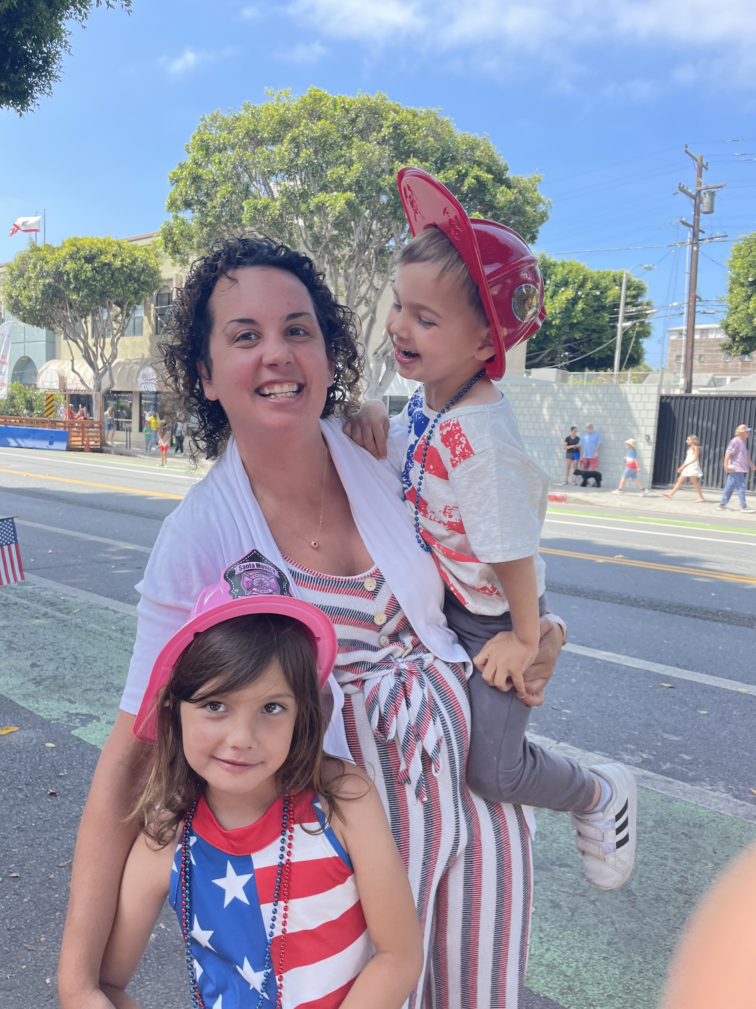
Get to Know Your Co-Workers
This month’s spotlight: Mariah Kalmin, phd
Family: 2 kids, Brendan age 3 and Tessa, age 6; very active and silly. When we aren’t at work/school you can find us at the pool or the beach!
Hobbies: Prior to having kids I used to love working out and running and am trying to get back into fitness. So far this year I’ve run 1 5k and have another one lined up next week followed by a 10k in September and half marathon in November!
Bucket list: travel, travel, and more travel both with and without kids. So far this year I’ve done a wine tasting trip in the Santa Ynez valley, kid trip to Phoenix to visit family, momma-daughter trip to Costa Rica, and a trip to Sedona, Grand Canyon, and Lake Powell with my partner. Hopefully many more trips to come!

Slide 14
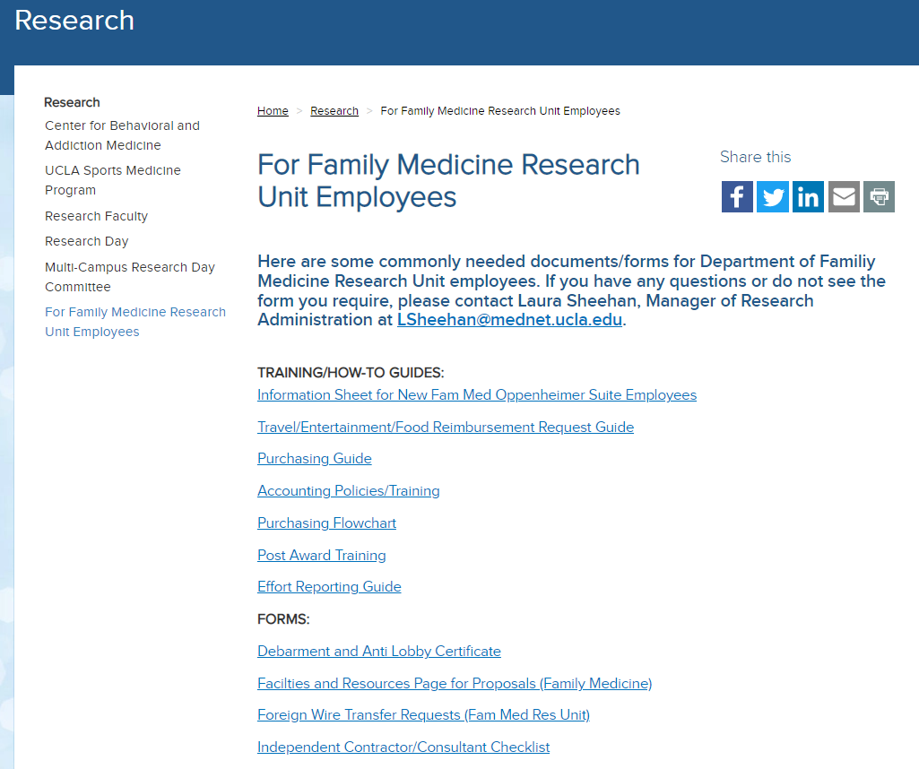
Financial Process
Independent Contractors/Consultants
Must be submitted in advance
Large administrative load
New Guidance available on website

Slide 15
Financial Process
Guest Speakers/Panelists
Discuss process prior to offer
Submit paperwork in advance
Best practice: do not offer pay to UC employees

Slide 16
Research/Contracts & Grants Updates
webIRB updates

Slide 17
Research/Contracts & Grants Updates
webIRB updates

Slide 18
Research/Contracts & Grants Updates
webIRB updates

Slide 19
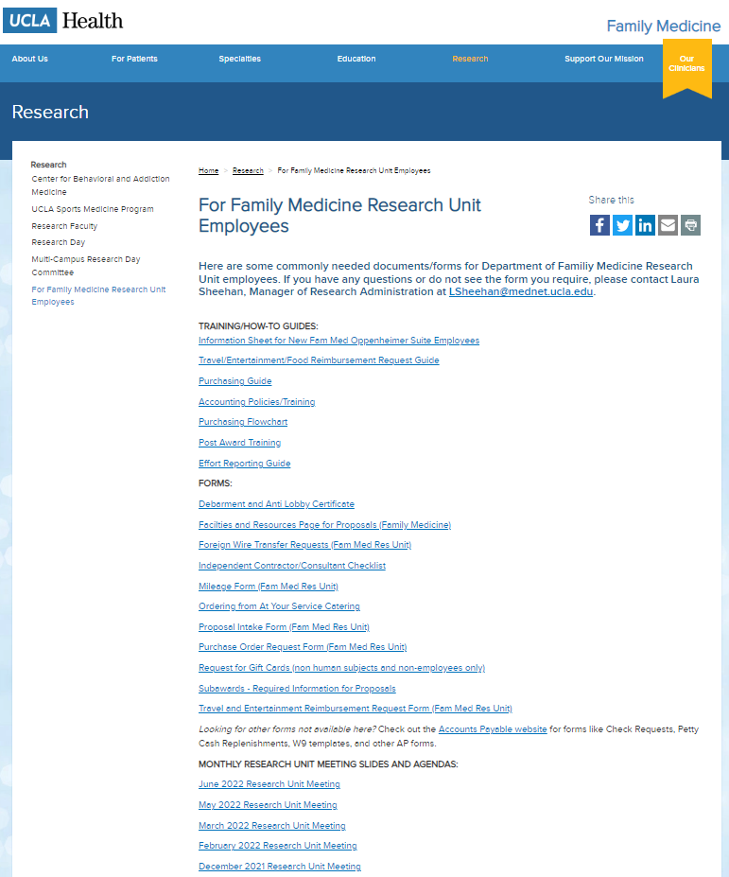
Meetings
Next Monthly Research Unit Meeting: Thursday, September 1
Prior monthly meeting agendas/slides are now available on the website

