Slide 1
Northwestern University Next-D2 Summary Effect of Medicaid Expansion on Diabetes Diagnosis, Treatment, and Outcomes
Pis: Abel Kho / Bernard Black
Co-Is: Alona Furmanchuk, Laura Rasmussen-Torvik, Russ Waitman (KUMC), John Meurer (MCW)

Slide 2
(Revised) Core objective
Assess how ACA health insurance expansion affects near-term and medium-term diabetes diagnosis, treatment compliance, and health outcomes.
Original plan: assess effect of Medicaid expansion
Limitations to EHR data (e.g. cannot determine who has Medicaid)
Will try to assess effect of Medicaid expansion in Next-D3 by linking Medicaid enrollment data (IL, IN, WI) to EHR data
Because EHR data doesn’t let us accurately measure who gains Medicaid insurance

Slide 3
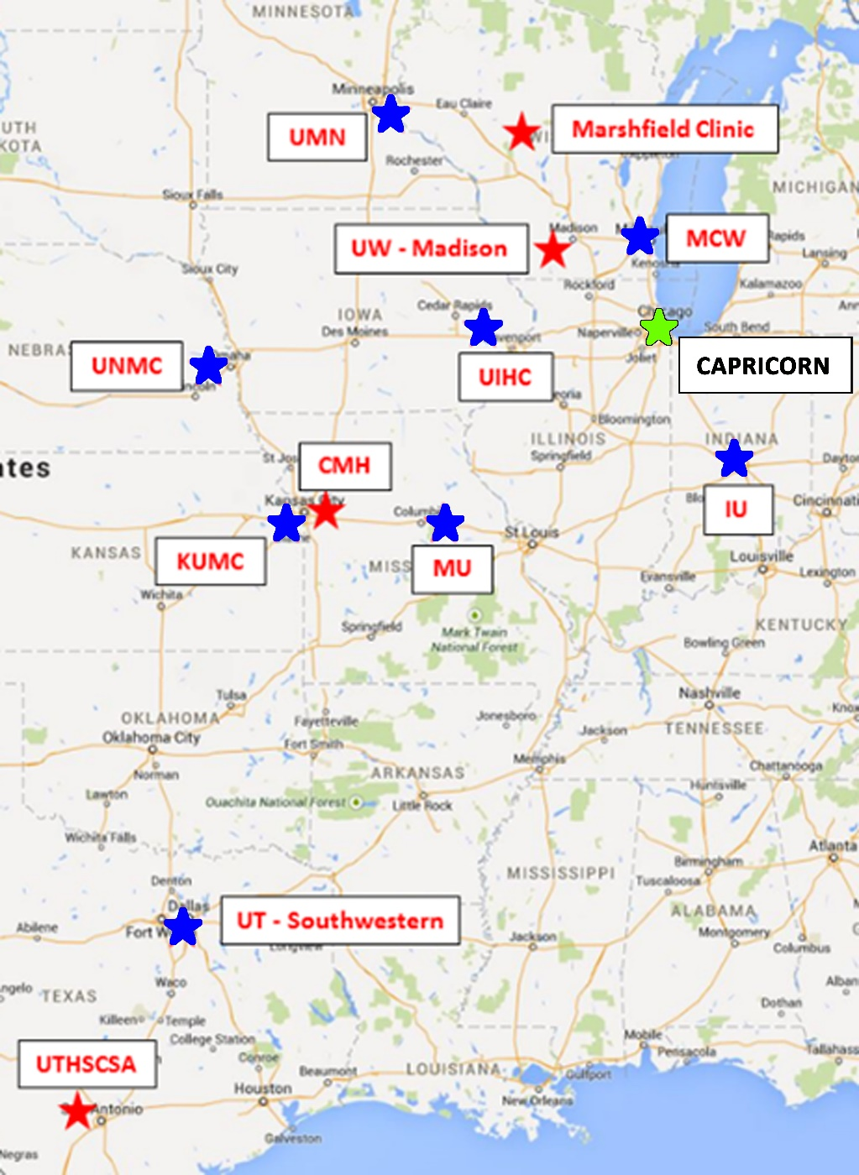
A Multi-State Collaboration of Two PCORnet networks
Cook County Health and Hospital Systems (CCHHS),
Loyola University Medical Center (Loyola),
Rush University Medical Center (RUMC),
Northwestern Medicine (NU)
IU (Indiana),
UIHC (Iowa),
UNMC (Nebraska),
MCW (Wisconsin),
MU (Missouri),
KUMC (Kansas),
UTSW (Texas)

Slide 4
Study States and Data Sources
EHR data from 8 states
3 implemented ACA Medicaid expansion on 1 January 2014 (Iowa, Wisconsin (partial expansion, to 100% of FPL), and Illinois)
1 expanded on 1 February 2015 (Indiana)
4 non-expansion states (Kansas, Nebraska, Missouri, Indiana, and Texas).
7.1M patients from 2011-2018

Slide 5
Revised Core Research Design
Methods:
Combined age discontinuity/difference-in-differences design: compare near elderly [close to but under age 65] to young elderly [close to but over age 65, before versus after ACA expansion in 2014.
Two age ranges: broad [55-64 vs. 65-74]; Narrow: [60-64 vs. 65-69]
Equally weighted average across 8 states [both Medicaid expansion and non-expansion]
Used geocoding to Census tract – lowest two quintiles of deprivation as proxy for gaining insurance
Outcomes: % patients from poor Census tracts:
new patient population
newly detected diabetes patients
diabetes patients receiving diabetes-relevant prescriptions

Slide 6
Townsend Deprivation Index to Measure SES
Divide all tracts in US into quintiles:
Quintile 1 = least deprived; quintile 5 = most deprived.
Used lowest two quintiles 4-5 as proxy for gaining insurance
Similar but noisier results if limit to quintile 5

Slide 7
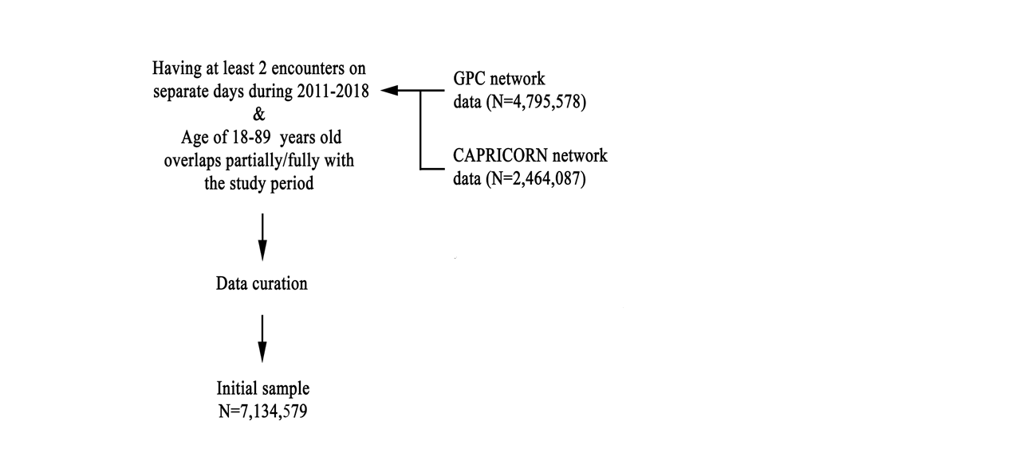
Data collection workflow
Proportion of patients who are new to the system, newly diabetic,* or with new diabetes medication prescriptions from lowest two deprivation quintiles
*Using a modified Supreme-DM definition

Slide 8
Baseline (2011-2013) characteristics of samples
 | 55-64 | 65-74
Total new patients | 387,210 | 260,204
Sex: % female | 53.3 | 52.3
Race: % white | 73.7 | 79.8
Race: % black | 6.1 | 4.4
Race: % Asian | 1.3 | 1.4
Race: % mixed | 0.2 | 0.2
Race: % missing | 7.5 | 7.9
Ethnicity: % Hispanic | 3.9 | 3.0
Ethnicity: % missing | 29 | 29.5
 | 55-64 | 65-74
Total newly detected diabetes | 59,626 | 52,848
Sex: % female | 46.7 | 46.3
Race: % white | 79.7 | 82.9
Race: % black | 10.7 | 7.6
Race: % Asian | 2.0 | 2.0
Race: % mixed | 0.4 | 0.4
Race: % missing | 7.3 | 7.1
Ethnicity: % Hispanic | 6.7 | 4.7
Ethnicity: % missing | 27.1 | 27.4
 | 55-64 | 65-74
Total with diabetes prescriptions | 34,831 | 32,252
Sex: % female | 51.0 | 49.9
Race: % white | 62.0 | 59.9
Race: % black | 15.7 | 11
Race: % Asian | 1.7 | 1.6
Race: % mixed | 0.3 | 0.3
Race: % missing | 6.1 | 5.2
Ethnicity: % Hispanic | 5.4 | 4.1
Ethnicity: % missing | 21.5 | 19.7

Slide 9
Age discontinuity + DiD
$$Y_{st}=θ_{State}+λ_{t}+β_{0}+β_{1}∗Young_{st}+δ\left(Post_{t}∙Young_{st}\right)+ε_{it}$$
Y is proportion pf patients [within age range] with [outcome], from poor tracts
θ_{s} are the state fixed effects (FE)
λ_{t} are the year FE
β₀ is a constant term
Young is a treatment (young) group dummy (= 1 if under 65, 0 if over 65)
Post is dummy variable for ACA expansion (=1 for 2014-2018; 0 for 2011-2013)
δ is the treatment effect, which captures the ACA effect on the outcome.

Slide 10
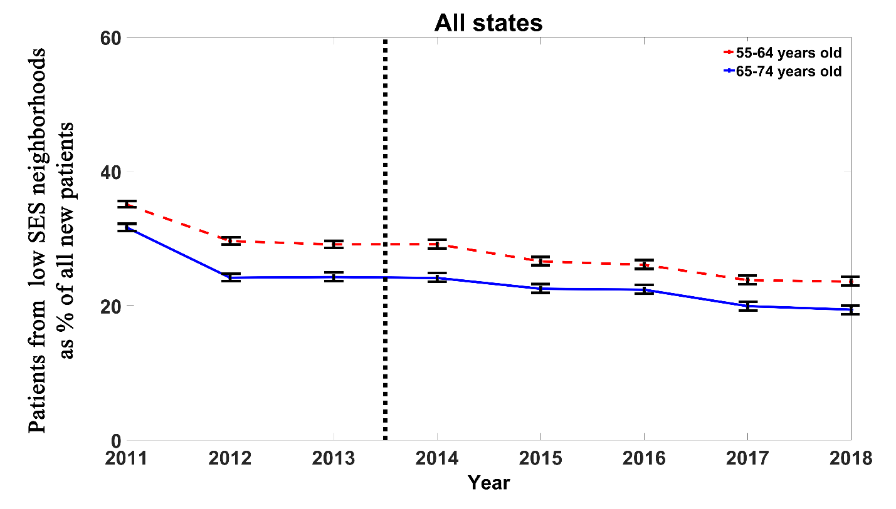
Outcome measure: New patients

Slide 11
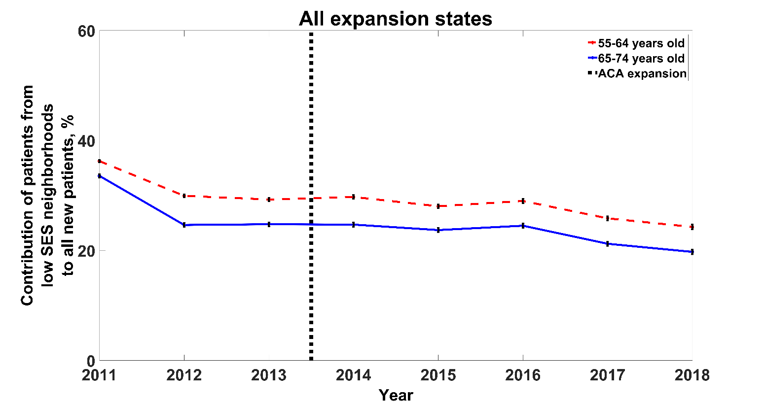
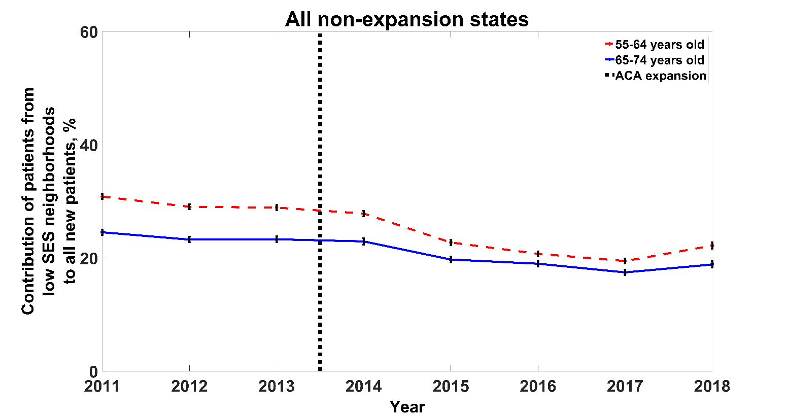
Outcome measure: New patients expansion vs. non-expansion states

Slide 12
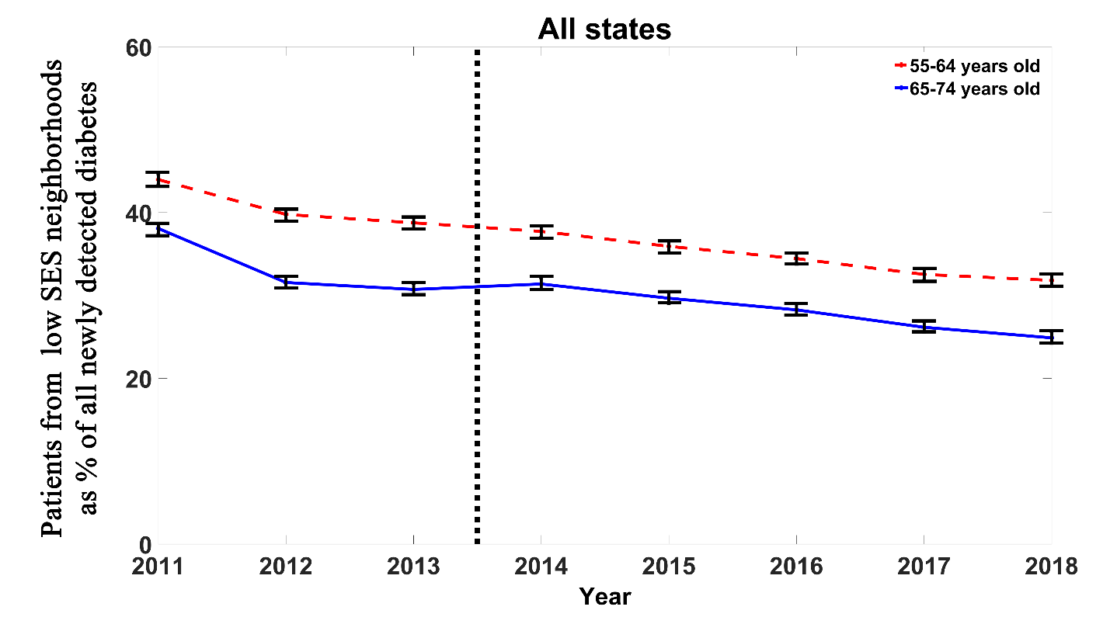
Outcome measure: Newly diagnosed diabetes

Slide 13
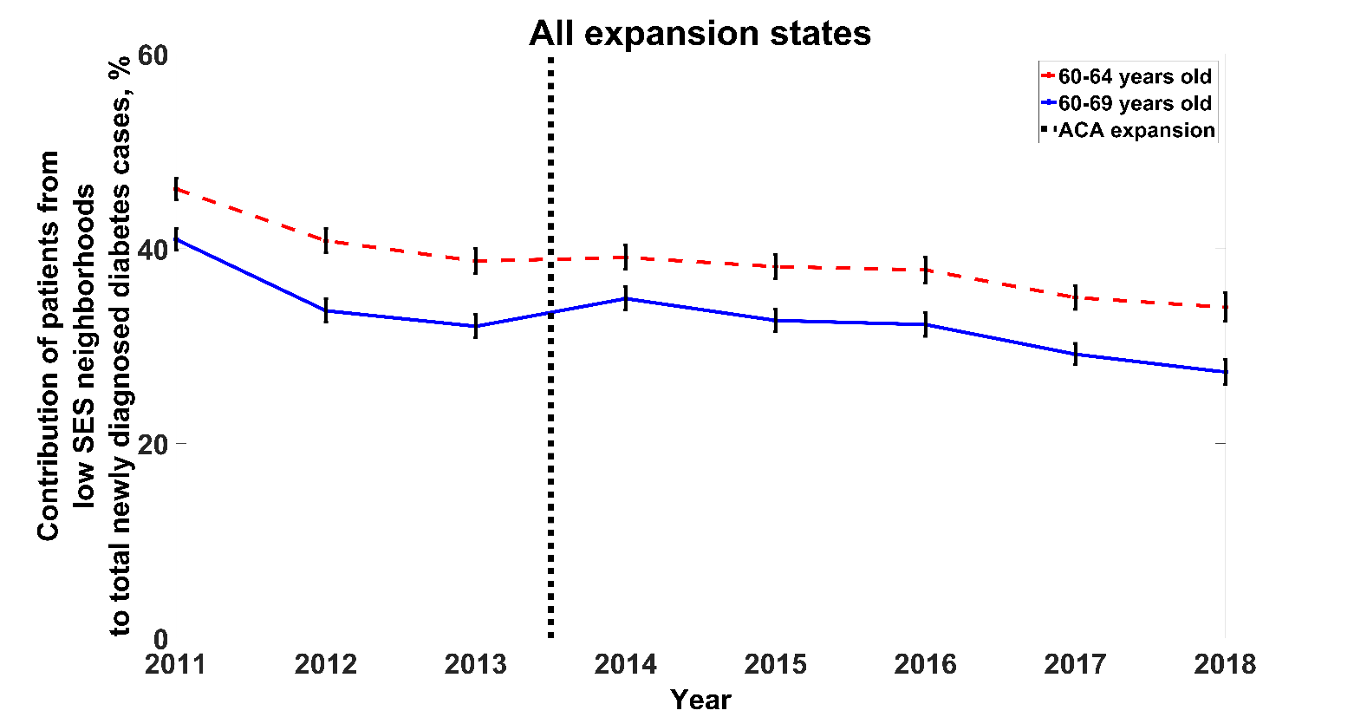
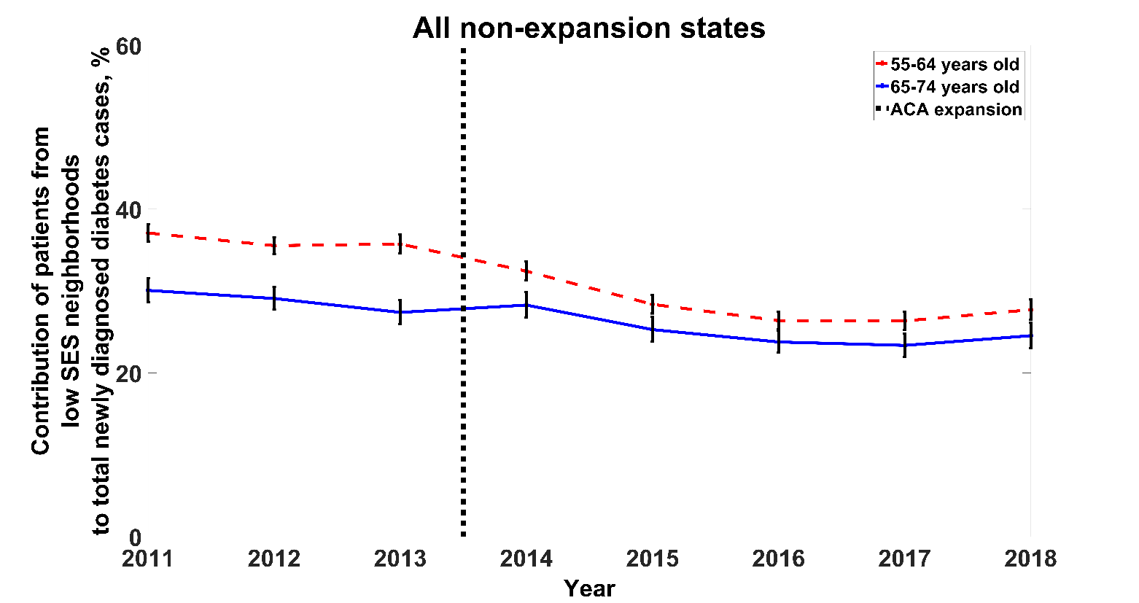
Outcome measure: Newly diagnosed diabetes expansion vs. non-expansion states

Slide 14
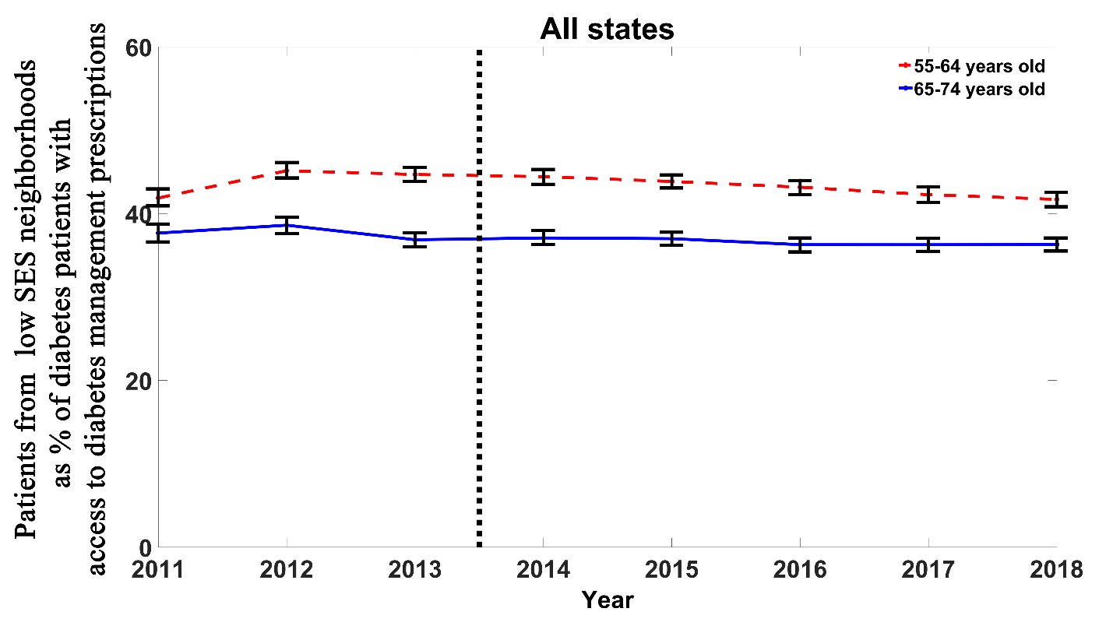
Outcome measure: Prescription of diabetes medications

Slide 15
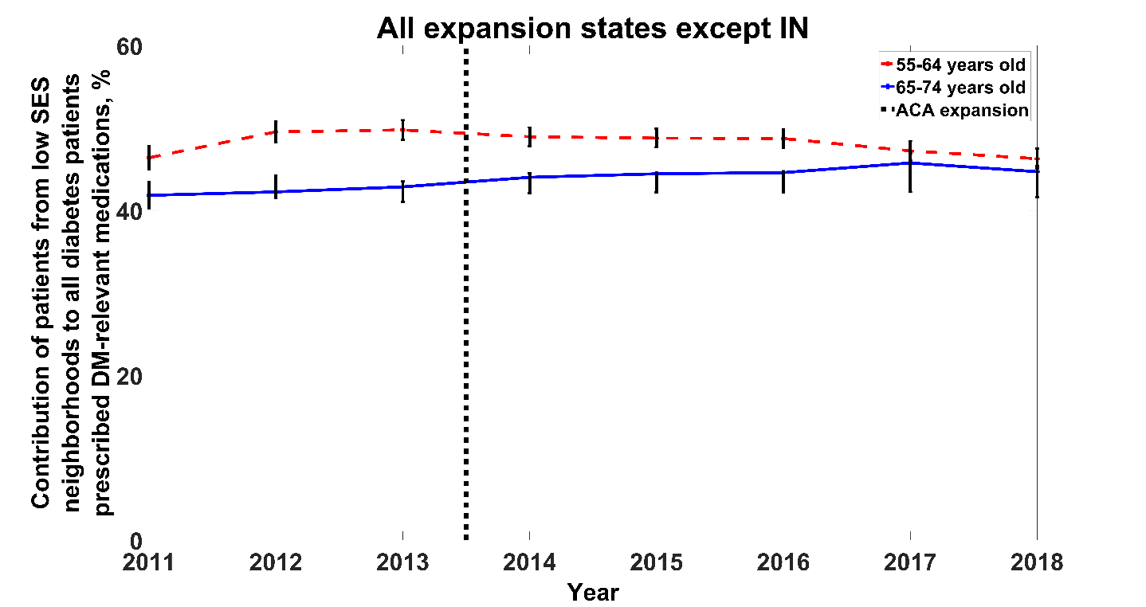
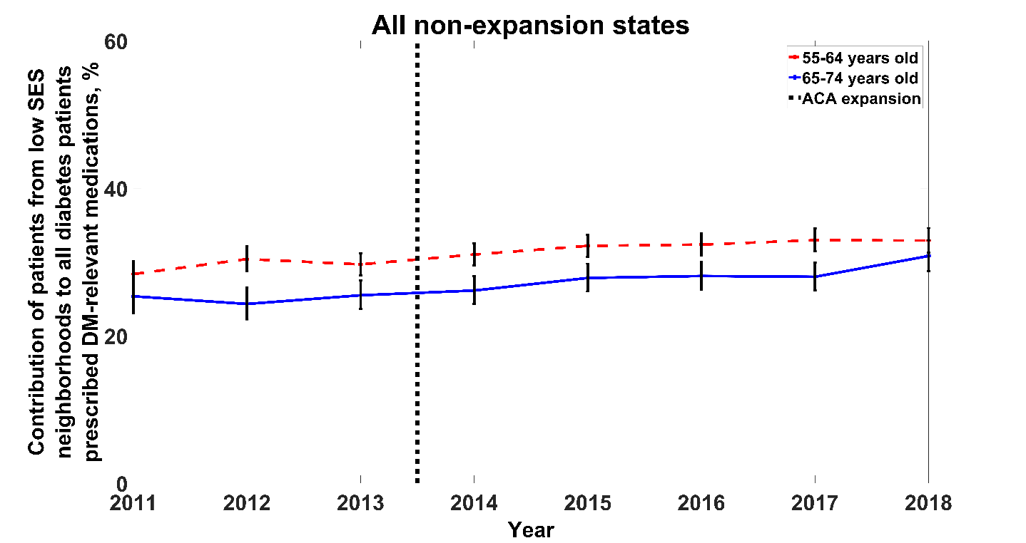
Outcome measure: Prescription of medications expansion vs. non-expansion states

Slide 16
Principal findings
 | new patients |  | newly detected diabetes | diabetes patients receiving diabetes prescriptions
Panel A. Broad age band: 55-74
DiD estimate (95% CI) |  | -0.63 (-2.85 to 1.58) | -0.72 (-3.22 to 1.77) | 0.21 (-2.10 to 2.52)
Robust Std. Err. |  | 1.12 | 1.26 | 1.17
p - value |  | 0.57 | 0.57 | 0.86
Sample size |  | 1,456,034 | 262,372 | 72,499
Panel B. Narrow age band: 60-69
DiD estimate (95% CI) |  | -0.47 (-2.55 to 1.60) | -1.28 (-3.79 to 1.23) | 0.54 (-2.00 to 3.07)
Robust Std. Err. |  | 1.05 | 1.27 | 1.28
p – value |  | 0.65 | 0.31 | 0.68
Sample size |  | 750,551 | 141,031 | 49,115

Slide 17
Limitations of the study
Unavailability of individual level insurance or income information
Relying on aggregate results for all persons living in low-SES tracts, rather than individual data
Race and ethnicity was not included into model. We judged that given the low percentage of minorities in our sample, and the overall lack of evidence for a significant effect of the ACA on our outcomes, subsample analysis would not be promising
Incomplete capture of medications.
Data on prescriptions written, not fills
Study visits to major academic health centers, not representative

Slide 18
Principal Findings
Compared with non-ACA states we observed no significant difference in new patients, new diabetics or new diabetes medication prescriptions.
Further analyses underway
Specific diabetes meds (e.g. newer classes)
Overall guideline compliant care (such as foot/eye exams)
Rates for major diabetes complications
Next-D3 – Medicaid effects

Slide 19
PREVENT-D
Post ACA Reform: Evaluation of community health center care of diabetes
PI: N Huguet
Co-Is: J DeVoe, H Angier, C Gallia, R Gold, J McConnell, M Marino, A Suchocki, S Lindner
Notes:
PREVENT-D is the project from OHSU team.

Slide 20
Specific Aims
Compare pre-post Affordable Care Act (ACA) Medicaid expansion among patients with diabetes or pre-diabetes:
We aim to assess compare changes by expansion/non-expansion state or insurance status (gained insurance, uninsured, continuously insured) on:
Access to care
Health care utilization
Preventive services receipt
DM biomarkers
Medicaid expenditures
Notes:
The goal of the PREVENT-D project is to assess the impact of ACA Medicaid expansion on several outcomes
The team looked at changes in visit rate by payer mix, types of visit, receipt of preventive services, impact on biomarkers by assessing improvement in HbA1c, and lastly changes in medicaid expenditures
They compare these outcomes in states that expanded Medicaid to those that did not and also looked at patient who gained insurance relative to those continuously insured or uninsured

Slide 21
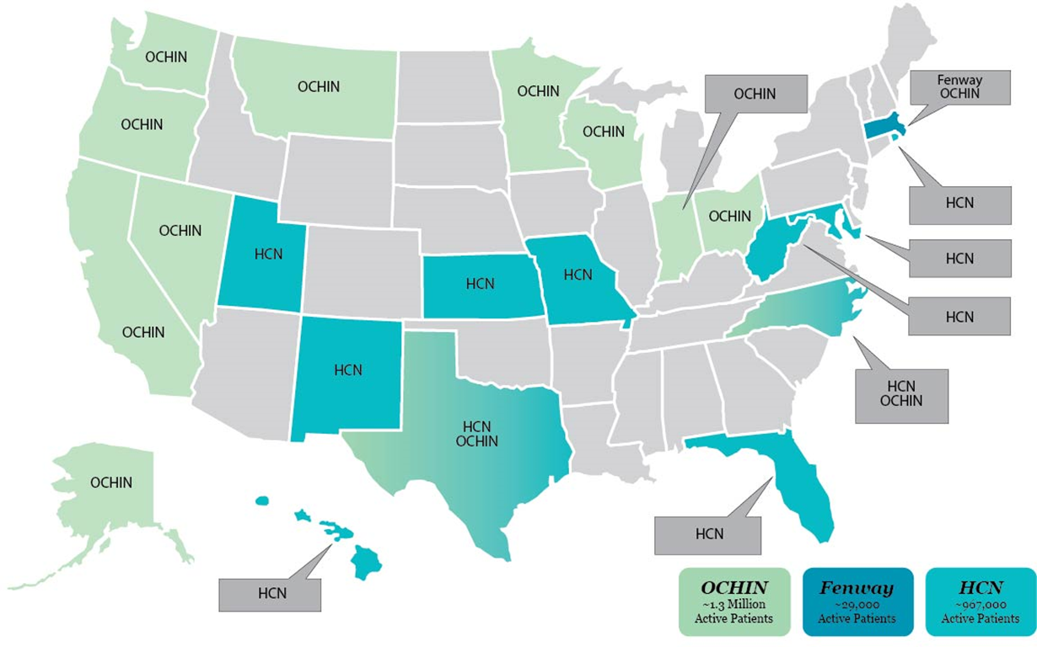
Datasets
ADVANCE (covering national CHC network)
Accelerating Data Value Across a National Community Health Center Network
A PCORnet Clinical Data Research Network (CDRN) of CHCs in 23 states
Aggregate patient-level data from 1,194 community health centers (CHCs) in 12 Medicaid expansion states and 1,001 CHCs in 11 non-expansion states
Oregon Medicaid administrative claims
Notes:
OHSU team used electronic health record data from the ADVANCE network which is one of the PCORnet CDRN and includes thousand of community health center across the nations. The map shows the different states in which clinics are located in the ADVANCE data
Community health centers provide care to underserved patients. They have a large proportion of patients with low income and and minority patients.
We also use oregon medicaid claims data to measure changes in expenditures

Slide 22
Payer mix and percent of patient with diabetes
Fig 2. Percent of patients with DM (uninsured pre-ACA)
NON-EXPANSION
EXPANSION
High rate of patients with DM uninsured pre-ACA
DM prevalence among previously uninsured increased by 20%
Large decrease in uninsured visits
Medicaid visits increased in expansion states
Private insurance increased in non-expansion states
NON-EXPANSION
EXPANSION
Source: Huguet N, et al. The impact of the Affordable Care Act Medicaid expansion on visit rates for diabetes in safety net health centers. JABFM. 2018;31:905-916; Huguet N, et al. Prevalence of Pre-existing Conditions Among Community Health Center Patients Before and After the Affordable Care Act. JABFM. 2019; 32:883-889.
Notes:
With these data, they shown changes in payer mix.
Here in fig 1, they found that a large number of visits pre-ACA among these chronically ill patients were uninsured (yellow bar pre-aca) .
It shows a large increase in medicaid-visit in expansion state accompanied by a large decrease in unisnured visit.
We see a parallel trend in non-expansion with a big increase in privately paid visits but a smaller decrease in uninsured visit
overall it looks like there is greater improvement in exp state that in non-expansion states
Fig 2 show the change in the percent of patient with a diagnosis of DM in a cohort of uninsured patient during the pre-period who gained either Medicaid or private uninsured.
The data show an increase in the proportion of patient with DM post, suggesting about 20% of these previously uninsured patient were likely patient with undiagnosed diabetes
[Abel: Figure 2: the orange pre bar is the % of uninsured patient in our CHCs that had DM, in the post: it is the same group, they gained Medicaid and they now have DM, so the rate of DM went from 14.3 to 17.6, which is a 20% increase. Figure 2 is only among patient who had no insurance prior to the ACA and then gained insurance post.]

Slide 23
Payer mix by race and ethnicity
*
*
*
*
*
*
*
*
*
Pre-ACA
Post-ACA
Pre-ACA
Post-ACA
Pre-ACA
Post-ACA
Pre-ACA
Post-ACA
Non-Expansion
Expansion
Non-Expansion
Expansion
* Statistically significant <p.05 difference from pre- to post-ACA
Medicaid visits increased in all groups in expansion states
Smallest change in uninsured visit rate in Hispanic patients
Parity in privately insured visits across the groups in non-expansion states
Pre-ACA
Post-ACA
Pre-ACA
Post-ACA
Non-Expansion
Expansion
Source: Angier et al. Racial/Ethnic Disparities in Health Insurance and Differences in Visit Type for a Population of Patients with Diabetes after Medicaid Expansion. Journal of health care for the poor and underserved, 2019; 30:116-130.
Notes:
The OHSU team assessed whether the positive changed in insured visits reduced racial and ethnic disparities.
In this study they observed a similar trend as in the previous slide: that is for all racial/ethnic groups, they found an increase in medicaid visit in expansion states, a rise in privately insured visit in non-expansion states, and a decrease in uninsured visits.
We do see however, that hispanic patient (yellow bar) had smaller change in uninsured visit than the other group, especially in expansion states.
Importantly, We see a near parity across groups in term of medicaid visit in expansion states and privately insured visit in non-expansion suggesting a reduction in access disparities.

Slide 24
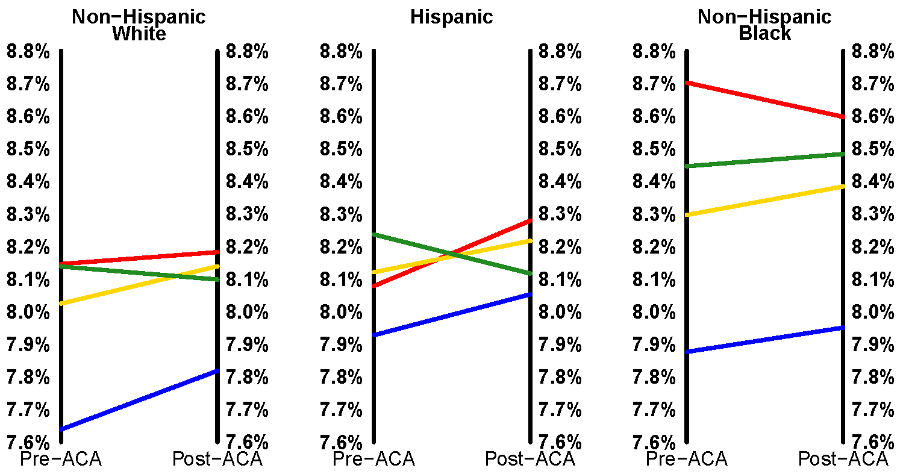
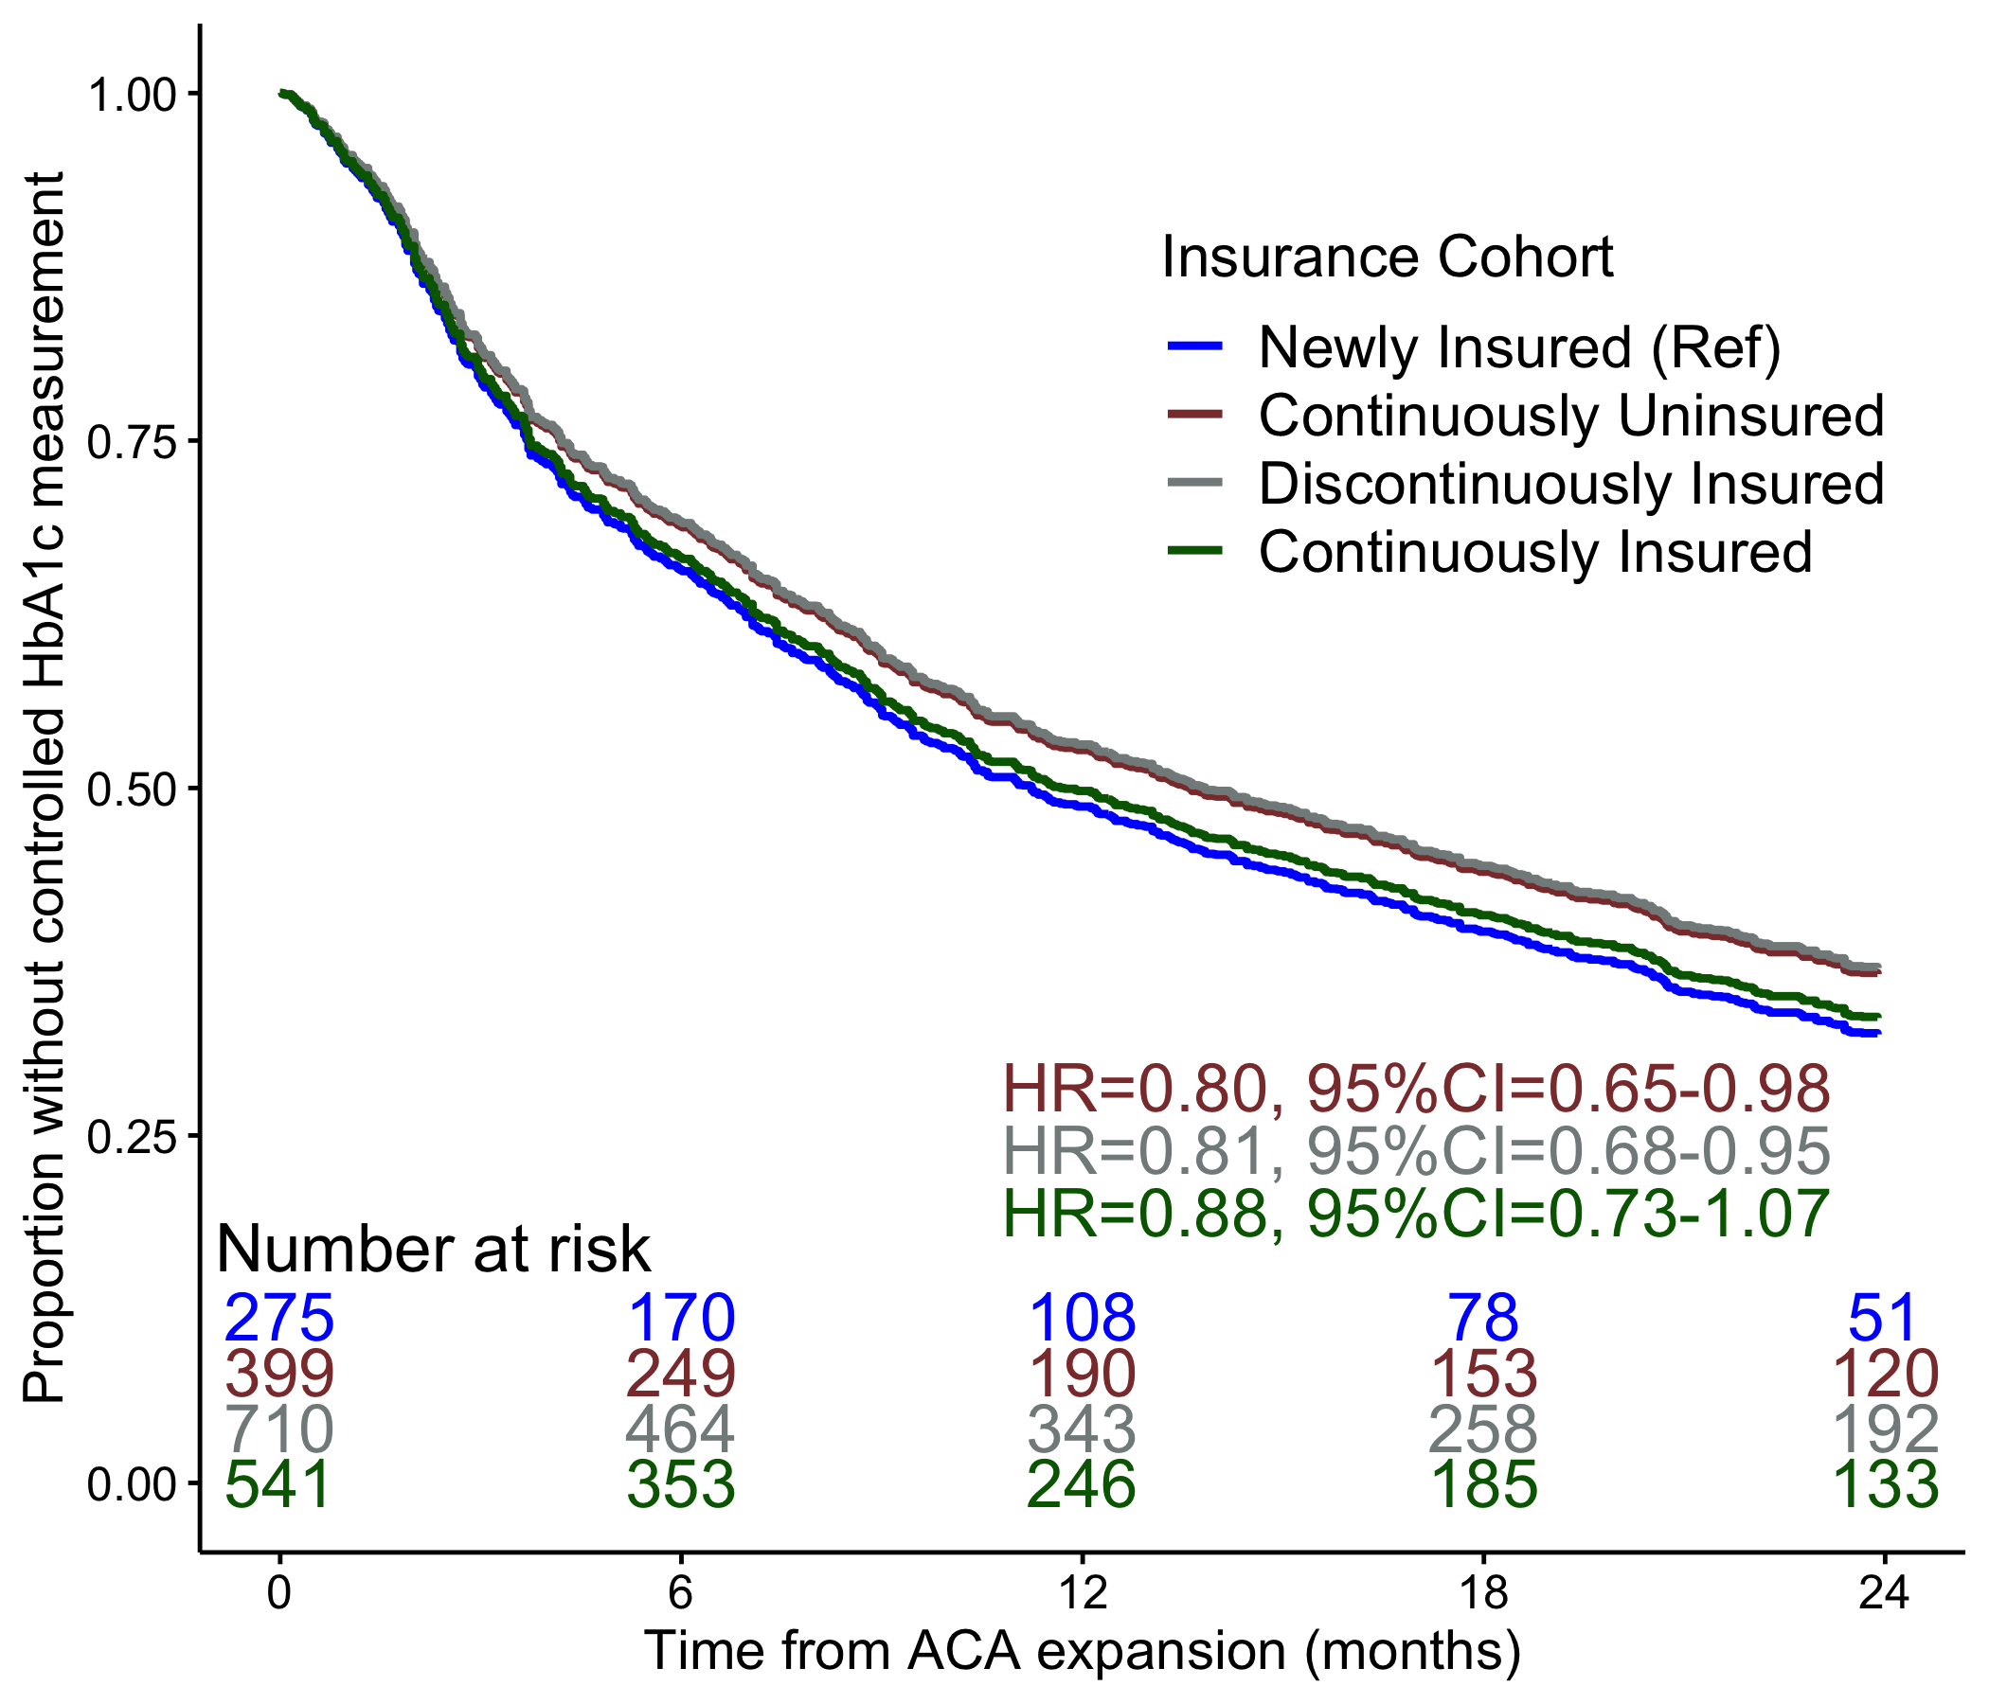
Newly insured patients improve most on diabetic biomarkers
Fig 1. Time from elevated HbA1c within 3 month pre-ACA expansion to a controlled measurement
Fig 2.Mean HbA1c measures by race/ethnicity
Better DM-related outcomes pre- to post-ACA in newly insured compared to other insurance groups
Newly insured Hispanic patients benefitted most with greatest improvement in HbA1c
The ACA impact varied by race and ethnicity
Source: Marino M. et al. The Affordable Care Act- Effects of Insurance on Diabetes Biomarkers. Diabetes Care, 2020: 43: 2074-2082. Marino M. et al. Disparities in biomarkers for patients with diabetes after the Affordable Care Act. Medical Care, 2020, 58 (suppl 6):S31-S39.
Notes:
The team also looked at improvement in A1cs.
IN figure 1: they look at time from an elevated A1c (≥9) identified 3 month pre-ACA to a controlled (<9) measurement within 24 months post ACA by insurance cohort among patients receiving care in clinics located in expansion states. Insurance cohort here are defined as newly insured: all pre-visit were uninsured all post-visit are insured’ continuously insured: all visits are insured in both periods; continuously uninsured: all visits are uninsured in both period; and discontinuously insured: churning in and out of insurance
They found that the greatest proportion of patient with controlled DM at 24 months was among newly insured group. Also found, as seen in Figure 1, that the newly insured had faster time to control than continuously or discontinuously insured patients. Findings suggest that health insurance gain was associated with improvements in diabetes-related biomarkers.
They also compared the change in average A1c pre to Post-ACA by race and ethnicity for each insurance cohort. They found that improvement in a1c by insurance cohort vary by race and ethnicity: Newly insured Hispanic (green line) had the greatest decline in a1c.
The bottom line is that newly insured group improved A1c following the ACA

Slide 25
Conclusions
CHC patients have better access to insurance and diagnosis post-ACA
Newly insured patients improve on diabetic biomarkers
Race/ethnicity impacts access to insurance and biomarker outcomes
Many CHC patients (especially ethnic minorities) remain uninsured
CHC continue to provide quality care for uninsured patients
PREVENT-D Team
Contact PI | Nathalie Huguet, PhD, Assistant Professor, Department of Family Medicine, OHSU, e-mail: huguetn@ohsu.edu
OHSU Family Medicine | CO-Is: Jen DeVoe, Heather Angier, Miguel Marino Biostat: David Ezekiel-Herrera, Jean O’Malley, Jorge Kaufmann, Rachel Springer PM: Heather Holderness, Irina Chamine
OCHIN | Site PI: Megan Hoopes Biostat: Teresa Schmidt, Annie Larson PM/Research Coordination: Nate Warren, William Pinnock
Other Co-Is, Stakeholders | Co-Is: Rachel Gold, KPNW; John McConnell, OHSU; Stephan Lindner, OHSU; Co-I, Community MD: Andrew Suchocki
Notes:
In conclusion:
The team work (not all presented here) found that [just read the bullets ☺
The OHSU team is a big team and the PI wants to acknowledge the collaborative work from this large team.

Slide 26
Summary
Northwestern
OCHIN
Academic Medical Centers
Midwest
4 Exp vs 4 non-exp
Focus on ages 55-64
No significant difference in new patients, new diabetics or new diabetes medication prescriptions.
Community Health Centers
National
12 exp vs 11 non-exp
Average age < 50
Increase in visits with insurance and newly insured with slight increase in diabetes control measures

Slide 27
Thank you! Questions?

