Slide 1
Translation: Connecting Research with Community Site and Network Level Engagement Approaches to Enhance Patient-Centeredness in Natural Experiments
Jennifer L. Kraschnewski, MD, MPH and Victoria L. Mayer, MD, MS
September 24, 2020

Slide 2
Topic Outline
Overview of Engagement Governance
Site and Network Level Activities
Mechanisms for Lay Dissemination
Engagement Impact

Slide 3
Engagement Committee Governance
Opportunity for monthly sharing of site level engagement activities and lessons learned across the NEXT-D2 network
PCORI’s Engagement Rubric as framework to guide engagement activities
Network level engagement projects identified and facilitated by committee

Slide 4
PCORI Engagement Principles
Co-learning
Partnerships
Reciprocal Relationships
Transparency, Honesty, Trust
Source: https://www.pcori.org/sites/default/files/Engagement-Rubric.pdf

Slide 5
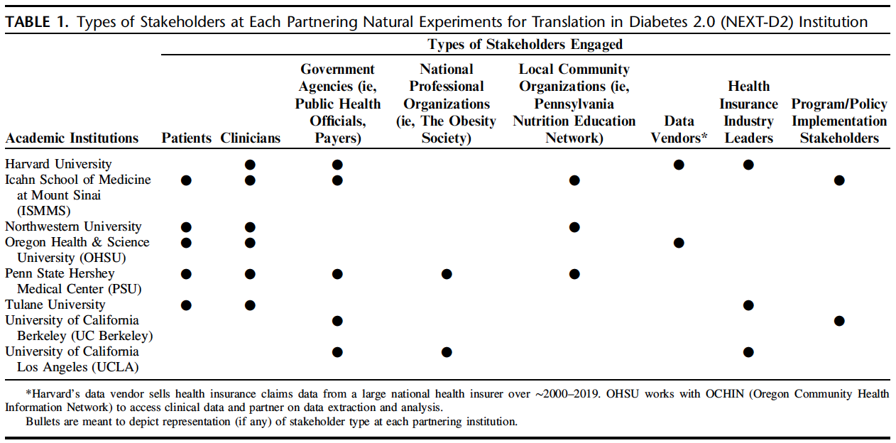
Broad Stakeholder Reach
Poger JM, Mayer V, Duru OK, Nauman B, Holderness H, Warren N, Vasquez C, Bibi S, Rasmussen-Torvik LJ, Hosseinian Z, Shi L, Wallace J, Goytia CN, Horowitz CR, Kraschnewski JL. Natural Experiments for Translation in Diabetes 2.0 (NEXT-D2) Network Engagement In Action: Stakeholder Engagement Activities to Enhance Patient-Centeredness of Research. Med Care. 2020;58 Suppl 6 Suppl 1:S66-S74. doi:10.1097/MLR.0000000000001264

Slide 6
Recruitment Mechanisms
Site stakeholders recruited by:
Serving on other advisory boards
Participating in prior research studies
Collaborating with other CDRN’s
Clinician referrals

Slide 7
Key Engagement Activities
Poger JM, Mayer V, Duru OK, Nauman B, Holderness H, Warren N, Vasquez C, Bibi S, Rasmussen-Torvik LJ, Hosseinian Z, Shi L, Wallace J, Goytia CN, Horowitz CR, Kraschnewski JL. Natural Experiments for Translation in Diabetes 2.0 (NEXT-D2) Network Engagement In Action: Stakeholder Engagement Activities to Enhance Patient-Centeredness of Research. Med Care. 2020;58 Suppl 6 Suppl 1:S66-S74. doi:10.1097/MLR.0000000000001264

Slide 8
Site Level Stakeholder Meetings
Web-based
Provide study updates
Incorporate stakeholder expertise and patient lived experience into study decisions
Troubleshoot study challenges
Develop dissemination plans
Discuss policy implications

Slide 9
Meeting Frequency
Annual Meetings (all team members)
Quarterly (larger stakeholder meetings)
Monthly (typically with patient partners)
Address any points that require further clariﬁcation or gather additional input from patient partners that they may not have the opportunity or conﬁdence to share with the whole group.
One-time focus groups/interviews with partners

Slide 10
Proposal Development
Work with stakeholders at study conception to drive key decisions regarding:
Specific intervention or study design
Outcome measures
Prioritize implementation foci and strategies
Notes:
Examples:
-UCLA: Engagement with payer stakeholders at study conception was critical to identify the speciﬁc intervention targeting high-cost, high-need Medicaid beneﬁciaries for study as a natural experiment and provided preliminary insurance claims data to strengthen their proposal.
-Harvard: Began their engagement with study stakeholders during this initial research phase to facilitate buy-in from data partners whose expertise were critical to project success.
-PSU and ISMMS: sought feedback from patient partners on study aims during their proposal development, resulting in outcomes that were more patient-centered. For example, patient partners at PSU felt weight was just as important an outcome measure as A1c given it is both a strong predictor of diabetes and monitored regularly during diabetes management.
-ISSMS: Since the diabetes accelerator already existed at ISMMS, they were able to move swiftly to engage a transdisciplinary group in proposal development who already had mutual trust and respect, and were ready to contribute their diverse perspectives into the proposal. UC Berkeley engaged their advisory group in an expert panel process to prioritize implementation foci and strategies by SIM states that would have the most (or the greatest/most signiﬁcant) impact on patient outcomes.
-Tulane: Stakeholders encouraged the research team to investigate not just exposure to chronic care management services, but also the content of such services during proposal development. This additional focus was incorporated into the qualitative research plan for the project.

Slide 11
Trainings & Educational Opportunities
Onboarding
Intro to research, roles/responsibilities, importance of engagement
Research training
Just-In-Time research trainings to prepare stakeholders for upcoming research phase (i.e. data analysis)
Relationship-building opportunities
Networking with other studies, pre-conference meals
Notes:
Examples:
ONBOARDING:
-Northwestern: engaged patients and other stakeholders in an onboarding process that included introductory meetings, the importance of stakeholder engagement, and an operations manual for their advisory committee.
-PSU: Met with patient partners during onboarding to outline study objectives and identify their role(s) throughout the project.
-ISSMS & PSU: For investigators with limited experience in stakeholder-engaged research, provide trainings on how to effectively conduct patient-centered research.
TRAINING:
-PSU and OHSU: offer patient partners timely study-related trainings based on selected topics of interest to prepare them for the current research phase (eg, data extraction, data analysis, dissemination). PSU applies adult learning principles to their training programs; created for the adult learner, content is presented in short (15–20min), interactive segments that include group discussion, scenarios, and role-play to encourage meaningful discussion and enhance knowledge acquisition.

Slide 12
Data Analysis
Troubleshoot data issues
Prioritize analysis plan
Engage clinician stakeholders in interpreting data and providing key clinical guidance
Policy and payer stakeholders provide formative feedback
Notes:
Examples:
-PSU: patient partners conducted a review of patient-reported outcomes collected at institutions within the CDRN and offered feedback on which measures they felt were most important to include during study analyses based on their lived experience (ie, they emphasized the strong link between heart health and diabetes and, therefore, encouraged the inclusion of cardiovascular self-report measures in secondary analyses).
-OHSU: engages a clinician stakeholder in interpreting study data and providing key clinical guidance to several project manuscripts, including interpretation of data, methods, and outcomes from their perspective as Medical Director of a County Public Health Department.
-UC Berkeley: Public health ofﬁcials and payers as well as program/policy implementation stakeholders provide formative feedback, assess the face validity of research results, and aid in the interpretation of quantitative results focused on hospitalization rates, 30-day readmissions, and behavioral health outcomes. The expert panel was integral to the creation of their taxonomy used to classify SIM implementation variation. Using a 3-round modiﬁed Delphi expert panel process, they asked stakeholders to rank the most important factors that differentiate SIM states with respect to implementation and outcomes. The process resulted in criteria used to create a taxonomy of state SIM implementation based on emphasis on behavioral health in payment and delivery system reforms, multipayer alignment and depth of testing of value-based payment reforms, and SIM funding per capita.
-ISSMS: A health system stakeholder at ISMMS who serves on the advisory board for the Health Home (the program under study) was able to provide critical insight into the meaning of variables present in administrative datasets and point out insightful interpretation of the data.
-Tulane: When preliminary analyses at Tulane revealed that some patients receiving non–face-to-face care coordination services for chronic care management had good glycemic control even before receiving the services, their patient partners encouraged the research team to explore whether this approach helped with glycemic control speciﬁcally for those with elevated A1c before receiving services. The patient partners were particularly interested in how the program impacts those who need help with their diabetes. As a result of this input, the research team conducted subgroup analyses focusing on patients with poor glycemic control a priori.

Slide 13
Study Results Dissemination
Leverage network connections and partner with stakeholders to:
Co-author manuscripts
Co-present at local, regional, & national conferences
Connect at community outreach events
Develop and distribute lay public dissemination resources
Notes:
Examples:
-PSU, OHSU, UC Berkeley: encouraged and facilitated stakeholder participation in scientiﬁc manuscript co-authorship and conference presentations as well as community-facing platforms (ie, Web sites, interviews, blogs).
-OHSU: Patient and clinician stakeholders at OHSU work with study staff to attend key project meetings with the study team, participate as coauthors in manuscripts, and disseminate study ﬁndings to clinicians, patient advocates and policy groups.
-OHSU, PSU, and ISMMS: leverage clinician stakeholder expertise to offer important insight in how study ﬁndings can be effectively disseminated to patient and clinician populations, as well as other relevant platforms from a clinical perspective.
-PSU: Patient partners contribute to the development and dissemination of study newsletters and a patient-facing study Web site to increase access to study resources and updates. Finally, study stakeholders from relevant government and professional organizations are well-positioned to transfer study ﬁndings into action through legislation or improved practice.
-UCLA: dissemination of study results to stakeholders had the additional beneﬁt of resulting in future research opportunities. Speciﬁcally, their stakeholder was appreciative of the analyses and, as a result, offered the opportunity for the team to evaluate 2 similar programs.

Slide 14
Engagement Evaluations
Qualitative “check-ins”
Yearly quantitative evaluations
360-degree Engagement Assessment Tool
Results from evaluations strengthen engagement processes.
Notes:
Examples:
-PSU: offers opportunities for the evaluation of engagement efforts twice each project period; a qualitative interview conducted by a nonteam member (1:1 with patient partners, group interview with other study stakeholders) to elucidate how successfully the research team has incorporated their voice and expertise and a quantitative evaluation to shed light on engagement activities that were most meaningful to partners and prioritize activities they are most interested in participating in the next project period.
-ISMMS: engagement coordinator facilitates periodic check-ins with board members to gain their feedback on activities.
-Tulane: uses a 360-degree Engagement Assessment Tool to optimize engagement based on the PCOR Engagement Principles. The evaluation is administered to all investigators and study stakeholders and used to create an anonymous report that highlights strengths and weaknesses in relationships between stakeholders and the research team.
Strengthen processes: At PSU, a patient partner offered that she would like more time to connect with the investigative team as monthly meetings are led by the engagement coordinator only. To address this feedback, patient partners now meet quarterly with study investigators to engage in both study operations and engagement activity discussions.

Slide 15
PaTH to Health: Diabetes Patient Partner Check-Ins
“The knowledge that I've gained listening into the calls and the experiences that they share, I can go and share that with other people that I know to get them engaged and become proactive in their health and wellness.”
“The video we did on how the data is processed was awesome because it helps us and others understand how patient health data is used in research and how it's protected.”
“Diabetes is an important topic not only in my life but also my family members so it's important to me because I'm able to contribute my time and do what I can to help out with the program. It adds value and purpose in what I do, in my life.”
“Whatever we’re working on and whatever you may want to put your voice or your opinion to, they take all of that. They listen to what you’re saying. We do have a voice in the project. It’s not just that you’re there. They take heed to what you’re saying and put your input towards the research.”

Slide 16
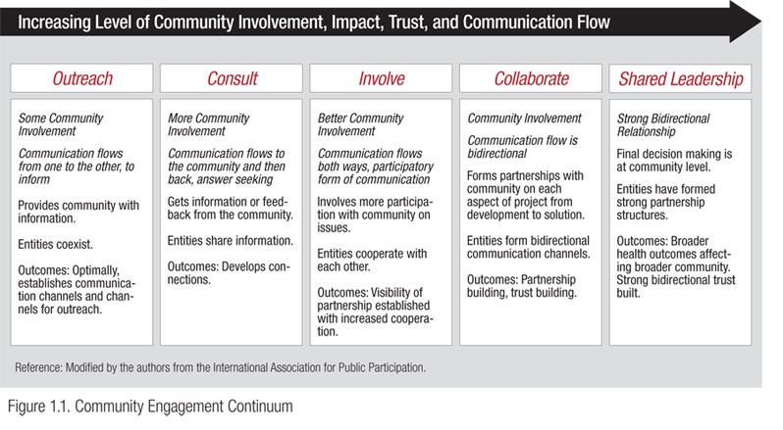
Tulane’s 360 Assessment
Which level of the engagement continuum do you believe the LEAD study is operating in?
Notes:
Study results: 2.6 (in between consult and involve)
Outreach=1
Consult=2
Involve=3
Collaborate=4
Shared Leadership=5
Stakeholders would like to move from consult to involve. Can accomplish by:
Structure of Meeting Times
Time &Dates
Face to Face v Calls
Communication
Specific requests for feedback from each stakeholder group
Ensure understanding of the study and terminology

Slide 17
Network Level Activities
Monthly study meetings for resource sharing and enhancing site level approaches in real-time, supportive environment
Leverage broad stakeholder feedback to advance network-wide engagement activities
NEXT-D2 Central Coordinating Center (CCC) network-wide meetings
Engagement with site stakeholders, health policy and program leaders
Notes:
Examples:
PSU shared their community research ethics training with other interested sites to use as well, minimizing duplicative efforts and increasing uptake of effective resources.
Sites also beneﬁt by learning through others’ experiences overcoming engagement barriers in real-time and through supportive feedback.

Slide 18
NEXT-D2 Whiteboard Video
English: https://youtu.be/hd9w4jJwW3g; Spanish: https://youtu.be/vrYPOeae6A0

Slide 19
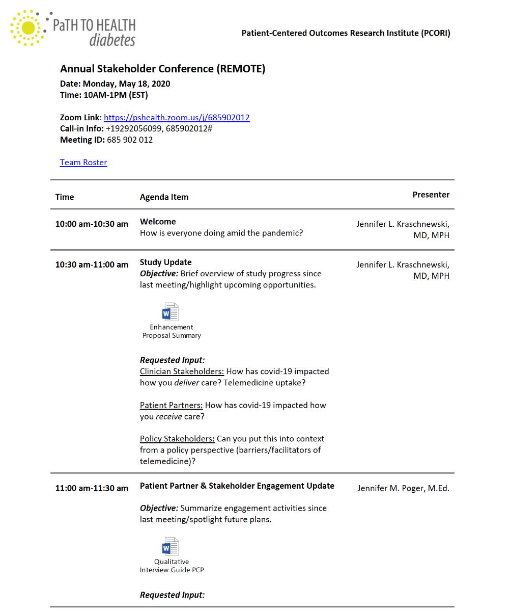
Resource Sharing
Just-In-Time partner training materials disseminated across sites
Targeted Stakeholder Agendas
Network level lay briefs

Slide 20
Vehicles for Lay Dissemination
Study newsletters
Mid-quarter correspondence
Lay public abstracts
Dissemination briefs

Slide 21
Mid-Quarter Correspondence
Provide stakeholders with mid-quarter refresher on study updates and look ahead at future milestones.

Slide 22
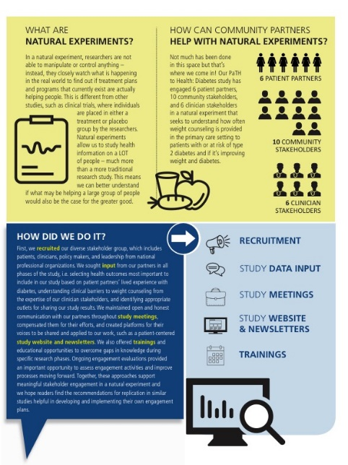
Lay Public Dissemination Briefs
Co-created by stakeholder partners.
Developed for a general audience to broadly disseminate published results.

Slide 23
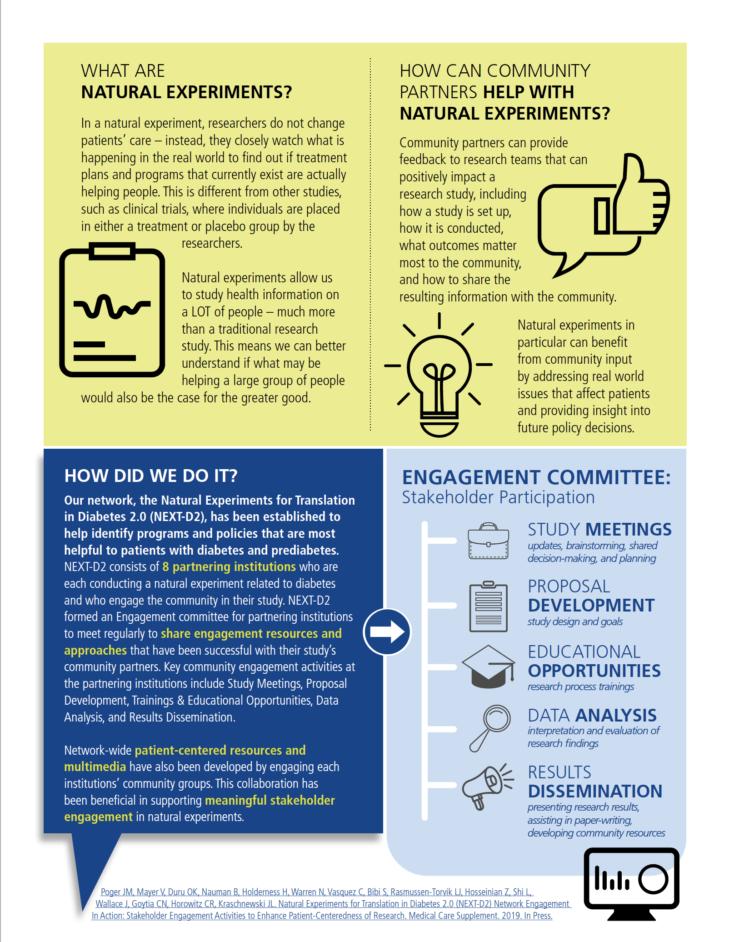
Lay Public Dissemination Briefs
Resources, including lay dissemination briefs are available on the PaTH to Health: Diabetes website
https://pathdiabetes.org/happenings/presentations/

Slide 24
Engagement Impact
Improved communication
Varied frequency of study meetings based on stakeholder role
Increased opportunities for engagement
Connecting stakeholders across studies and networks
Enhanced contributions after having attended research training(s)
Evaluative feedback inform future engagement activities
Notes:
How PaTH to Health: Diabetes study improved based on stakeholder feedback – from a clinician standpoint, understanding their barriers to IBT implementation helped explain/support the low uptake we were seeing from our preliminary analyses. It was at one of our stakeholder meetings that the idea of the qualitative interviews came up as a way to understand how providers overcome barriers to implementation. From a patient partner perspective, having patient partners engage with the community was invaluable in being able to communicate a natural experiment to a lay audience. Patient partner Angie did a great job getting patients excited about our work and signing them up to receive our study resources (website, newsletters).

Slide 25
Thank you!
Contact:
Jkraschnewski@pennstatehealth.psu.edu
Victoria.mayer@mountsinai.org

