Slide 1
Natural Experiments Examining Social Risk Factors among Adults with Diabetes

Slide 2
Social Risk Factors & Diabetes
Diabetes outcomes & antecedents are impacted by social-ecological factors, i.e. education, economic stability, food security, built environment, social & community support (American Diabetes Association, 2017; Clark & Utz, 2014).
Clinical guidelines encourage providers to screen for social risk factors and use information to adjust treatment (American Diabetes Association, 2017).
Rates of screening for social risks remain low (Fraze et al. 2019).

Slide 3
NEXT-D2 Social Risk Factor Research Examples
Mt. Sinai: How Health Home program implementation in NYC impacts patients’ experiences of social risk assessment and management
UCLA: Whether a Care Coordination Organization intervention for high cost patients is associated with reduced utilization and whether adults with diabetes with more unmet social needs have greater utilization.
Berkeley: Whether the CMS State Innovation Models Initiative, which implemented state-based delivery system and payment reforms, was associated with greater assessment of social risk factors among hospitalized adults with diabetes

Slide 4
Barriers to Addressing Social Risk Factors
No financial incentive to screen and code for social risks (Lewis et al., 2016; Torres et al., 2017).
Clinicians are hesitant to screen when they cannot link patients to appropriate services (Garg et al., 2016).
Documenting social risk factors in EHRs is difficult and confusing (Freij et al., 2019; Olson et al., 2019).

Slide 5
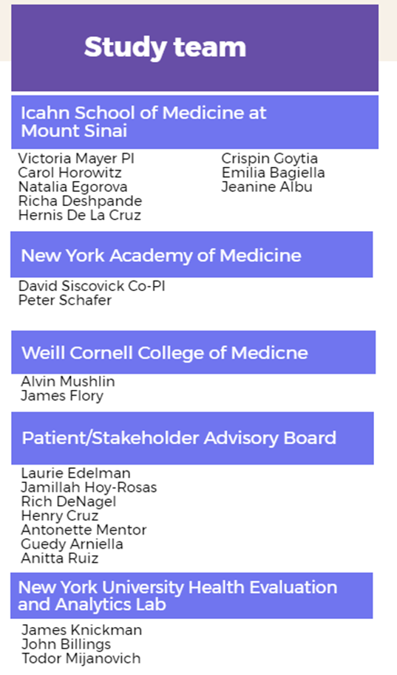
The Impact of Medicaid Health Homes on Patients with Diabetes
Research reported in this presentation was funded through a Patient-Centered Outcomes Research Institute (PCORI) Award (NEN-1508-32252).
Michele Calvo

Slide 6
Background, approach
Among adult patients insured by Medicaid with clinical diabetes in New York City, we aim to assess the impact of Medicaid Health Homes on process of care, health outcomes, and racial and ethnic disparities.
Mixed-methods approach
Natural experiment methods
Qualitative methods
Focus groups and interviews with Medicaid patients
Describe challenges to good health and diabetes management
Explore experiences with the Health Home program
Patient/Stakeholder Advisory Board involvement
Notes:
Spoke with 63 people
31 Health Home members
10 focus groups, 23 individual interviews
Worked with Patient/Stakeholder Advisory Board to develop discussion guide
Spoke with 63 people
31 Health Home members
10 focus groups, 23 individual interviews

Slide 7
Results: cross-cutting themes related to social determinants of health
Theme | Illustrative quotations
Access to care | “So the challenge was to me was my appointments … I have so much appointments that I forget and then in that morning I’m like, did I go? … The social worker is helping me with that now… she will give me a calendar of all my appointments … I go here every day and look at the refrigerator.”
Nonmedical challenges | “[My care manager] did it to where she’s trying to benefit me, so that I can be stable, not just medically, but financially, home wise, family.”
Support | “I feel more comfortable because I’m not alone anymore …. [my care manager’s] very concerned about my life …. And that makes me happy because it helps me.”
Notes:
More examples of nonmedical challenges: HH care managers help members:
Facilitate communication, interpretation
Accompany members to nonmedical appointments (e.g., court proceedings, social service agencies)
Secure transportation
Set up home health aides
Housing
Entitlement applications

Slide 8
UCLA: Associations of Greater Social Needs and Barriers to Care with Higher Utilization among CCO Beneficiaries
A subset of Care Coordination Organization (CCO) beneficiaries (n=18,243) completed Health Risk Assessments (HRA) at program intake
The UCLA team created a Barriers to Care index (7 items) and Social Needs index (4 items) from the HRA
Higher scores on both indices were significantly associated with greater ED and hospital utilization
Several individual items had strong associations with increased utilization
Barriers to Care: Not knowing PCP, not able to access PCP, no reliable transportation
Social Needs: Going without housing in last year, going without food in last year

Slide 9
UCLA: CCO for High-Cost, High-Need Medicaid Patients – Some Decreases in Utilization
The UCLA team evaluated a care coordination program integrating medical, behavioral, and social support for high-cost, high-need Medicaid beneficiaries (n=42,214) by targeting access barriers and social determinants.
Individual-level Interrupted time series with a contemporaneous comparator group, examining changes in 1) ED use and 2) hospitalizations
Findings at 12 months:
SSI – significantly fewer predicted ED visits among intervention sample (DID: -6.6%)
Expansion – significantly fewer predicted hospitalizations among intervention sample (DID: -5.8%)
TANF and Dual-Eligible – no significant differences in predicted ED visits and/or hospitalizations

Slide 10
UCLA: CCO Program Enrollment and Comparator Group Selection
The CCO was designed to enroll almost all high-need, high cost patients projected to be in the top 5% of spend over the next 12 months, defined as either:
1) exceeding a threshold “persistent superutilizer” score, or
2) admitted with a high-risk hospitalization
Using CCO-eligible, non-enrolled patients as comparators is prone to selection bias
Instead, we identified a comparator group of CCO-eligible patients who were never offered the CCO because they received care in clinics already engaged in a separate, practice-level intervention (Accountable Care Communities/ACC)
ACC comparators had very similar baseline utilization to CCO patients, and we adjusted in the analyses for demographic differences (ACC patients were more likely to be Latino, dual-eligible, live in states with large ACC footprint)

Slide 11
Berkeley SIM Study
Question: Did the CMS State Innovation Models (SIM) Initiative (Round 1) accelerate the use of social risk diagnoses among hospitalized adults with diabetes?
AHRQ Health Care Cost and Utilization Project (HCUP) state inpatient files
Hospitalization-level data containing all-payer inpatient discharge records for participating states
Data from 8 states for Jan. 2010-Oct. 2015
Treatment states:
Round 1 SIM awardees: Arkansas, Massachusetts, Oregon, Vermont
Comparison states:
Non-SIM: Arizona, Georgia, New Jersey, New Mexico

Slide 12
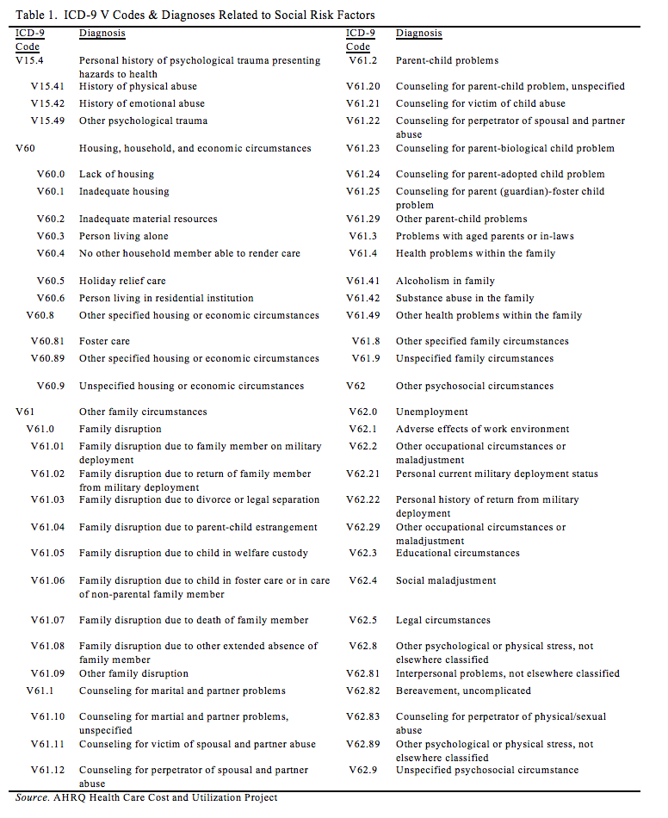
Measures
ICD-9 V codes: “persons encountering health services in other circumstances”
Outcome variable: indicator for discharge record containing any ICD-9 V Code

Slide 13
Methods
DID with logistic regression:
Y_{it}=β₀ + β₁Post_{t} + β₂(SIM_{i} x Post_{t}) + β₃X_{it} + β₄Year_{t} + β₅State_{i} + ϵ_{it}
Covariates (X_{it}): age, gender, race/ethnicity, primary payer, psychiatric diagnosis, admission via emergency department
Year and state fixed effects
Standard errors clustered at hospital level
Notes:
in comparison states over this time period

Slide 14
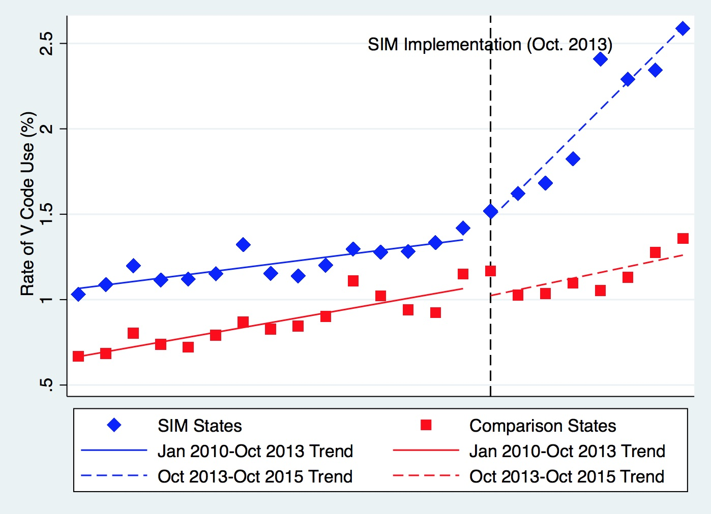
Accelerated V code use in hospitalizations of adults with diabetes in SIM states
Source: Phillips, A. Z., Brewster, A. L., Kyalwazi, M. J., & Rodriguez, H. P. (2020). The Centers for Medicaid and Medicare Services State Innovation Models Initiative and Social Risk Factors: Improved Diagnosis Among Hospitalized Adults With Diabetes. American Journal of Preventive Medicine, 59(4), e161–e166.

Slide 15
Delivery System Reform and Social Risks
The CMS SIM Initiative was associated with accelerated diagnoses of social risk factors among hospitalized adults with diabetes in four grantee states.
State-led payment and delivery system reforms can help incentivize diagnoses and documentation of social risk factors in the hospital setting.

Slide 16
Network Summary- Social Risk Factors
Adults with diabetes enrolled in a Health Home program reported improved support for social and financial needs (Mt. Sinai).
Adults with diabetes with more unmet social needs have higher ED and hospital utilization (UCLA).
A patient-level care coordination intervention for high cost adults with diabetes is associated with decreased utilization for vulnerable subgroups (UCLA) .
State-level delivery system and payment reform intervention is associated with increased diagnoses of social risks among hospitalized adults with diabetes in the short-run (Berkeley).

Slide 17
Policy and Research Implications
Health care systems and physician practices are not routinely assessing social risk factors among adults with diabetes.
Adults with diabetes and multiple social risk factors have higher utilization compared to adults with diabetes with no/few social risk factors.
Social risks may be important moderators of intervention effectiveness. Routine collection of social risk data will enable important research to improve the effectiveness of programs.
Routine social risk assessment may aid risk stratification and targeting of support to patients. This is only possible with broader social risk factor data collection in the EHR.

Slide 18
COVID-19 and Food Insecurity
Food insecurity has intensified during COVID-19.
Blacks and Latinos have a higher likelihood of experiencing food insecurity, with rates of 21.2% and 16.2%, respectively, as do households by a single woman (27.8%).
Risk for hypoglycemia admission increases 27% in the last week of the month compared to the first week low-income populations (Seligman et. Al, 2014)

Slide 19
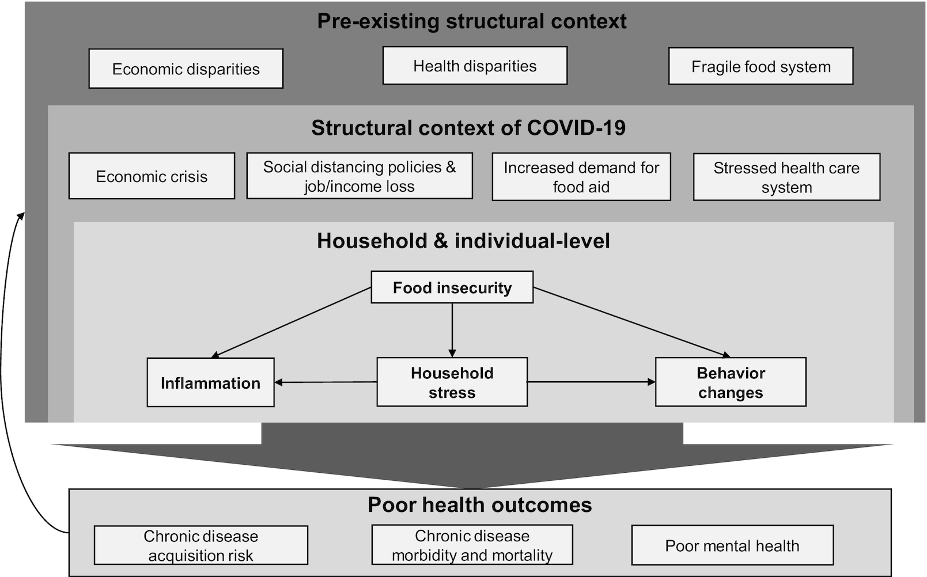
Leddy, A. M., Weiser, S. D., Palar, K., & Seligman, H. (2020). A conceptual model for understanding the rapid COVID-19–related increase in food insecurity and its impact on health and healthcare. The American Journal of Clinical Nutrition, nqaa226. Am J Clin Nutr, nqaa226, https://doi.org/10.1093/ajcn/nqaa226

Slide 20
Notes:
An estimated 19 to 23 million individuals are at high risk of being evicted from their homes by the end of September. Compared to White renters, Black and Latinx renters are less able to pay rent in the current economic climate, which may cause Black and Latinx renters to be disproportionately impacted by elimination of eviction protections and unemployment benefits.
Extending eviction moratoriums that are set to expire is a vital first step. The Health and Economic Recovery Omnibus Emergency Solutions (HEROES) Act, which passed the House and has stalled in the Senate, includes a 12-month moratorium on non-payment evictions and requires landlords to provide a 30-day notice of eviction to tenants after the moratorium expires.

Slide 21
Tackling Barriers to Social Risk Assessment
EHR vendors have developed and are disseminating standardized social risk factor assessments, e.g., PREPARE tool in EPIC
Development and testing of protocols for routine social risk assessment, treatment, and referral to enable dissemination of evidence-based approaches.
May start by targeting assessment and referral to the highest risk populations (UCLA CCO program example)
Social risk data is potentially valuable for predictive analytics, e.g., readmissions, ED visits, etc., but this may not be a sufficiently large incentive for health care systems and physician practices to routinely assess social risks.

Slide 22
Alternatives to Individual Social Risk Assessment for Natural Experiment Research
Census track data is widely considered the most relevant geographic unit for assessment of community deprivation.
Zip level deprivation data, e.g., the Univ. of Wisconsin's Area Deprivation Index, is a national publicly available option.
Zip level deprivation data vs. census tract data

Slide 23
Thank You
Email:
hrod@berkeley.edu

