Slide 1
Family Medicine Research Unit
Monthly Meeting - July 2022
Laura Sheehan
Manager of Research Administration, Dept. of Family Medicine

Slide 2
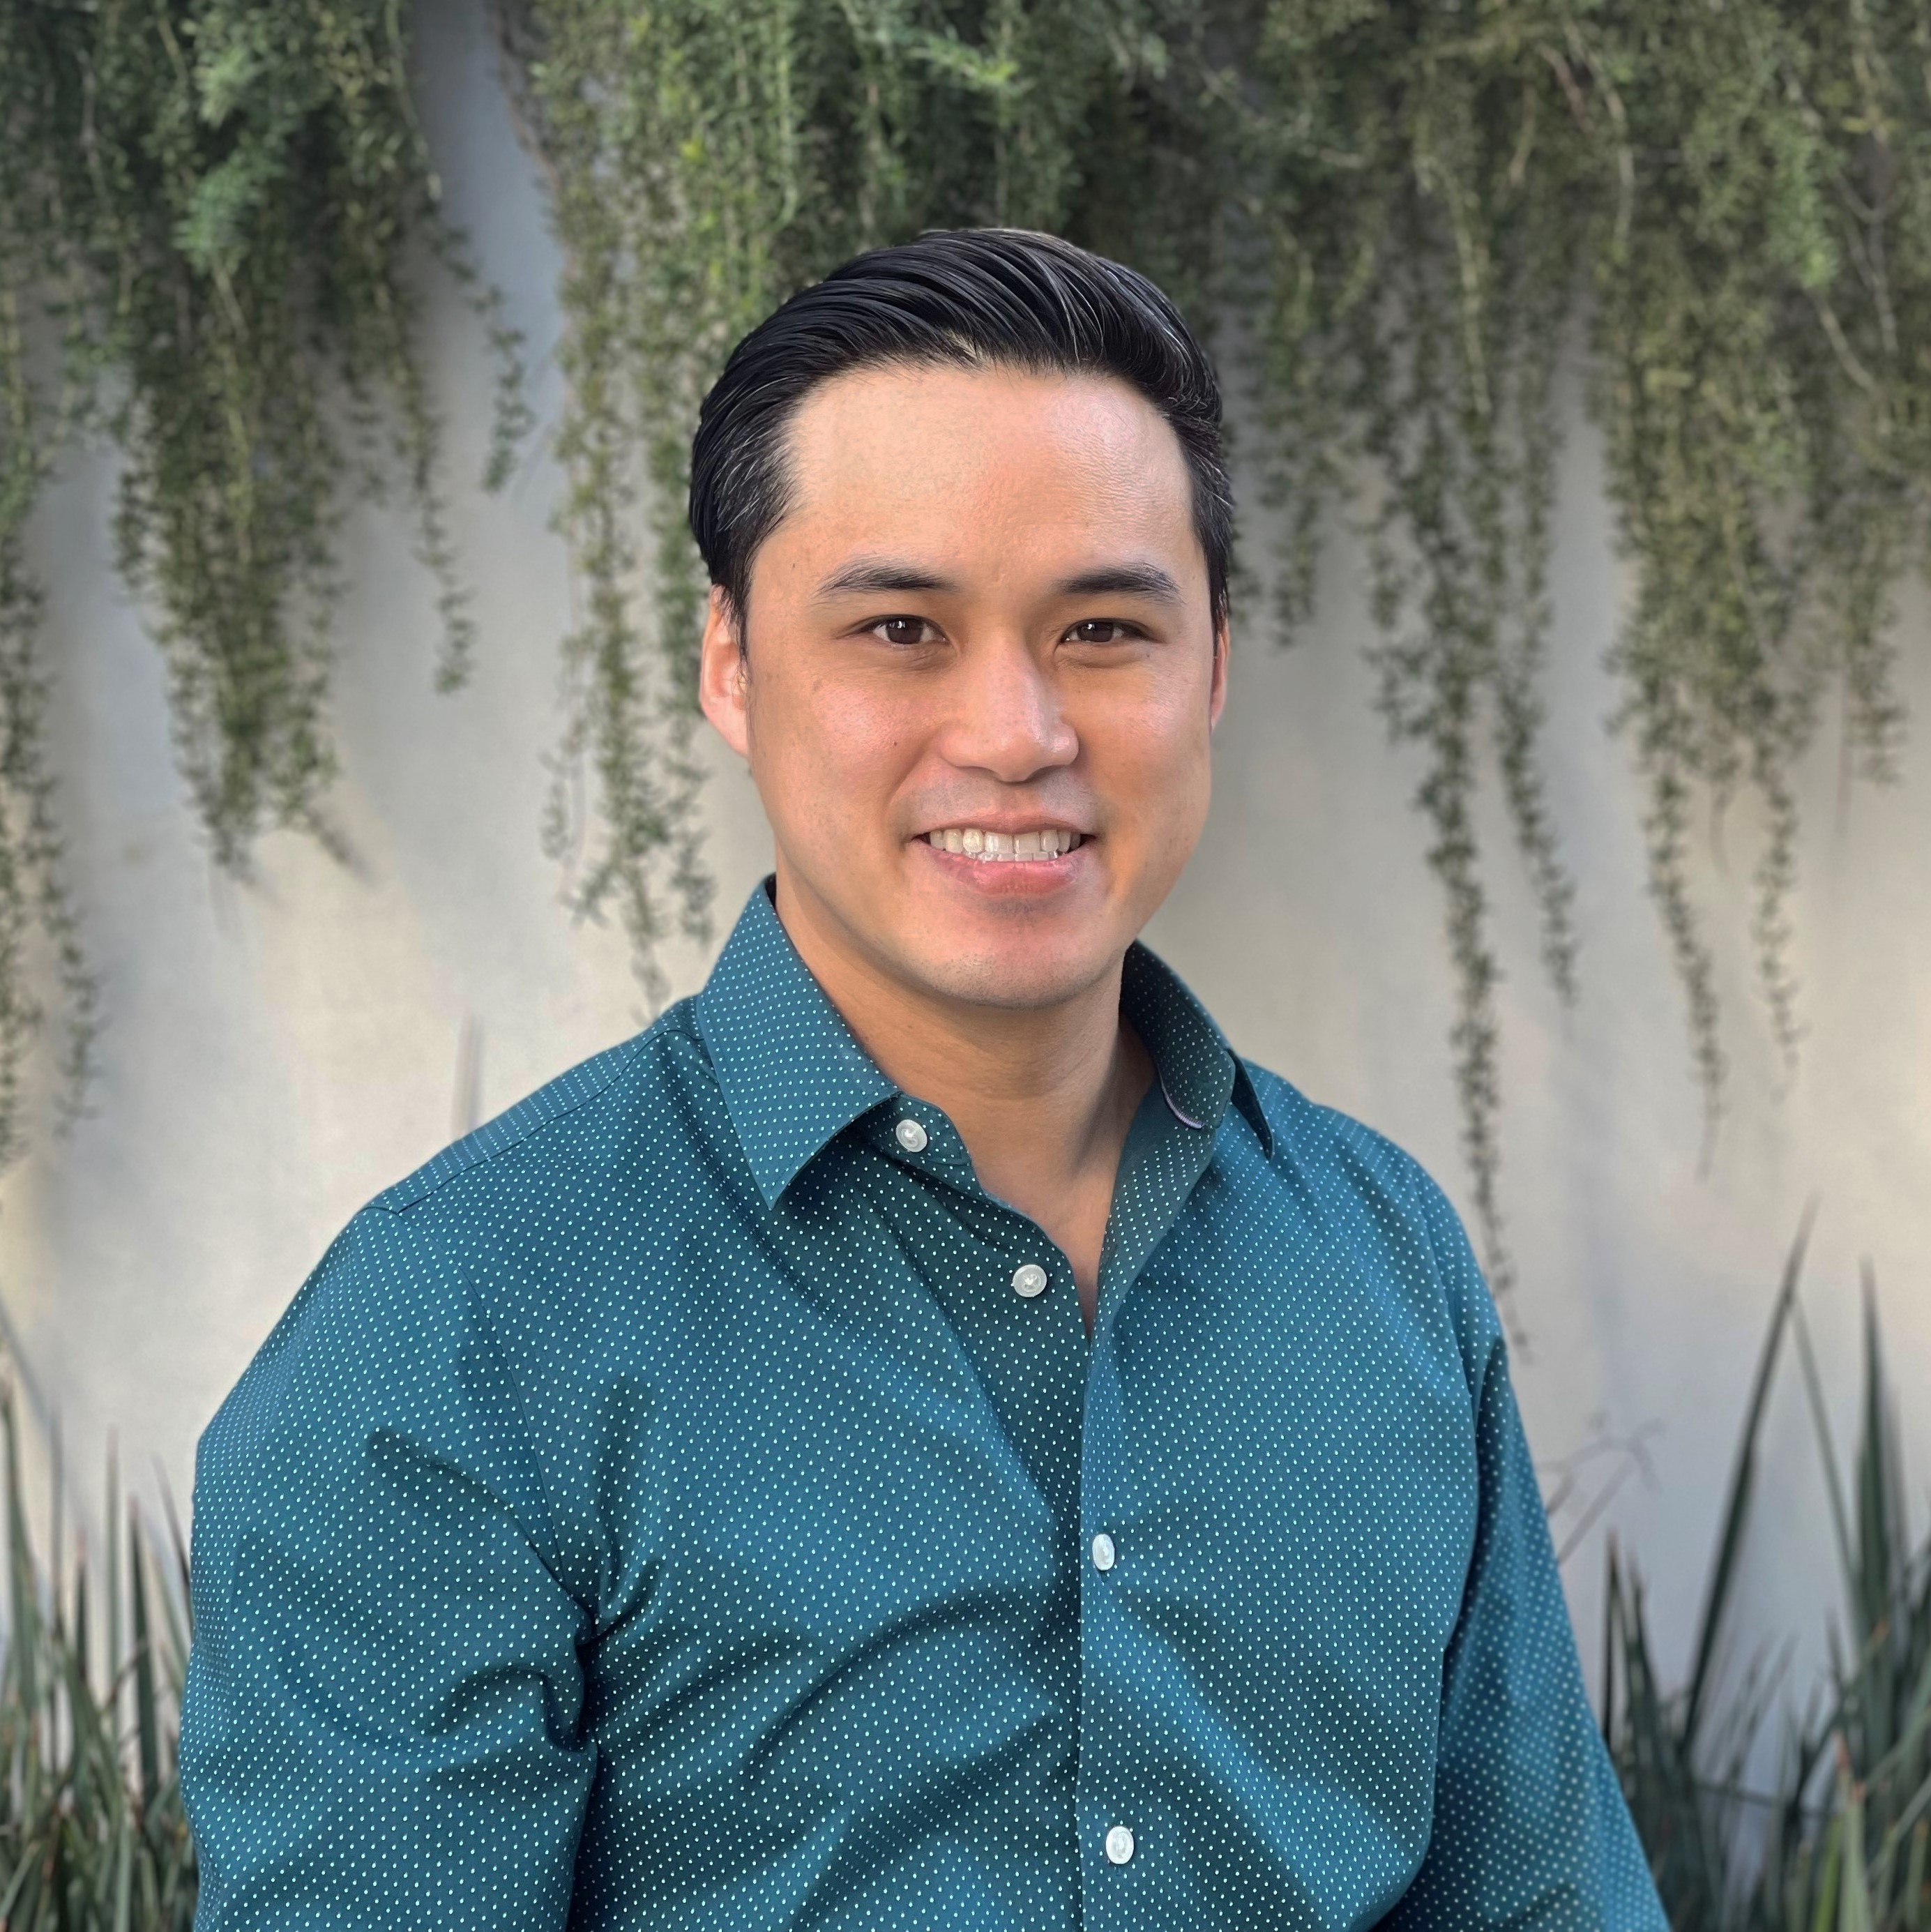
Michael Li, PhD, MPH
A Social Genomics Perspective on Social Adversity and Substance Use Disorders in Communities Impacted by HIV

Slide 3
Recently Processed Research Funding
PI | Award Title | Sponsor | Prime Sponsor | Action Type
Donohoe, Thomas J | Pacific AIDS Education & Training Center | UCSF | DHHS-HRSA | Continuation
Clark, Jesse Lawton | Mirtazapine for Methamphetamine Use Disorder: Drug-Drug Interaction Study | FHI 360 | HELUNA HEALTH | No Cost Extension
Brooks, Ronald Andrew | Implementing HIV PrEP Among Latino Men Who Have Sex with Men and Transgender Women | USC | DHHS-HRSA | Continuation
Donohoe, Thomas J | Ending the HIV Epidemic: A Plan for America – Technical Assistance Provider | Cicatelli Associates | DHHS-HRSA | Continuation
Shoptaw, Steven J | Core Function Activities - Task Order 1 | NIH-NIAAA | - | Option
Castellon-Lopez, Yelba Mariaheli | Understanding Barriers to Engagement in the Diabetes Prevention Program Among Low-Income Latino Patients: Design and Implementation of an Intervention in Community Health Centers | NIH-NIDDK | - | New
Castellon-Lopez, Yelba Mariaheli | miVacunaLA: Stakeholder Perspectives on Improving COVID-19 Vaccinations Among Vulnerable Latino Families (PHASE 3) | CHLA | - | Supplement

Slide 4
Recently Submitted Outgoing Proposals
PI | Title | Sponsor | Prime Sponsor | Proposal Type
Donohoe, Thomas J | The Substance Abuse Treatment to HIV Care II (SAT2HIV-II) Project | OHIO STATE UNIVERSITY | NIH | New
Gelberg, Lillian | QUIT: Targeting Opioids in Rural Settings (QUITTORS) | FRIENDS RESEARCH INSTITUTE, INC. | NIH | New
Kalmin, Mariah Mattera | Reducing Overdose and Suicide Risk in Individuals with OUD and Co-occurring Disorders | RAND CORPORATION | NIH-NIDA | Resubmission - New
Tarn, Derjung Mimi | Increasing the Feasibility, Impact, and Equity of the Medicare Annual Wellness Visit | NIH-NIA | - | New
Gelberg, Lillian | Disparities in Rates & Impact of Tobacco and Marijuana Use in UCLA Primary Care | UC TRDRP | - | Supplement
Shoptaw, Steve | Clinical Trials Network Big South/West Node – Yr18 CO Request: Yr18 CTN0109A1 Study | University of Texas Southwestern Med | NIH | Supplement
Shoptaw, Steve | Clinical Trials Network Big South/West Node – Yr18 CO Request: Yr18 CTN0108 Study | University of Texas Southwestern Med | NIH | Supplement
Shoptaw, Steve | Clinical Trials Network Big South/West Node – Yr18 CO Request: Yr17 CTN0110 Study | University of Texas Southwestern Med | NIH | Supplement
Shoptaw, Steve | Clinical Trials Network Big South/West Node – Yr18 CO Request: Yr17 CTN0108 Study | University of Texas Southwestern Med | NIH | Supplement

Slide 5
Human Resources/Personnel
Retirements
Wendy Songer, CAO – will return on recall in a few months
Michael Rodriguez, MD MPH – Emeritus Professor
Departures
Audra Potz, Academic HR Manager – clinical position with Kaiser
Natalie Martinez, Gelberg Staff – going to medical school

Slide 6
17th Annual UCLA All-Staff Picnic
When: Thursday, August 16
11:30AM– 1:30PM
Each year, the All-Staff Picnic brings together colleagues from across campus to enjoy a friendly, relaxing, summertime lunch sponsored by UCLA Staff Assembly and the Chancellor’s Office! An invitation to all staff members will be distributed via e-mail in the coming weeks.

Slide 7
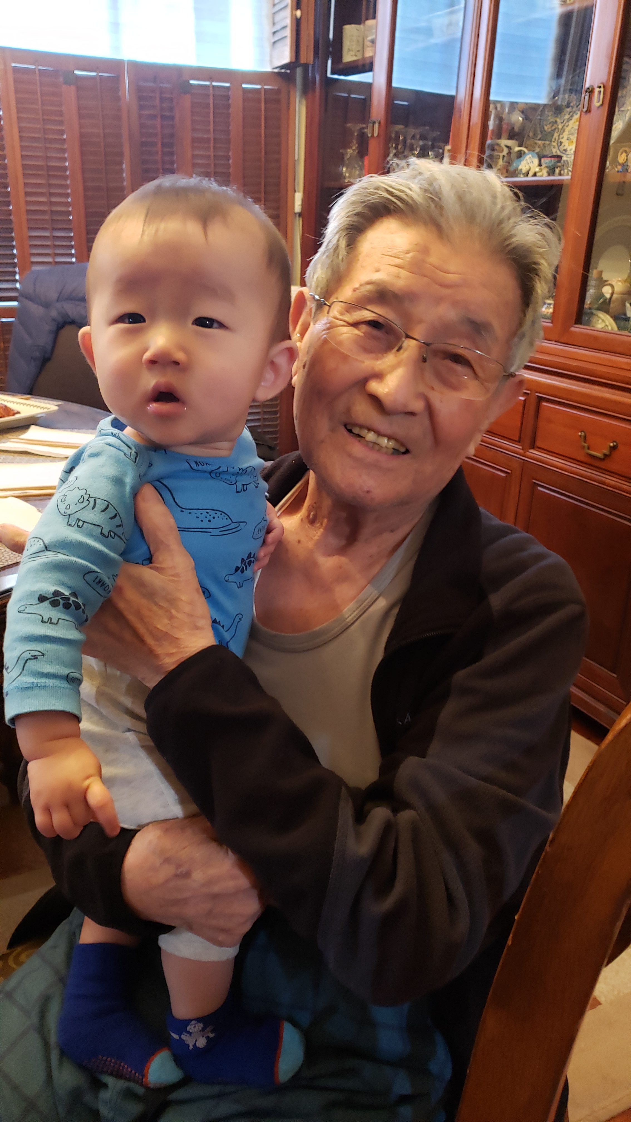
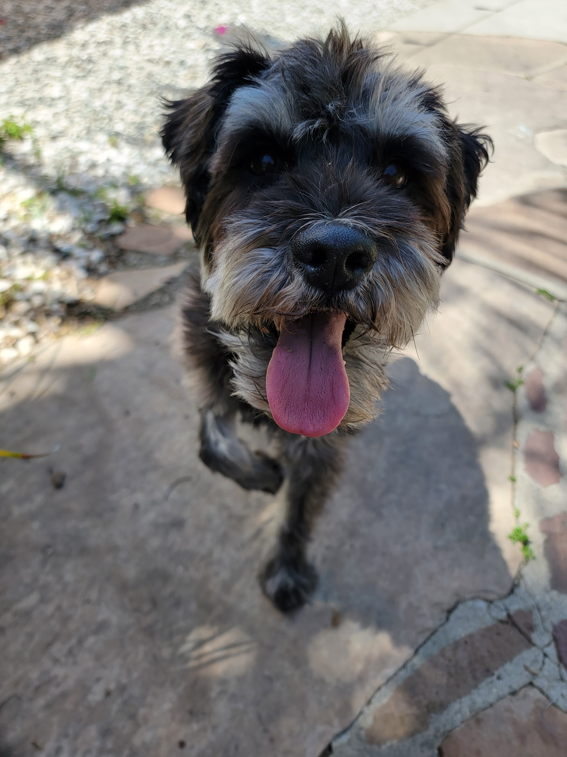
Get to Know Your Co-Workers
This month’s spotlight: Christine park
My family consists of my husband, toddler, and two dogs. With the addition of my toddler, Noah, we have four generations currently living! Noah’s best friend is his great grandpa. When I’m not chasing Noah around, I like to garden, explore toddler friendly activities, hike, and eat. Pre-COVID, my husband and I used to go on road trips to explore the states.
When I started working at family medicine I had three dogs but one passed away. Currently, I have Bruce, a 10-year-old Jindo who is more of a cat than a dog, and Teddy, who is an 8-year-old miniature schnauzer who has a little dog complex.

Slide 8
Get to Know Your Co-Workers
This month’s spotlight: Christine park
Question: How many positions Christine has held at UCLA?
Answer: Six!
Conference Services Coordinator (intern)
Special Projects – Conferences, Catering, & Marketing
Special Projects – Food & Beverage operations (on campus housing and Luskin Conference Center)
Executive Assistant to Director of University Apartments
Senior Fund Manager at School of Education and Information Studies
Senior Fund Manager with Family Medicine.

Slide 9
Financial
Ordering Process
PO Request Form
Payment Works
Transcepta
Invoicing and Payment

Slide 10
Financial Process
Requester: The person who needs the item or is requesting the item for someone on their team. The Requester determines what needs to be purchased and from which vendor. This person will complete most of the forms for submission to the Authorizer.
Types of request forms:
PO Request Form
Independent Contractor/Consultant Checklist and attachments
Travel/Entertainment Reimbursement Form
Mileage Reimbursement Form
Foreign Wire Transfer Request Form
Check Request Form
Submits the request form(s) to Authorizer (e.g. PI) for approval and signature.

Slide 11
Financial Process
The vendor should not be providing any goods or services at this time in the process. Submitting a PO Request Form is NOT the same thing has creating or having a PO (purchase order), and a PO must be in place in order for work to begin or for services/deliverables to be provided.

Slide 12
Financial Process
REQUESTER determines need, gathers information regarding pricing/ordering, and completes required paperwork to request payment/purchase order/reimbursement
AUTHORIZER (e.g. PI) reviews request and signs off if appropriate
Submits to Authorizer
Submits to Approver
PURCHASER reviews for completeness and compliance with UCLA policies. Processes the request using appropriate system (e.g. BruinBuy, Concur, etc.). Contacts vendor (if applicable).
APPROVER (Fund Manager) reviews for allowability, accuracy, fund availability, and sponsor compliance
Submits to Purchaser

Slide 13
Financial Process
What Used to Happen:
Valencia created a PO in BruinBuy
The vendor was contacted with the PO # and the order was placed/work began
The item would be delivered or work completed
The vendor would send an invoice to the Requester or to Valencia
The Requester or Valencia would make sure the PO # was on the invoice and would then submit it to Accounts Payable (AP) to be paid
Accounts Payable would receive the invoice, match it up with the PO #, and if approved, they would cut a check and send it to the vendor

Slide 14
Financial Process
What happens now:
Vendor must register with PaymentWorks
Vendor must enroll in Transcepta (some exceptions)
Then Valencia can create a PO
The item can then be ordered/delivered or work completed
The vendor submits their invoices directly to Transcepta, listing the PO
AP reviews the invoices and, if approved, pays the vendor using their preferred method of payment

Slide 15
Financial Process
The following vendor types are exempt from the new process/Transcepta:
Vendors for goods and services reviewed by UCLA Travel & Entertainment Accounting (e.g., catering, lodging, or air transportation vendors)
Foreign and nonresident vendors
Utility vendors​​​​​
Federal/State agencies
Subcontract and subaward vendors (e.g., G & S class orders)
One-time payees (e.g., honorarium recipients, guest speakers, and human subjects)

Slide 16
Financial Process
PaymentWorks
(Required if vendor is not already registered)
Requester is responsible for providing the vendor’s email when completing PO Request Form.
Valencia emails vendor to initiate the process and send an invitation to register.
Vendor submits their information directly into PaymentWorks.
PaymentWorks verifies and validates the vendor’s submitted details.
Vendor information is routed to UCLA Vendor Management Team for review and approval.
Vendor Management will then assign the vendor’s ID/number (e.g. VCK).
This process can take 2-4 weeks. Valencia can utilize the Onboarding Tracker to see where a vendor is in the process, but she is not responsible for any of the steps except #2 above. She cannot create a PO # until the VCK is created. Vendors also need to make a payment method selection.

Slide 17
Financial Process
Transcepta
(UCLA’s electronic invoicing submission platform)
Vendor must enroll. This is a separate process from PaymentWorks, which must already be completed.
After enrollment, vendors will submit their invoices directly to Transcepta to get paid
Vendors must include the appropriate PO# on their invoices otherwise they will not get paid
You must still submit PO request forms to create PO numbers! Vendors should not be providing goods or services without a (new) PO #.
If you have a recurring charge/vendor who will be providing the same thing on a regular basis, you may wish to create a “blanket PO” that will allow more than one invoice to charge to the same PO. But you are responsible for reviewing ledgers/invoices to make sure the PO has enough funds to cover all invoices and to close it out when done.
Remember, don’t use this system for utility invoices or subaward invoices.

Slide 18
Financial
Justifications (for purchases or travel/entertainment)
Need to be detailed and understandable to a lay person
Explain what you are paying for and why the listed FAU is the appropriate funding source
Examples:
“For Invoice #348-91 on the HLC project”
“For consulting services during Year 3 of the Bruin Research Project study, as listed in our budget justification (attached).”
“General office supplies for the Oppenheimer research office”
Might be OK, depends.
Dude, no.
Good to go.

Slide 19
Financial
Object Codes
4-digit code
Used for classification and tracking
You are responsible for selecting the correct object code, but we can help
Use https://ga.accounting.ucla.edu/ to help you find the right one

Slide 20
Financial
UPS vs. FedEx
UPS rates for most services have increase from the old agreement to the new agreement. UPS average projected increases are as follows:
Next Day Air: 32% increase from old agreement to new agreement
2-Day Air: 41% increase from old agreement to new agreement
Ground: 66% increase from old agreement to new agreement
Please start shifting business to FedEx, as the FedEx systemwide contract rates are superior to UPS list rates:
Next Day Air: FedEx is (on average) 17% less expensive than UPS
2-Day Air: FedEx is (on average) 10% more expensive than UPS
Ground: FedEx is (on average) 38% less expensive than UPS

Slide 21
UCLA Health Innovation Challenge
UCLA Health invites our community members to join our mission, as we search for the next great idea, from novel medical devices to optimizing patient experience. The UCLA Health Innovation Challenge invites applications from faculty, staff, trainees, students, patients, caregivers and volunteers seeking to advance long-lasting health and equitable care.
Choose from three different challenge tracks: Scale Health Equity, Invent HealthTech, and Submit Your Greatest Idea. Watch this video to learn more. Prizes include support of up to $50,000 in seed funding.

Slide 22
UCLA Health Innovation Challenge: Three Tracks
This track invites solutions tackling challenges related to equitable care delivery, socio-structural drivers of health, and optimal health outcomes for individuals from vulnerable and marginalized populations. Awards up to $50,000.
The healthtech track seeks value driven solutions across the patient journey, including medical devices, diagnostics, digital therapeutics and other digital health or software solutions. Basic science funding requests are encouraged to apply to the David Geffen School of Medicine Seed Grant Program. Awards up to $50,000.
Applicants can submit ideas across the continuum of health care delivery. From patient experience and community outreach to process improvement and clinical workflow to financial stability and operation & decision support. Awards vary, and may include prizes, recognition and/or funding.

Slide 23
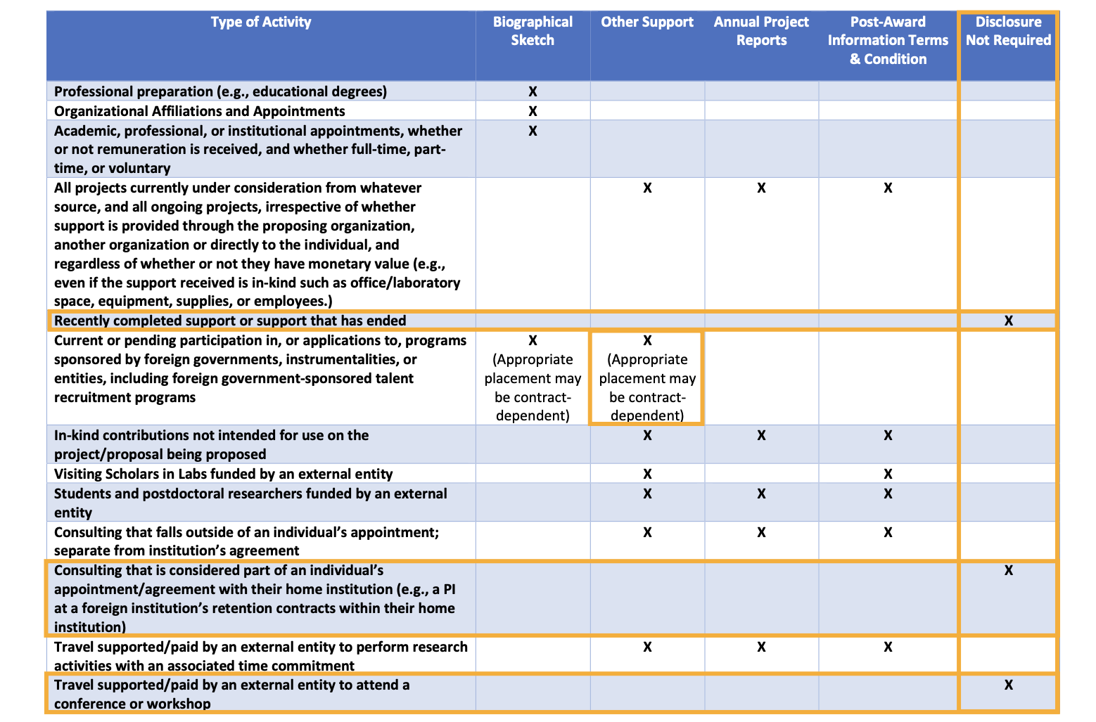
NIH Updated Biosketch and Other Support Disclosures Table

Slide 24
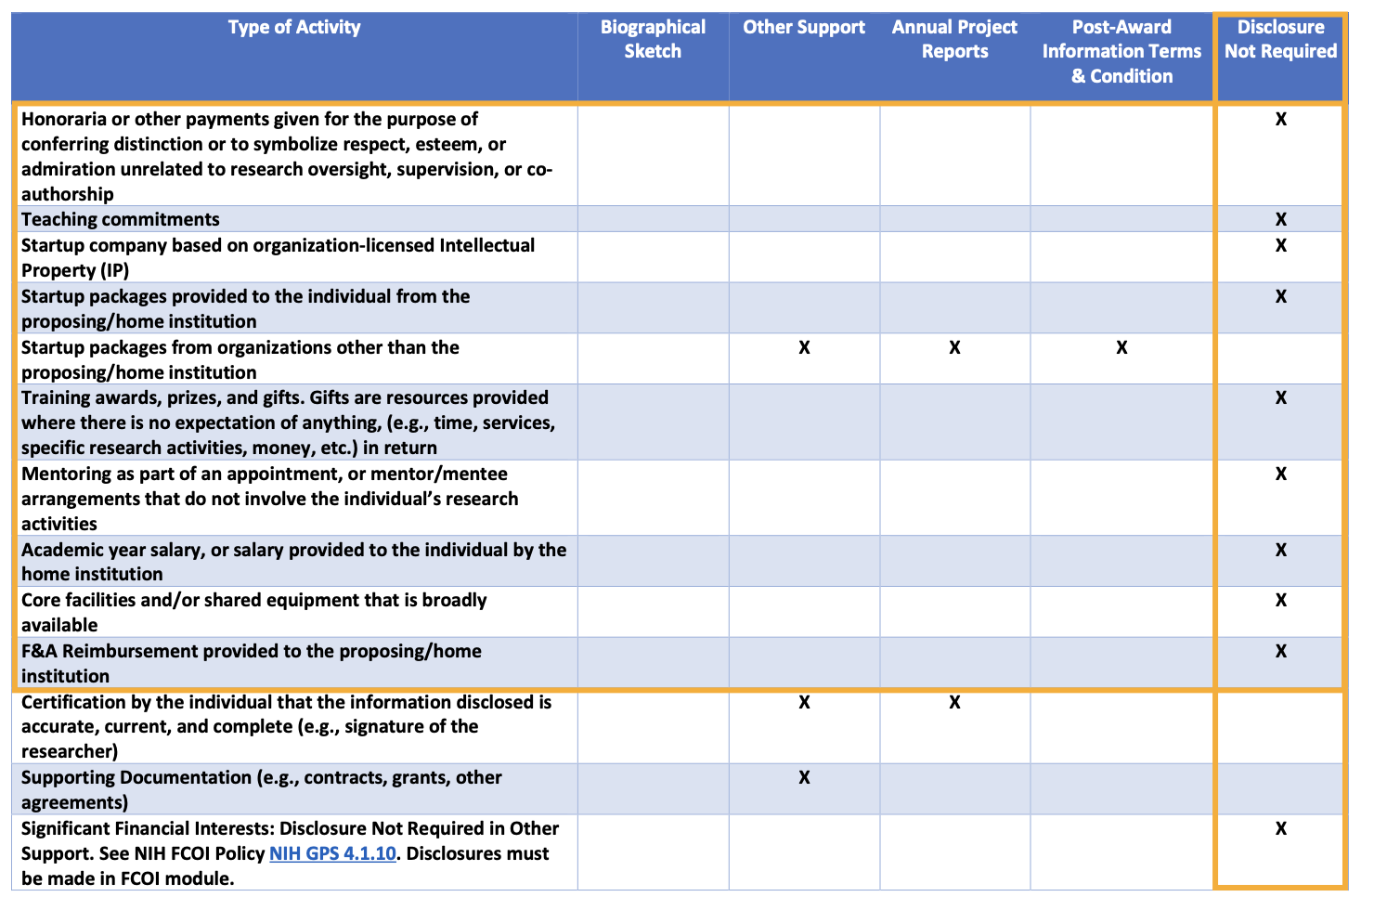
NIH Updated Biosketch and Other Support Disclosures Table

Slide 25
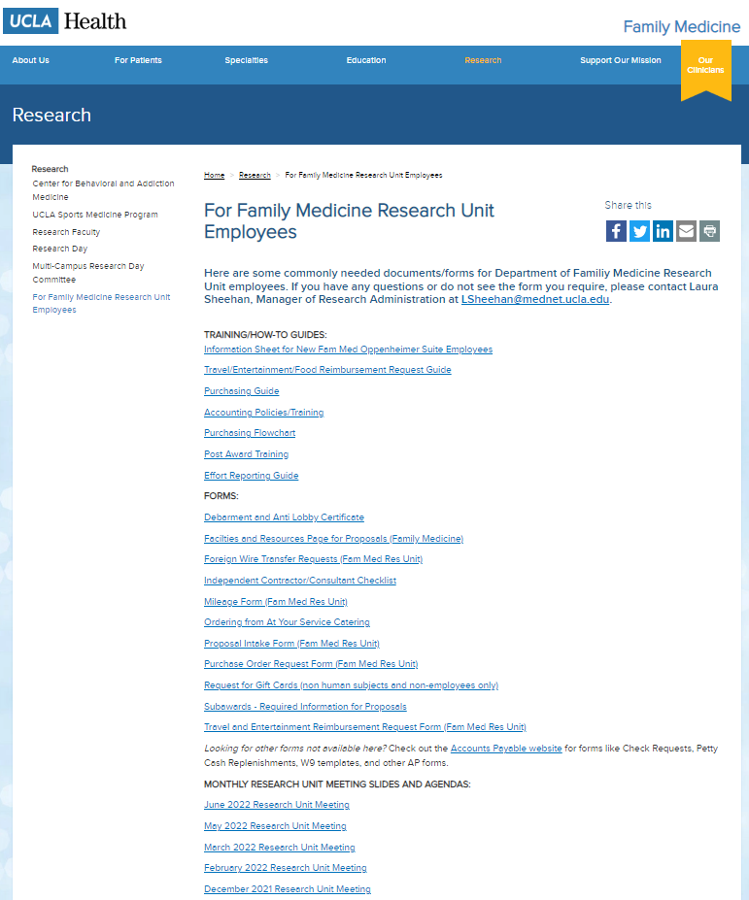
Meetings
Next Monthly Research Unit Meeting: Thursday, August 4
Prior monthly meeting agendas/slides are now available on the website

