Slide 1
Family Medicine Research Unit
Monthly Meeting
March 2023

Slide 2
Recently Processed Awards
PI | Award Title | Sponsor | Prime Sponsor | Action Type
Donohoe, Thomas J | Ending the HIV Epidemic: A Plan for America – Technical Assistance Provider | Cicatelli Associates | DHHS-HRSA Health Resources and Services Administration | Continuation
Gelberg, Lillian | Comparative Effectiveness of Single-Site and Scattered-Site Permanent Supportive Housing on Patient-Centered and COVID-19 Related Outcomes for People Experiencing Homelessness Receiving Contingency Management | UNIVERSITY OF SOUTHERN CALIFORNIA | PATIENT-CENTERED OUTCOMES RESEARCH INSTITUTE | Modification/Amendment
Shoptaw, Steven J | Center for HIV Identification, Prevention and Treatment Services | NIH-NIMH National Institute of Mental Health | - | Continuation

Slide 3
Recently Submitted Proposals
PI | Title | Sponsor | Prime Sponsor | Type
Gelberg, Lillian | Understanding the Complex Risk Pathways of Multiple Chronic Conditions | UNIVERSITY OF NORTH CAROLINA | NIH - National Institutes of Health | Resubmission - New
Gelberg, Lillian | Effect of an Adapted Community-Based Biofeedback Program on Heart Rate Variability and Mental Health among People Experiencing Homelessness | UNIVERSITY OF CALIFORNIA, IRVINE | NIH - National Institutes of Health | New
Gelberg, Lillian | NIDA Clinical Trials Network: Greater New York Node - Supplement: Subthreshold Opioid Use Disorder Prevention (STOP) Trial (Year 6) | NEW YORK UNIVERSITY | NIH-NIDA National Institute on Drug Abuse | Modification/Amendment

Slide 4
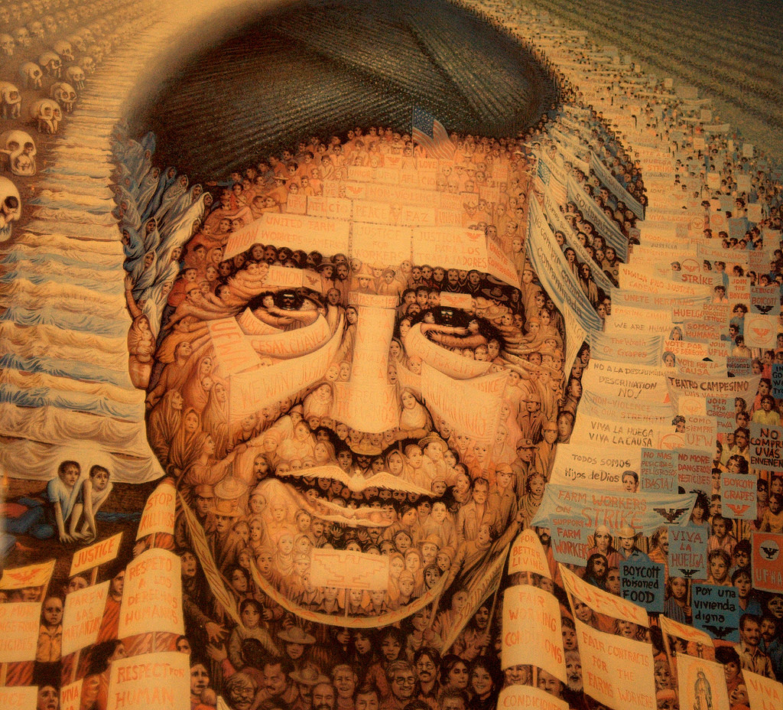
Upcoming Holidays
March 31, 2023 – Cesar Chavez Day

Slide 5
Performance Evaluations
For career staff in non-represented, non-academic positions
Self-evaluation now available in Cornerstone

Slide 6
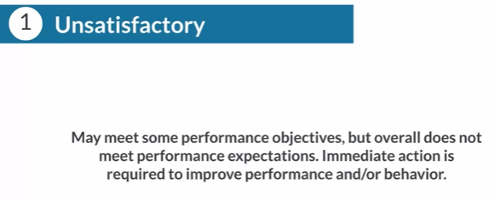
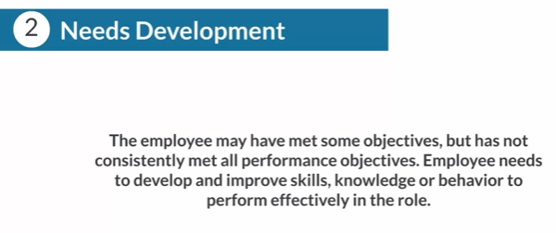
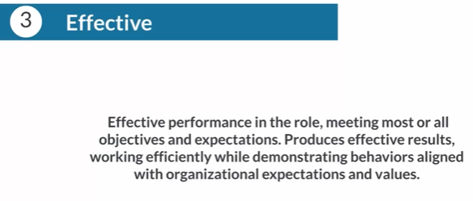
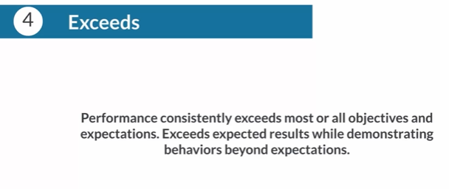
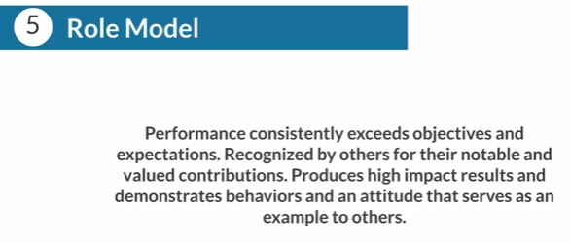
Performance Evaluations
Five-point rating system

Slide 7
New Applicant Tracking System
Avature
Replaces Cornerstone for reviewing applicants
Training for hiring managers is available here: https://mednet.uclahealth.org/managertoolkit/
In progress requisitions: applicants will need to re-apply via new system
Requisitions put on hold during blackout should be processed shortly

Slide 8
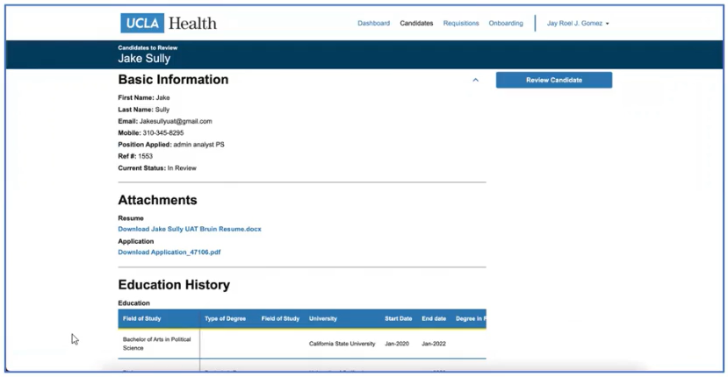
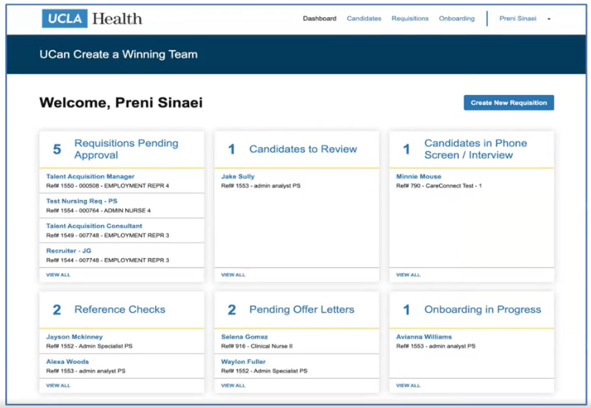
Talent+ Scores have not yet incorporated into new system
Will likely be reinstated in April

Slide 9
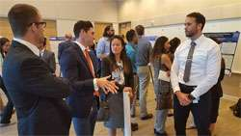
Research Day
2023 Meeting Information
In-person at the California Endowment (Center for Healthy Communities Los Angeles)
Wednesday, May 10, 2023
Keynote Speaker: Dr. Steve Shoptaw
Abstract Submissions
Submission Guidelines and other info can be found on our website
Abstracts must be submitted via the Submission Portal by April 7, 2023.

Slide 10
Grand Rounds
Congratulations to Dr. Üsküp on presenting our inaugural Grand Rounds address in February
Fourth Friday of every month, from 12-1pm
Via Zoom (email Denise Acelar if you do not already have the invite)
Faculty, staff, and students are encouraged to attend

Slide 11
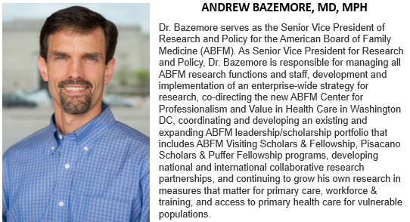
Grand Rounds
Next event: Friday, March 24th

Slide 12
Discovery Year Mentorship Program
New curriculum for medical students: year-long protected time for substantive creative/scholarly/research experience in their area of interest
Eight DGSOM Discovery Area of Concentrations (AoC)
Our Department is offering fellowships under the Health Justice and Advocacy AoC
Three faculty mentors this year: Drs. Mary Marfisee, Jyoti Puvvula, and Steve Shoptaw
Students should complete application and submit by March 31, 2023

Slide 13
Jabber
Allows users to make and receive phone calls from your VoIP office phone number on your laptop or mobile device
Request via IT Services Web Center, or reach out to Valencia
Ideal for mostly remote employees who may need a UCLA office phone number, but don’t have a dedicated UCLA office or phone (handset)

Slide 14
Medical License Renewals
Instead of paying for renewal and seeking reimbursement: Valencia can pay through BreEZe directly with the P-card
Doctors must designate her as an Authorized Representative in BreEZe
Submit PO request to let us know the FAU, etc.

Slide 15
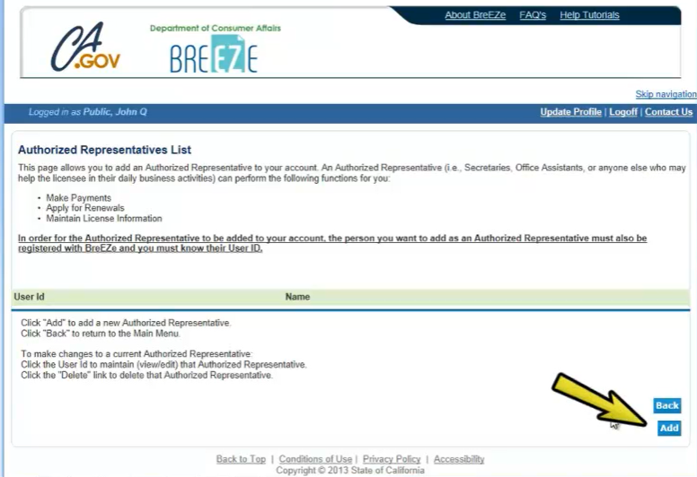
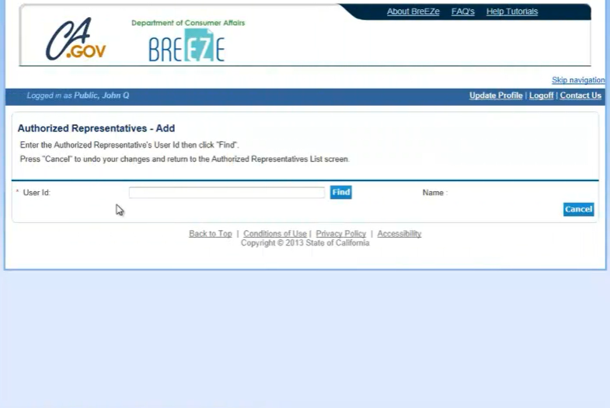
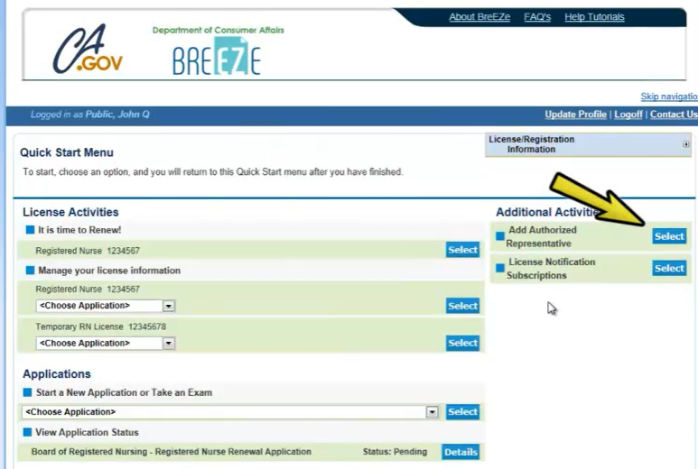
Enter Valencia’s User ID: Vmoody123

Slide 16
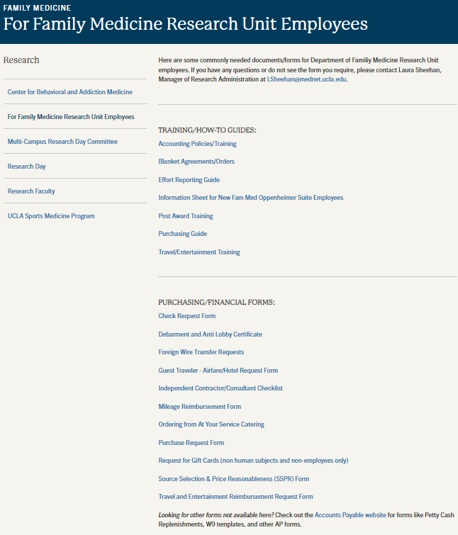
Website Updates
Faculty: provide Laura with your research information ASAP
Updated how-to guides and financial forms are now available on the “For Fam Med Research Unit Employees” page

Slide 17
NIH Updates
How do I budget effort for personnel whose duties are included as part of the Data Management and Sharing Plan?

Slide 18
NIH Updates
All costs for data management and sharing activities, including personnel costs, must be included in the single line item in section F - Other Direct Costs. Supporting details, including a breakdown of any personnel effort, must be included in the budget justification.

Slide 19
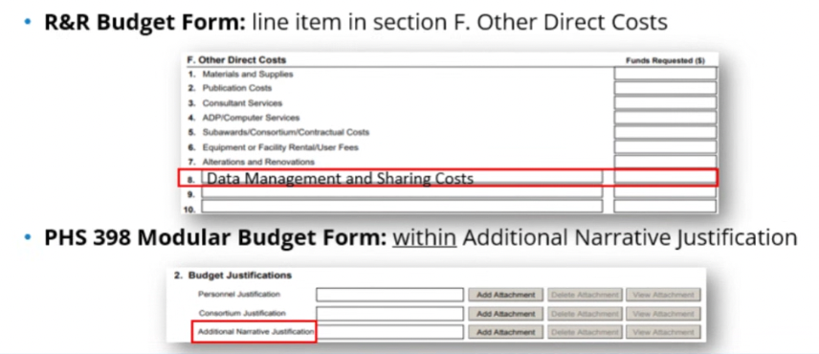
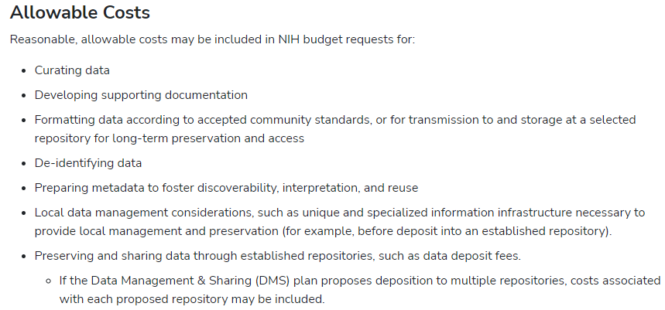
NIH Updates

Slide 20
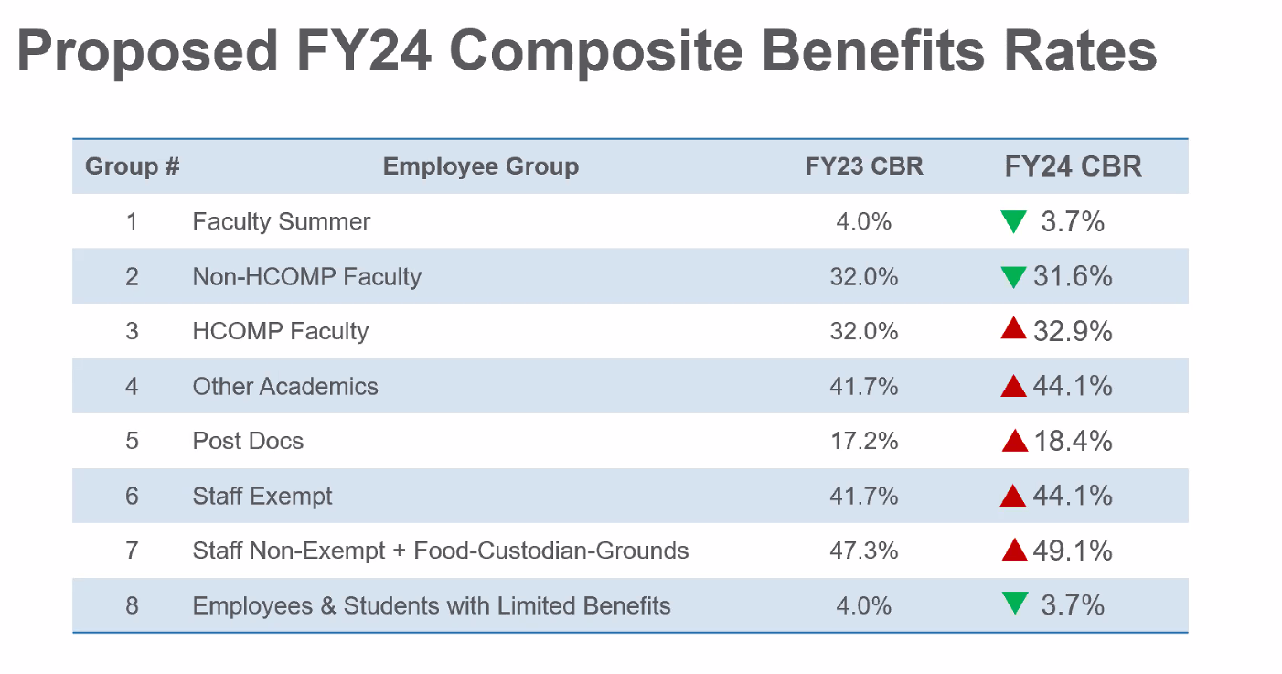
New CBR Rates

Slide 21
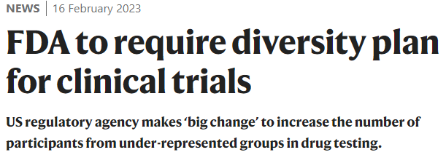
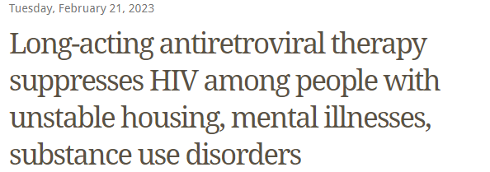
In the News

Slide 22
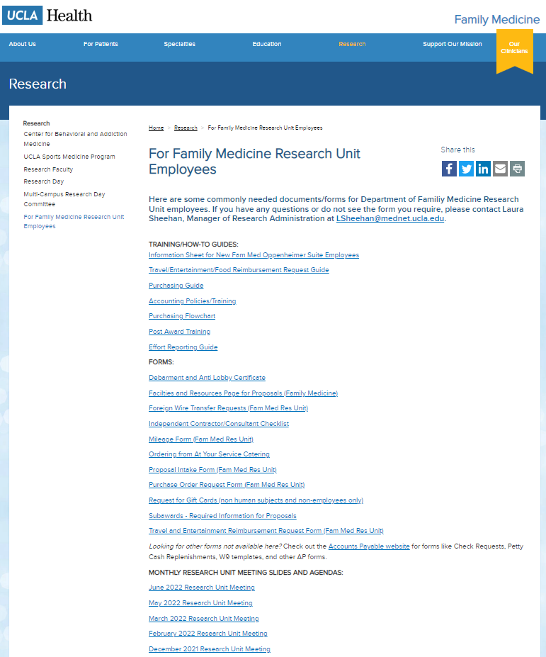
Meetings/Events
Next Research Unit Meeting: April 6
Next Grand Rounds: Friday, March 24
Building a Budget: Financial Basics for Research Proposals (March 9, 2023, from 12-1:30pm, hosted by CHIPTS)
Research Day: May 10, 2023 at the California Endowment (downtown)
Prior monthly meeting agendas/slides are available on the website

