Slide 1
Percutaneous Injection Laryngoplasty
Dinesh K. Chhetri, MD
Associate Professor
Department of Head and Neck Surgery
University of California, Los Angeles

Slide 2
Why Percutaneous Injection
Pros
Cons
Fast (< 30 seconds injection time)
Minimal discomfort
No need for endolaryngeal anesthesia
Excellent results with experience
Learning curve
The injection itself, while viewed on the video monitor, is done by feel
Can’t directly see needle going into the vocal fold
May be difficult in very large or obese necks as adequate palpation of laryngeal landmarks is critical to the procedure
Need someone to hold scope

Slide 3
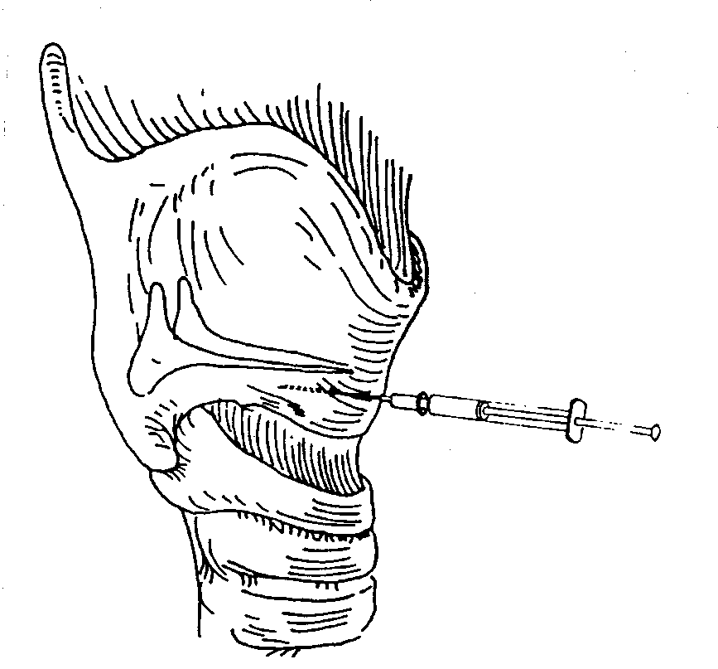
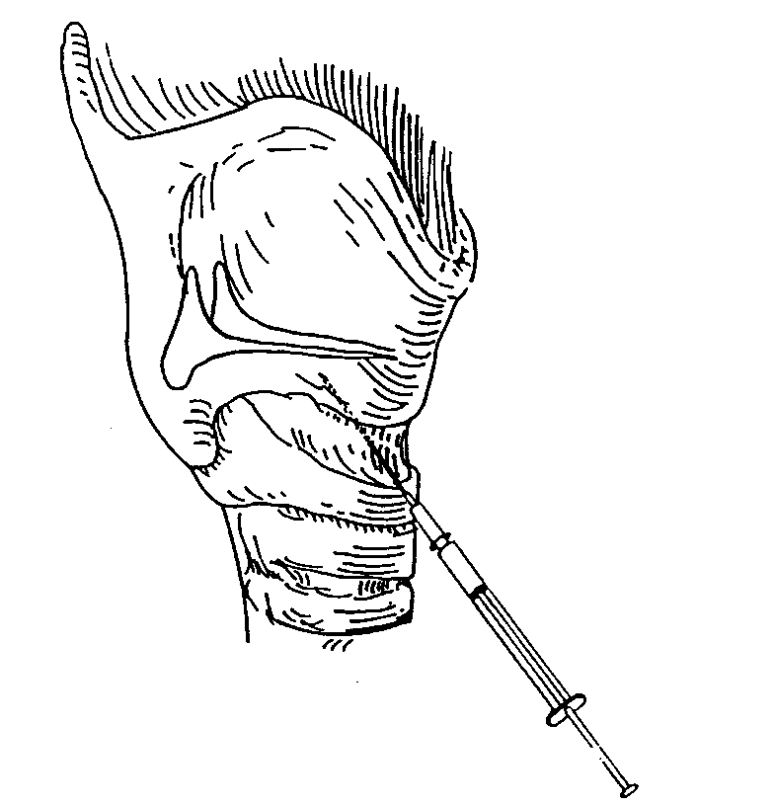
Percutaneous Injection of Larynx
Ward et al. (1985): “Transcutaneous Teflon Injection”
Green et al. (1992): “Point Touch Technique”
5 mm
5 mm
Trans-thyroid cartilage injection
Trans-cricothyroid membrane
injection

Slide 4
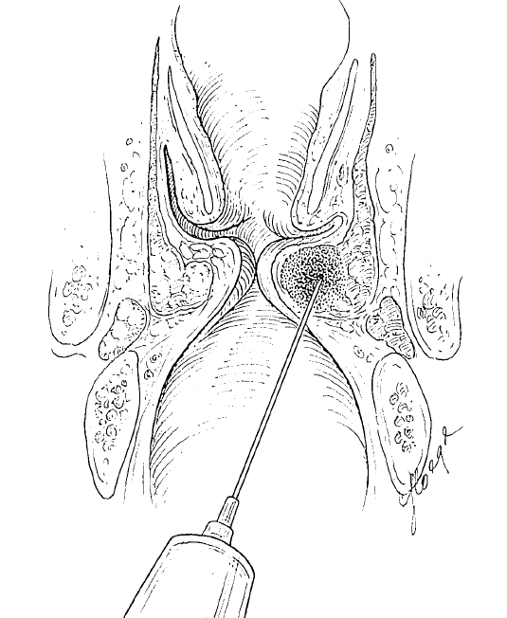
Ideal Vocal Fold Implant
Biocompatible
Injectable with a small bore needle
Non-volatile
Non-degradable
Sized to prevent phagocytosis and migration
Does not adversely affect the viscoelastic properties of the vocal fold
Such material does not exist!

Slide 5
Zyplast® Collagen (Bovine)
Hypersensitivity?
Not really
NO skin testing needed
Had the following desirable qualities in an IL product:
Ideal viscosity
Ideal vocal fold response during medialization

Slide 6
Alas, Zyplast Collagen No More!
X

Slide 7
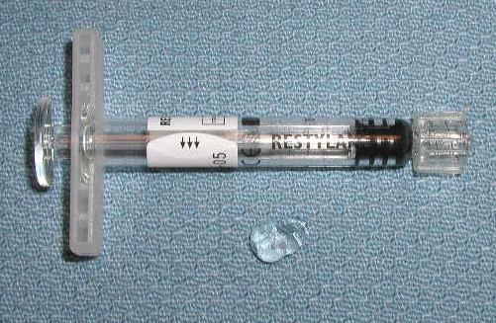
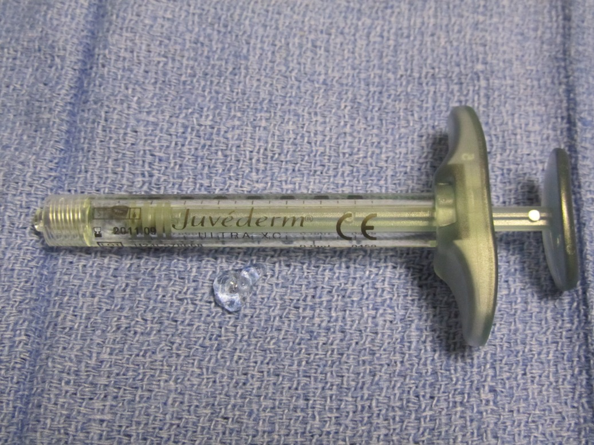
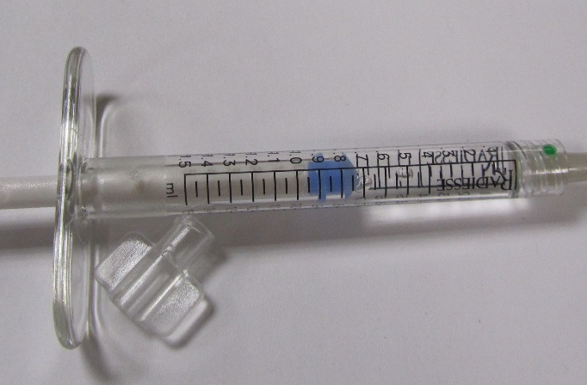
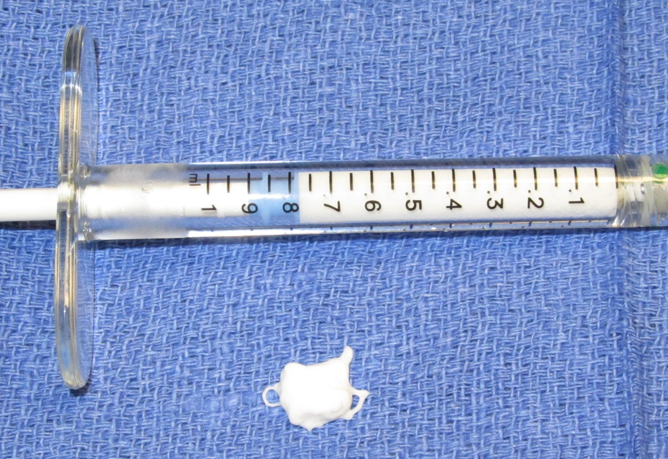
Restylane
Juvederm
Radiesse Voice Gel
Radiesse Voice

Slide 8
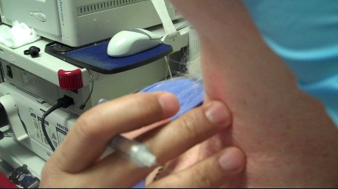
Trans-membrane: Step 1
How I Do It
Palpate anterior laryngeal landmarks:
Thyroid and cricoid cartilage, cricothyroid membrane

Slide 9
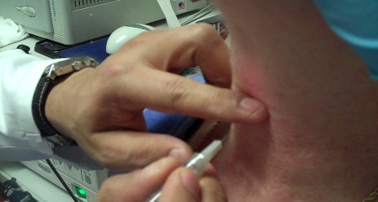
Trans-membrane: Step 2
Place finger over the cricothyroid membrane at the inferior thyroid ala

Slide 10
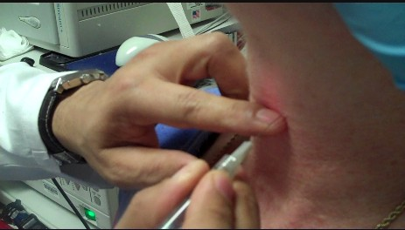
Trans-membrane: Step 3
Insert needle at inferior border of the thyroid cartilage and make needle-tip/cartilage contact

Slide 11
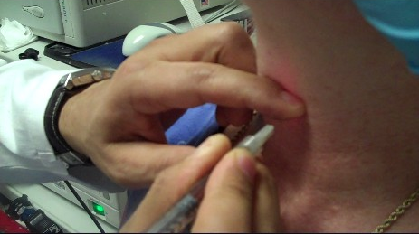
Trans-membrane: Step 4
Press needle tip down and under the inferior thyroid cartilage

Slide 12
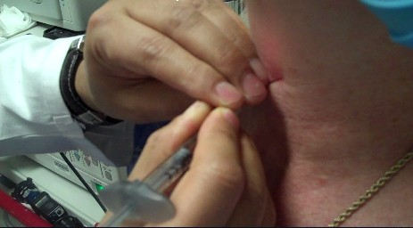
Trans-membrane: Step 5
Bend the needle towards the paraglottic space (lateral and superior)

Slide 13
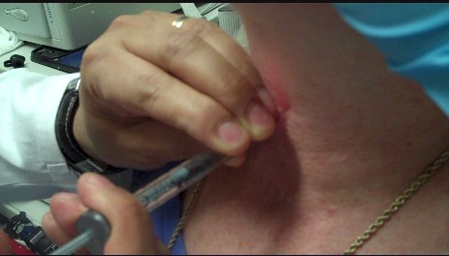
Trans-membrane: Step 6
Inject while watching on video monitor

Slide 14
Trans-membrane: Review

Slide 15
Video Monitor Injection

Slide 16
Trans-cartilage: Step 1 and 2
How I Do It
Palpate laryngeal landmarks
Place finger at the level of the cricothyroid membrane

Slide 17
Trans-cartilage: Step 3
Insert needle perpendicular to the thyroid cartilage slightly above the inferior border

Slide 18
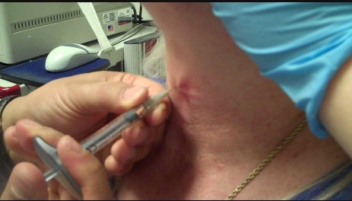
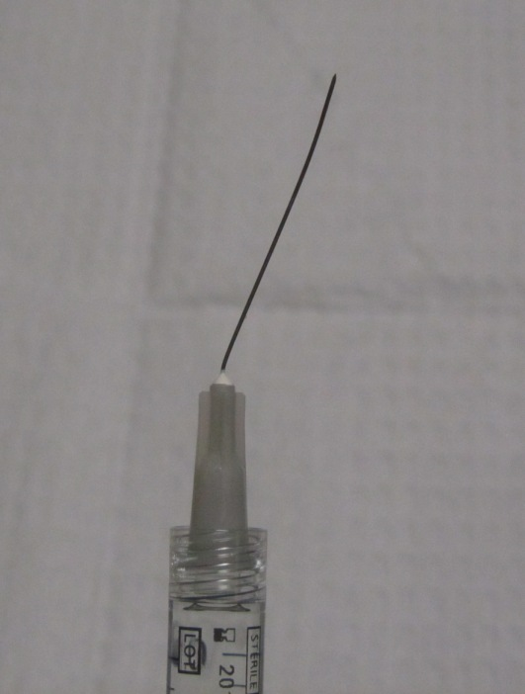
Trans-cartilage: Step 4
Once you “pop” through the cartilage, bend needle towards the paraglottic space (lateral)

Slide 19
Trans-cartilage: Step 5
Inject while watching on video monitor (layer it in paraglottic space to get vocal fold medialization)

Slide 20
Trans-cartilage: Review

Slide 21
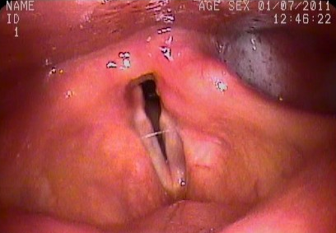
When to stop the injection?

Slide 22
Narrow Airway can be Injected Percutaneously

Slide 23
Percutaneous Injection Pearls
Key is to targeting the paraglottic space and avoid superficial injection while getting adequate medialization.
“Bend the needle”
TC: Feel the inferior border of the thyroid ala with the needle, then slide the needle underneath, then bend the needle up and lateral
TM: Feel the needle pop through the cartilage then immediately bend the needle lateral

Slide 24
Percutaneous Injection Pearls
Use a 27 gauze Needle (easier to bend)
Practice and experience
Trans-cartilage Bend
Trans-membrane Bend

