Slide 1
Family Medicine Research Unit
Monthly Meeting
June 2024

Slide 2
Recently Submitted Proposals (since April)
PI | Title | Sponsor | Prime Sponsor | Program Type | Overall Proposal Type | Project Begin Date | Project End Date
Gelberg, Lillian | Effect of an Adapted Community-Based Biofeedback Program on Heart Rate Variability and Mental Health among People Experiencing Homelessness | UNIVERSITY OF CALIFORNIA, IRVINE | NIH-NIMH | Clinical Research | New | 3/1/2025 | 2/28/2030
Shoptaw, Steven J | Clinical Trials Network Big South/West Node – Yr20 Core | University of Texas-Southwestern Medical Center at Dallas | NIH-NIDA | CT Govt/Non-Profit | Modification/ Amendment | 3/1/2024 | 2/28/2025
Shoptaw, Steven J | CTN-0109: Randomized, placebo-controlled trial of injectable naltrexone and monthly injectable buprenorphine for cocaine use (CURB-2) | University of Texas-Southwestern Medical Center at Dallas | NIH-NIDA | Clinical Research | Modification/ Amendment | 3/1/2024 | 5/31/2025

Slide 3
Recently Processed Awards (since April)
PI | Award Title | Sponsor | Prime Sponsor | Program Type | Action Type | Project Period Start Date | Project Period End Date
Gelberg, Lillian | mHealth to Enhance & Sustain Drug Use Reduction of the QUIT BI in Primary Care | NIH-NIDA | - | CT Govt/Non-Profit | Continuation | 06/01/2020 | 03/31/2025
Li, Michael Jonathan | Trajectories of Socially Regulated Gene Expression, Methamphetamine Use, and Viral Load Among HIV-positive Men Who Have Sex with Men (MSM) Receiving Contingency Management | NIH-NIDA | - | Research Training | Continuation | 04/01/2021 | 03/31/2026
Sur, Denise Kc | CalMedForce State Funded Grant (2021-2024) | Physicians for a Healthy California | UCOP | Research Training | Continuation | 07/01/2021 | 06/30/2024
Sur, Denise Kc | CalMedForce - UCLA Family Medicine Residency Program (2022-2025) | Physicians for a Healthy Calif. | UCOP | Research Training | New | 07/01/2022 | 06/30/2025
Shoptaw, Steven J | Phenotyping Substance Use Disorder | UNIVERSITY OF ROCHESTER | - | Clinical Research | No Cost Extension | 05/01/2022 | 12/31/2024
Tarn, Derjung Mimi | Increasing the Feasibility, Impact, and Equity of the Medicare Annual Wellness Visit | NIH-NIA | - | CT Govt/Non-Profit | Continuation | 08/01/2023 | 04/30/2028
Tarn, Derjung Mimi | Los Angeles Maternal Mental Health Access (LAMMHA) – Phase 2 | UNIVERSITY OF WASHINGTON | CA. HEALTHCARE FDTN | Other Org Research | Continuation | 02/01/2023 | 01/31/2027
Shoptaw, Steven J | Nguyen, Birch Diep: 2024 National Institute on Drug Abuse (NIDA) International Visiting Scientists and Technical Exchange Program (INVEST) Clinical Trials Network Drug Use and Addiction Research Fellowship | IQ Solutions, Inc. | NIH-NIDA | Research Training | New | 04/30/2024 | 05/01/2025

Slide 4
Evaluations and Mandatory Training
Performance Evaluations for career staff in non-represented, non-academic positions should be delivered to all employees by June 9, 2024.
Please ensure you are up-to-date on all required trainings in Cornerstone, UC Learning Center, and building safety.

Slide 5
Pay Increases
Eligible, non-represented, policy-covered staff employees and academic appointees are scheduled to receive a 4.2% salary increase in July (contingent on UC’s allocation in the State of California’s budget)
For union-represented employees, please check the most recent union-negotiated contract for your particular union regarding scheduled pay increases.

Slide 6
Upcoming Holidays
Juneteenth
Wednesday, June 19th
Independence Day
Thursday, July 4th

Slide 7
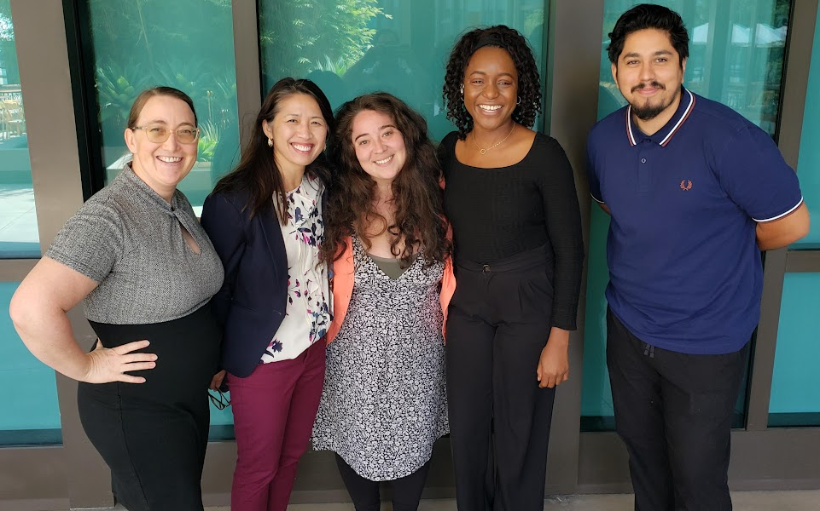
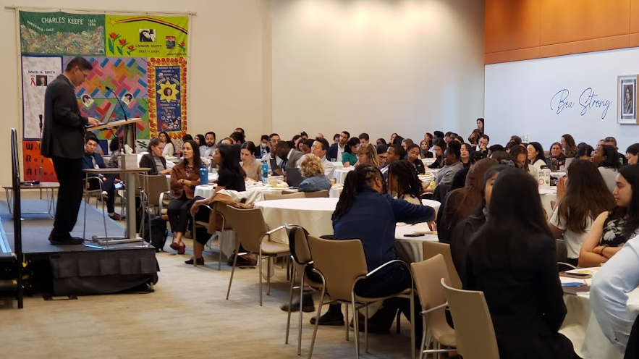
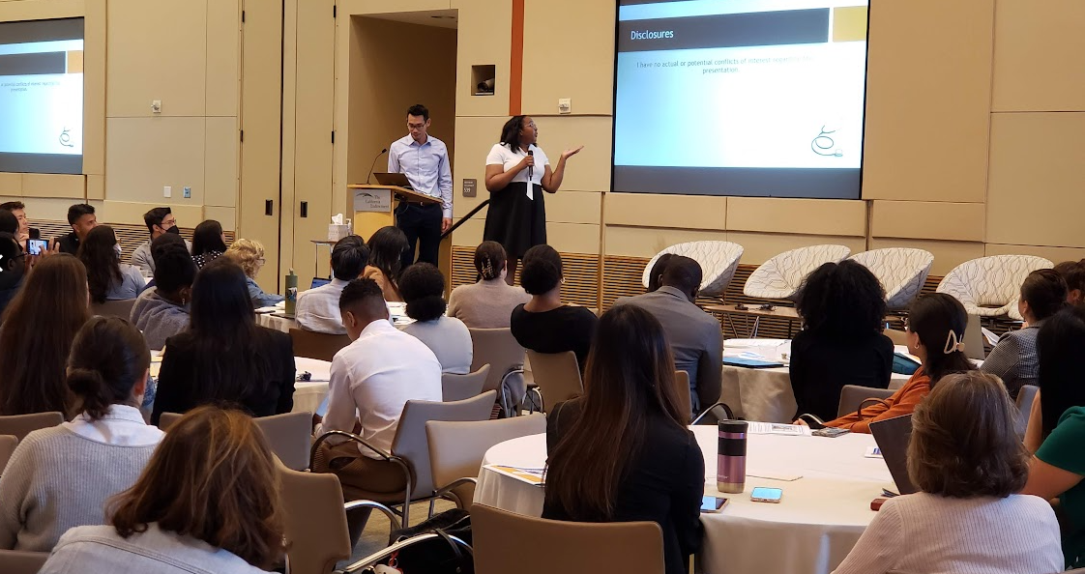
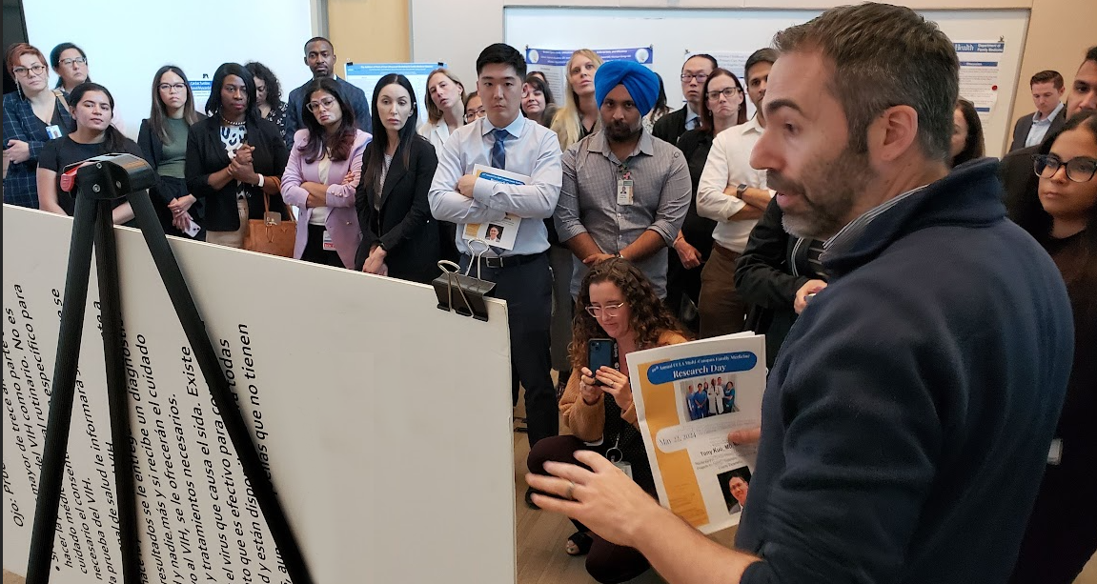
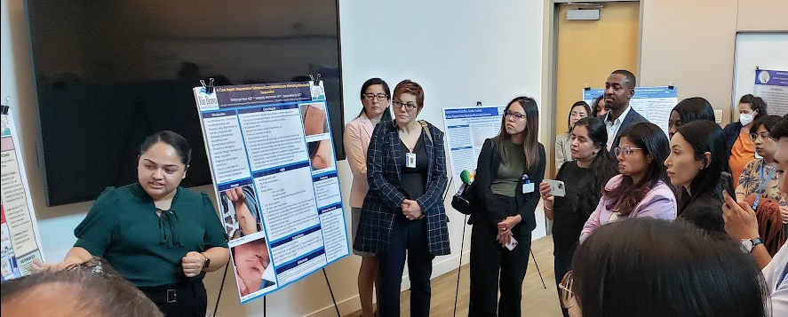
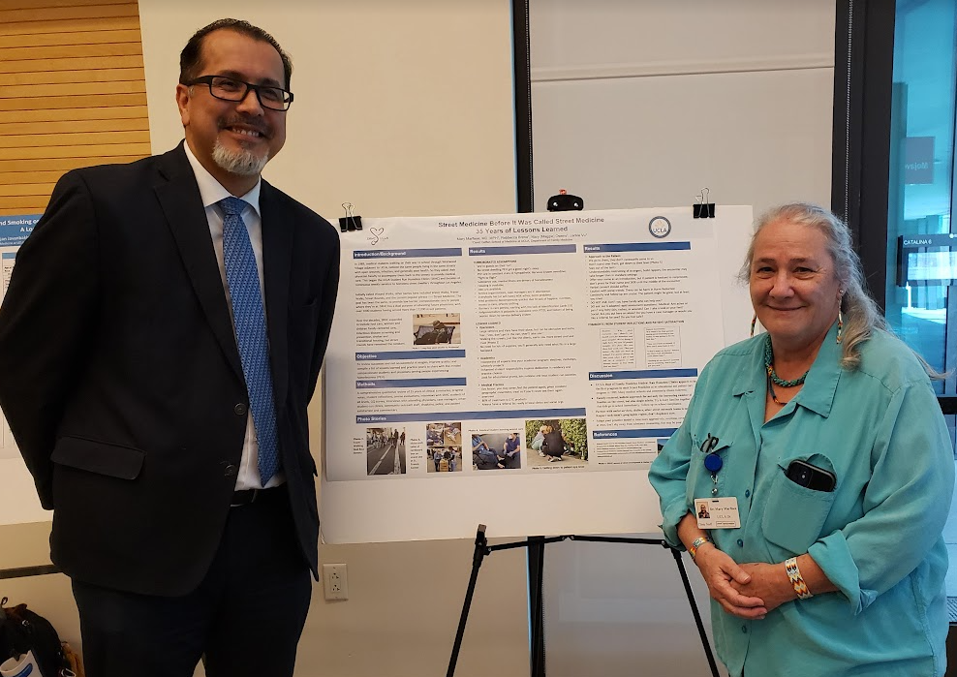
Research Day 2024

Slide 8
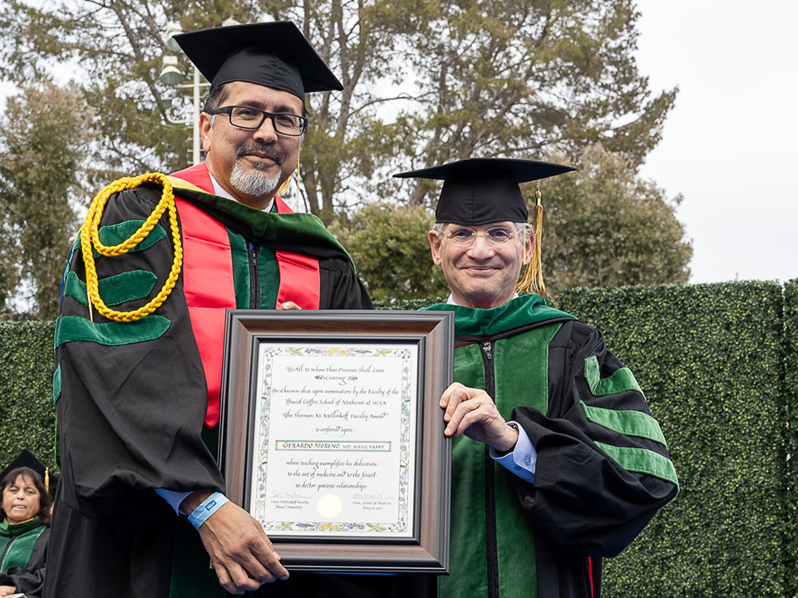
Dr. Moreno Receives the Mellinkoff Faculty Award
Gerardo Moreno, MD, MSHS, FAAFP, was honored with the Sherman M. Mellinkoff Faculty Award. Dr. Moreno's recognition with this award highlights his exemplary contributions to DGSOM, and his dedication to teaching, patients and communities.
This award is considered by the faculty to be the highest honor of the David Geffen School of Medicine at UCLA.
He is the first family medicine physician to be honored with the Mellinkoff Award since it was first awarded in 1980!

Slide 9
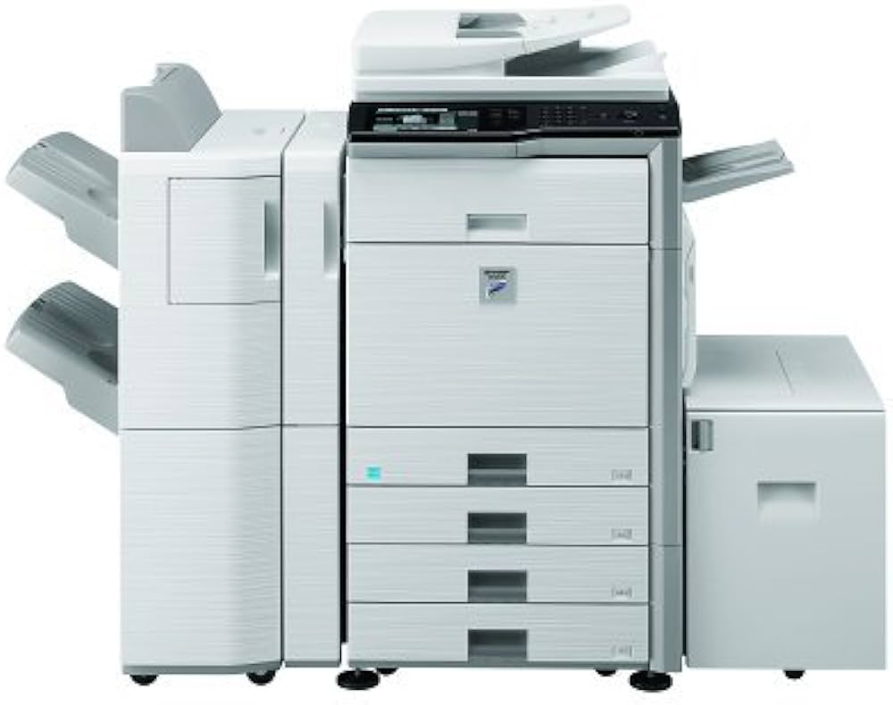
Oppy Copier – Back in Business
The repair tech had to replace the hard drive, so Valencia is manually adding in everyone’s email addresses to utilize the scanning functions.

Slide 10
Grand Rounds
There will be no
June 2024
Grand Rounds
Please join us on July 26th for our next Ground Rounds meeting

Slide 11
Research Faculty Meet the Residents
Wednesday, July 17, from 8-11am
Faculty are required to attend, or send proxy
Opportunity to meet the residents, introduce yourself and your research foci
Each faculty member will have approximately 10-15 mins; PowerPoint optional
RSVP to Laura and let her know which time slot you prefer
Will be conducted via Zoom

Slide 12
Research Admin Team Updates
Laura Sheehan
Manager of Research Admin
TBD
Post-Award Fund Manager
TBD
Post Award
Fund Manager
Valencia Moody
Purchaser
TBD
Pre-Award
Res Admin 2

Slide 13
Admin Team Responsibilities
You or your approver should submit all procurement requests to Laura and Valencia (purchase requests, travel reimbursements, on-campus services, independent contractors, etc.) for approval and processing
Gift Card requests should be submitted to Laura
Laura will help create monthly financial reports for review
Laura will set-up/manage subawards
Laura will submit Close-Outs until another solution is found
Submit Transfers of Funds (TOFs) and NPEAR requests to Laura. She will reach out to Valencia or Andrew if extra assistance is needed.
Discuss payroll/effort adjustments with Laura, and she will coordinate with Andrew to process these.

Slide 14
Your Responsibilities
Research Personnel (PI’s, Project Directors, Research Staff, etc.) are responsible for submitting purchase requests that are in compliance with UCLA campus, department, and vendor policies
Research Personnel should keep a record of all submitted purchase requests (and other financial requests) for reconciliation and auditing purposes
Please reach out to Valencia/Laura if you need to check the status of submitted requests and cannot access this information yourself
Please take extra initiative to manage your own financial portfolio as best you can during this staff shortage and schedule meetings with Laura if you need assistance.

Slide 15
Laura’s Upcoming Vacation
Laura will be out of the office June 10-21.
Please hold off on any non-urgent financial or proposal activity during this time
Will check email periodically; please text if urgent. May be a day or two delay in my responses if I don’t have cell reception in a particular area.
Contact Valencia Moody for any purchasing or suite-related needs
Contact Andrew Titus for super urgent (same-day) financial needs
All proposal activity has been taken care of as of June 5. If a new, urgent proposal that needs to be submitted to OCGA prior to June 24 comes up, please reach out to Laura via text or email.

Slide 16
Discovery Program
DGSOM Discovery is a required component of the M.D. curriculum to provide 3rd-year medical students with a nearly year-long period of protected time for a deep and substantive creative and scholarly experience in an area of concentration (AoC) that aligns with their interests.
The Department of Family Medicine and Community Health is offering student mentorships under the Health Justice and Advocacy AoC.
The 2024-2025 Discovery Year Mentorship program dates are October 28, 2024 through June 13, 2025.
Mentors for the upcoming year include:
Jesse Clark, MD
Lillian Gelberg, MD MPH
Anne Marie Hernandez, MD MPH
Mary Marfisee, MD MPH
Gerardo Moreno, MD
Jyoti Puvvula, MD
Steven Shoptaw, PhD
Dallas Swendeman, PhD MPH

Slide 17
Updates for Newsletter
Please send any updates for the department newsletter to Tiffany De La Cruz and Denise Acelar. This includes:
Recent publications
Newly funded research projects
Academic or research achievements/announcements
Other news you would like to share with the department
Photos are welcome!

Slide 18
BruinIRB Training
OHRPP is moving forward with a transition to the BruinIRB system for IRB submissions. To support the research community during this transition, OHRPP has put together a schedule of trainings. All trainings will be recorded and available on OHRPP’s YouTube channel shortly after each session.
Date | Presentation | Registration link
Thursday June 6, 2024 | Learn at Lunch: BruinIRB Protocol Uploads | Link
Tuesday June 25, 2024 | Learn at Lunch: Migration of Existing Studies from webIRB to BruinIRB | Link
Tuesday July 9, 2024 | Learn at Lunch: CR/AMs and AMs in BruinIRB | Link
Wednesday July 24, 2024 | Learn at Lunch: How to Submit New Studies in BruinIRB | Link
Wednesday August 7, 2024 | Learn at Lunch: CRAMs and AMs in BruinIRB (live repeat) | Link
Wednesday August 21, 2024 | Learn at Lunch: How to Submit New Studies in BruinIRB (live repeat) | Link

Slide 19
NIH Updates

Slide 20
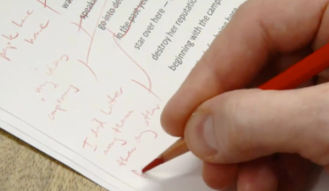
Updated Guidance on NIH Resubmissions
NOT-OD-24-061 : Effective May 25, 2024, the use of markups such as bracketing, indenting, highlighting, bolding, italicizing, underlining, margin lines, change in typography, font, or font color, or any other type of markup should not be used to identify changes in Resubmission applications.
Changes made to a Resubmission application should only be outlined in the Introduction attachment.

Slide 21
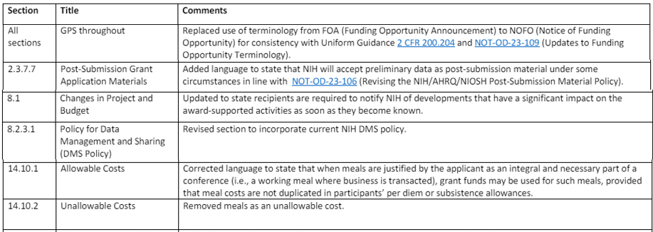
Updates to NIH Grants Policy Statement
The NIH Grants Policy Statement (NIHGPS) was revised April 2024 and is applicable to all NIH grants and cooperative agreements beginning on or after October 1, 2023.

Slide 22
NIH Common Fund 2025 Budget
The NIH Common Fund is a funding entity within NIH that supports bold scientific programs that catalyze discovery across all biomedical and behavioral research. These programs create a space where investigators and multiple NIH Institutes, Centers, and Offices collaborate on innovative research expected to address high priority challenges for the NIH as a whole and make a broader impact in the scientific community.
Several high-priority science programs will be supported in the 2025 CF, including:

Slide 23
NIH Plan for Diverse Perspectives (PEDP)
NIH introduced the Plan for Enhancing Diverse Perspectives (PEDP) requirement as part of their Brain Initiative in 2021. Recently, we’ve been seeing this requirement spread to more funding opportunities, including NIAID. NIH frames diverse perspectives as relating to: who does the research, where (the types of institutions) the research is done, and who participates in the research as part of the study population. The plan should describe the project’s plan to include participation of individuals (e.g. researchers, community members, students, patients, patients’ families or other individuals) with various types of backgrounds (disciplinary, geographic, career stage, racial, ethnic, gender, people with disabilities, people from disadvantaged backgrounds).
More Information

Slide 24
Financial and Procurement
Issues

Slide 25
General Procurement Guidance
You should never purchase an item or have a service rendered until there is an active Purchase Order in place. There are some exceptions that can be paid using the "direct pay" feature or Pcard, and we've covered those in previous research meetings (e.g. utility invoices, guest speaker fees, memberships, etc.), but each of these still require you to submit a Purchase Request Form in advance.
Get a Quote
Submit the appropriate procurement form*
If the item requires a Purchase Order – you must wait for the PO to be created by UCLA Purchasing before proceeding
NEVER SIGN CONTRACTS OR T&C YOURSELF
unless explicitly instructed otherwise.

Slide 26
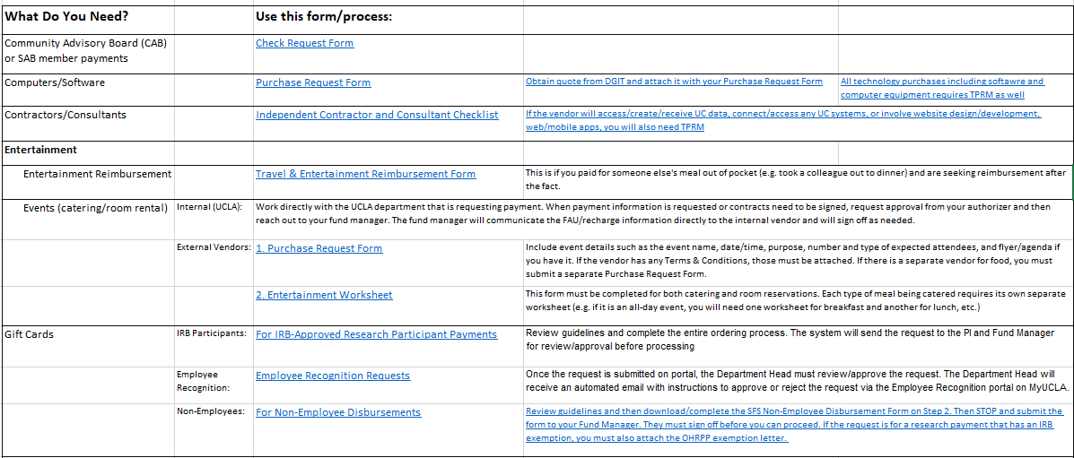
Procurement Forms/Process - WIP

Slide 27
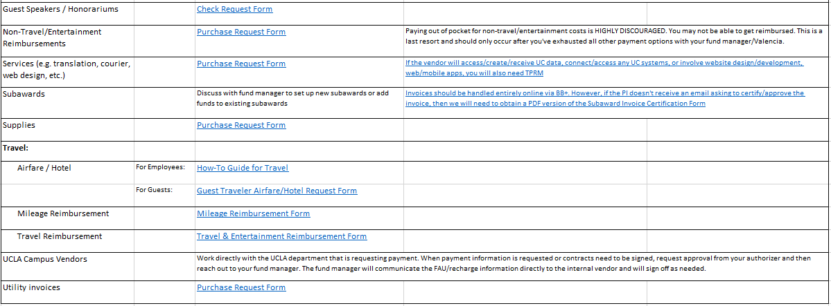
Procurement Forms/Process - WIP

Slide 28
How are subawards paid?
1. Subaward contract is fully executed and then PO is set up.
2. Subawardee can then begin work and invoice.
3. Subawardee submits invoice for payment, citing the appropriate PO # on their invoice.
4. Invoice gets scanned by a computer and automatically matched to the appropriate PO in the BB+ system.
5. BB+ issues an automatic email to the Fund Manager asking them to create a receipt in BB+. BB+ also simultaneously issues an automatic email to the PI asking them to approve the invoice in BB+.
6. PI approves the invoice by following the link in the email provided.
7. Now that both a receipt has been created and the PI approval has been received, Account Payable can then issue payment to the subawardee.

Slide 29
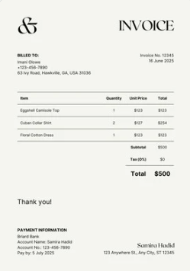
Managing Subawards – PI Responsibilities
Principal Investigators are required to review and approve invoices for their subawards/ subcontracts in BruinBuy Plus.
PIs SHOULD receive an email notification when a subaward/subcontract invoice requires their review and approval. (PI’s can also log in directly to approve within the BruinBuy Plus application)
If PI doesn’t receive the notification, the fund manager will obtain signature on the PDF form instead.

Slide 30
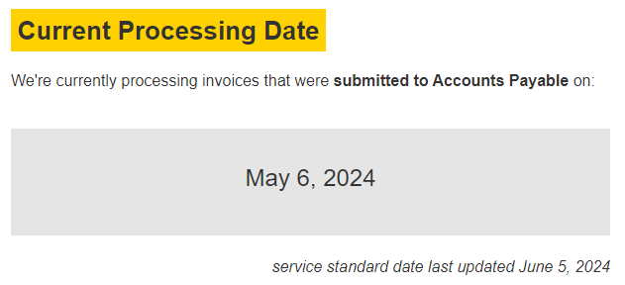
Good News – Vendor Invoicing
UCLA Accounts Payable is current processing invoices that were submitted to AP on:

Slide 31
Vendor Invoices
Once a PO has been created, the vendor will automatically receive a copy of it. They can then provide the item/service and then submit their invoice.
They can do that in one of two ways:
Submit their invoice directly to noreply@invoices.ucla.edu
Submit the invoice to you, and you submit it to Valencia so that it can be sent to noreply@invoices.ucla.edu

Slide 32
Vendor Submitted Invoices – Pros and Cons
PROS Recommended by BB+ Easy for vendors to remember (same inbox for entire University) Fastest (in theory) | CONS Invoices are auto-scanned, so errors will prevent proper processing. We have no way to track them if they don’t match in the system. Harder to keep track of remaining funds (for Declining Balance POs) Vendor will be paid whether or not item was delivered/service was rendered, unless PO was set up to mandate Receiving

Slide 33
Vendor Invoices – Helpful Tips
Invoices should be PDFs and must be standard 8.5 x 11 in size.
Only one invoice per PDF. The invoice can be more than 1 page, but you can’t have more than 1 invoice in the same attachment.
The PO # must be clearly typed on the invoice. It cannot be handwritten. If it is fuzzy, or has weird spacing or parenthesis, or anything else that may confuse an automated scan, it may not be matched correctly.
Having the PO # in the filename doesn’t matter. The PO # must be typed on the invoice itself.
It can take up to 5 business days to “match” in the system, but I’ve seen it happen in minutes as well.

Slide 36
Quiz
1. Can I sign a contract to reserve a room/host an event?
No. You/your authorizer should reach out to your assigned fund manager. For internal vendors the fund manager can sign off. For external vendors, only Authorized Officials (AO’s) have signing authority (AO’s are typically central office employees, e.g. UCLA Purchasing or OCGA).
Do I need to obtain approval before buying a campus service, e.g. guest parking?
Yes, all purchases, whether external or internal, require prior approval.
3. Do I need to maintain copies of what I’ve submitted?
Yes, requesters and/or PI’s must maintain copies of submitted purchase requests and supporting documentation for reconciliation and auditing purposes.
Funds belong to:
The faculty member or PI to whom the account is assigned
The Regents of the University of California
The person requesting the purchase
The Department of Family Medicine

Slide 37
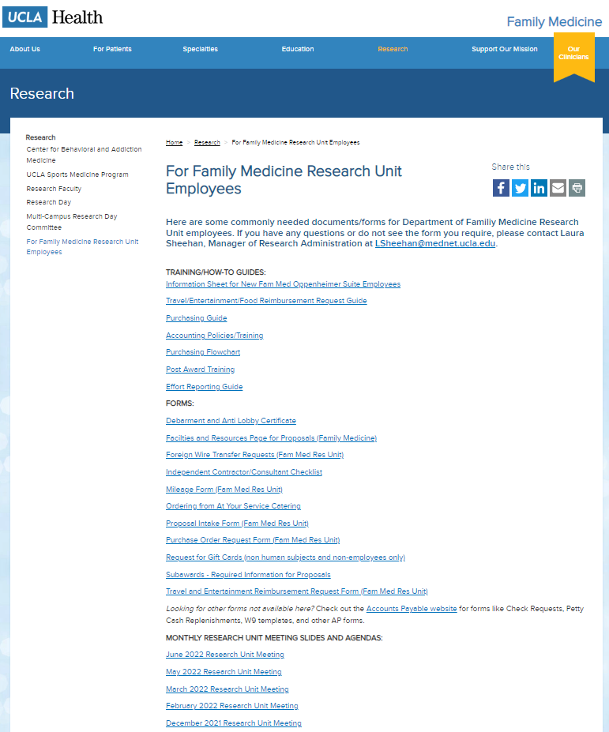
Upcoming Meetings/Events
Next Research Unit Meeting: August 1 (there is no July Research Unit Meeting)
Next Grand Rounds: July 26
Research Faculty Meet the Residents: July 17
Prior monthly meeting agendas/slides are available on the website

