Slide 1
Travel and Entertainment Reimbursement Requests
Department of Family Medicine
Laura Sheehan
Manager of Research Administration
Lsheehan@mednet.ucla.edu; 310-794-8298
Valencia Moody
Purchaser
Vmoody@mednet.ucla.edu; 310-794-8952

Slide 2
ENTERTAINMENT
“Entertainment” = payment for food/refreshments for others
Must be a necessary and integral part of a business meeting (rather than a matter of personal convenience)
The purpose or nature of the event must be clearly stated
A guest list containing the names, titles, and affiliations must be provided to establish the business relationship to the University of the participants being entertained
Examples:
Hosting a meeting or conference
When the University is host to official guests (non-employees) or prospective appointees for positions requiring specialized training or experience of a professional, technical or administrative nature
When meetings of an administrative nature are held which are directly concerned with the welfare of the University
When meetings between faculty or administrators and students are held

Slide 3
TRAVEL
In order to be reimbursable, travel must be for a legitimate business purpose. This may include activities that contribute to any one of the University’s major functions of teaching, research, patient care, or public service, or to any other substantial and bona fide University business activity.
University employees traveling on official business shall observe normally accepted standards of propriety in the type and manner of expenses they incur. In addition, it is the traveler's responsibility to report their actual travel expenses in a responsible and ethical manner.
https://policy.ucop.edu/doc/3420365/BFB-G-28

Slide 4
Travel Reimbursement Methods
Self-service system (Travel Express/Concur)
Requires training
Traveler must download app and upload receipts into system
Traveler responsible for submitting accurate, comprehensive, and compliant report
https://www.finance.ucla.edu/express/general-user for training
Complete Travel/Entertainment Reimbursement Request Form
Review this presentation for training
Save receipts and submit to Fund Manager with Reimbursement Request Form
Fund Manager and Purchaser will review for accuracy/compliance
Guests must use this option
Note: PTA is recommended for either option for purchase of airfare

Slide 5
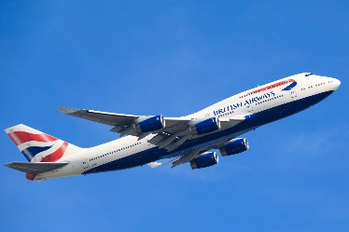
Purchasing Airfare with PTA
PTA = Pre-Trip Authorization
Best option, preferred method, no out-of-pocket expense
Flight arranged via UCLA (ensures compliance, low fares, easy to track)
STEP 1 – CREATE ITINERARY:
Contact Travel at 800-235-8252/310-206-2639 or travel@finance.ucla.edu
Or create your own using UC Travel Center online booking tool
STEP 2 – EMAIL FUND MANAGER/PURCHASER TO REQUEST PTA:
Forward itinerary (with traveler name, dates, destination, and cost) and provide business justification and FAU
Guest travelers: you will need to gather more info, visit website for details
STEP 3 – COMMUNICATE PTA TO UC TRAVEL:
Purchaser will provide you and the travel agent with the PTA. (If you booked it yourself, enter the PTA online)
STEP 4 – FINALIZE
Once PTA is received, UC Travel will email boarding pass

Slide 6
Purchasing Airfare Directly (without PTA)
Strongly discouraged
If you proceed, you must abide by the following:
Be familiar with and in compliance with all travel policies
UC: https://www.ucop.edu/central-travel-management/resources/index.html
UCLA: https://travel.ucla.edu/policies
Sponsor policies
Obtain and submit original receipt for airfare
Must include form of payment
Must be itemized
Don’t use Expedia, Travelocity, Orbitz, etc. (they do not provide itemized receipts)
Must be economy/coach (otherwise, need physician letter and letter from CAO)
Cannot be reimbursed until travel has taken place

Slide 7
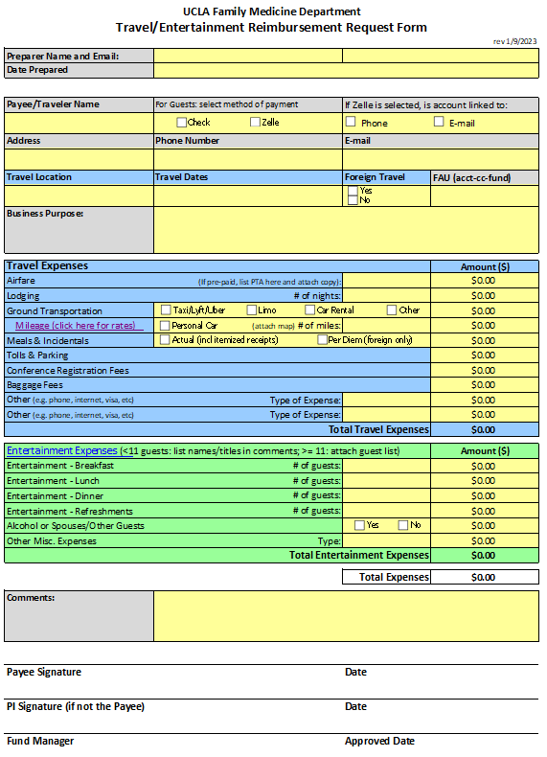
Travel/Entertainment Reimbursement Request Form
Download latest version of form on our website
Only use this form for Travel and Entertainment
Blue = Travel
Green = Entertainment
Rarely you may need to request both on same form

Slide 8
Things to consider
Organize your reimbursement cleanly and clearly
SAVE ALL RECEIPTS!
Tape receipts to a regular-sized sheet of paper so that they lay flat and can be easily scanned
Organize receipts by either type or by day
Include notes to clarify
If receipt is missing, include a note in the receipt section
Check for Accuracy
Be sure the amount you are requesting matches the receipts provided
NOTE: if you prefer to upload receipts directly into Concur, reach out to Purchaser prior to travel to download app and receive training)

Slide 9
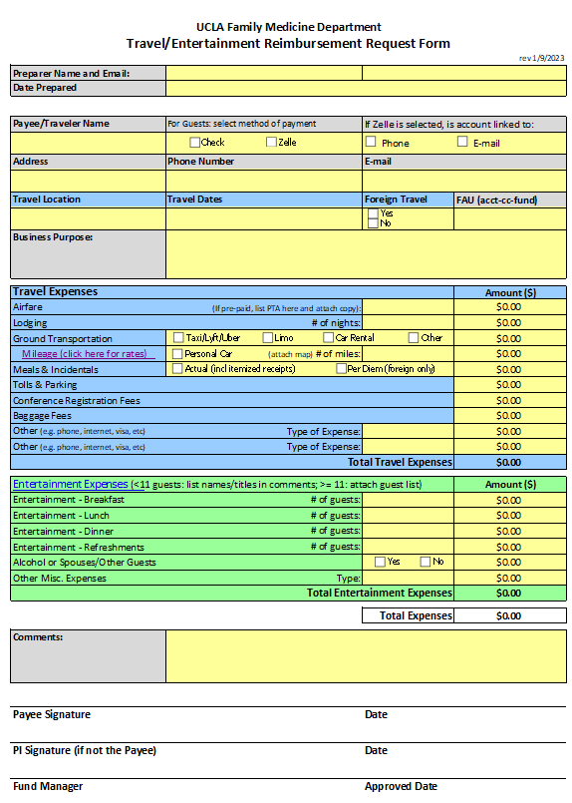

Slide 10
1st box: Preparer information (person completing the form)
2nd box: Payee information (person receiving reimbursement)
Non-employee travelers: select reimbursement payment type; if Zelle: be sure to include phone # and/or email of the linked account
FAU information: IMPORTANT!
Account #, cost center, fund #
Discuss with PI and fund manager to be sure this is correct
Must be an allowable cost (on the budget)
Must be enough funds remaining to cover the cost
Must be within the allowable time period (after start date, before end date)

Slide 11
Business Purpose/Justification
Incredibly important
Be specific
No abbreviations
Example:
“To attend HPTN conference in DC”
“For the Principal Investigator to present research data at the 2016 Annual HIV Prevention Trials Network conference in Washington, DC” GOOD!
---------------------------------------- WRONG!

Slide 13
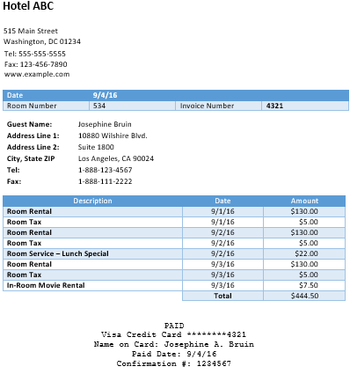
Input PTA # (if no PTA, be sure to include original, itemized receipt)
Lodging must include itemized receipt
Receipt must show room rate and taxes
Separate other charges and list in the appropriate section
Should be subtracted from Lodging total and listed under Meals instead
Should be subtracted from Lodging total and marked as “Personal: do not reimburse”

Slide 14
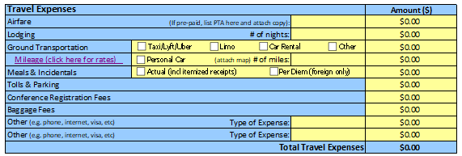
Ground Transportation
Include reason (e.g. “from home to airport”)
If over $75: receipt and explanation required
Car rental receipts must be original and itemized
Meals & Incidentals
Best practices require receipts as reimbursements are based on actual expenses.
Cannot exceed the maximums allowable. Please note maximum meal rate is not a per diem.
Only exception is for foreign travel, where daily per diem for food is allowable. Visit US Dept of State website for latest rates based on location of travel.
If meal receipts are lost/unavailable, traveler may provide best estimate
Meal reimbursement eligibility requires overnight stay

Slide 15
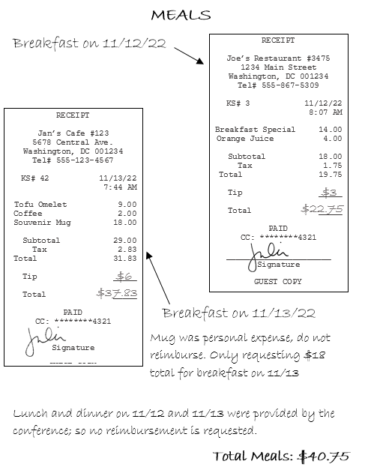
Meal Receipts Example

Slide 16
Registration can be paid in advance
If not, you must provide:
Receipt
Copy of bank/credit card statement
Copy of the meeting agenda
Note: Cannot be reimbursed until after meeting has taken place (so expense may be sitting on your credit card for months)

Slide 17
Travel Reimbursement Workflow
If corrections are needed
Preparer – person completing the reimbursement form (could be the traveler or employee acting on behalf of traveler).
Preparer must obtain PI approval before submitting to Fund Manager
Purchaser will input into Concur, but only the Traveler has the ability to submit
Traveler MUST submit themselves; neither the Purchaser nor the Preparer can do it on their behalf
Preparer
Fund Manager
Purchaser
If corrections are needed
Travel Accounting
Fund Manager
Traveler (must log in and submit)
Accounts Payable
(Payment issued)

Slide 18
Things to consider
Submit in a timely manner
You should prepare your reimbursement immediately upon return
Submit within 20 days of travel
Once Purchaser has completed reimbursement in Concur, you must log in and submit it
If request is not successfully approved by Travel Accounting within 45 days, you will need to provide memo and justification for why it is late
Late reimbursements may appear as income on W2

Slide 20
ENTERTAINMENT
It is preferred that we pay catering expenses directly to vendor in advance, rather than as a reimbursement. To do so:
Obtain a quote from vendor
Review for compliance with maximums
Submit Purchase Request Form to Fund Manager including:
Estimated number of attendees and breakdown of per person costs
Business justification
FAU information
After Fund Manager approves, Purchaser will work with UCLA Purchasing to create a PO# and will communicate that to the vendor
After the event takes place, the final invoice and guest list needs to be submitted to Purchaser

Slide 21
ENTERTAINMENT
IF SEEKING REIMBURSEMENT AFTER THE FACT:
If 10 or less guests, use Comments section to list:
Full names
Titles
Affiliations/institutions
If 11 or more attendees, you can attach a list (create the sign-in sheet before the event so that attendees can sign)
Maximums:
https://travel.ucla.edu/policy-resources/reimbursement-allowances-mileage-meals
Maximum includes labor, tax, delivery, set-up, service fees, tips, etc.
Justification must include type of event and # of participants

Slide 23
Total expenses will calculate automatically
Use comment section to explain anything that is unusual
Help us understand the expenses and information provided
The more detail the better
Must be signed by the payee/person who will receive the reimbursement (not the preparer)
Need PI signature if the Payee is not the PI
Submit to Fund Manager

Slide 24
The Fine Print
Reimbursements for travel and entertainment expenses must comply with receipt and documentation requirements specified in the UC Business and Finance Bulletin, G-28, Policy and Regulations Governing Travel or UC Business and Finance Bulletin BUS-79, Expenditures for Entertainment, Business Meetings and Other Occasions. Visit https://travel.ucla.edu/policies to review all UC travel policies.
You must also comply with sponsor guidelines!

Slide 25
As a Reminder…
The more information, the better
Organize!
Include receipts for EVERYTHING to be on the safe side
Ask questions before travelling and before submission
Double-check your work
Convert currency yourself to manage expectations
Submit on time
Review/approve on time
We’re here to help you

